Slide 1
Classical Civilizations in the East

Slide 2
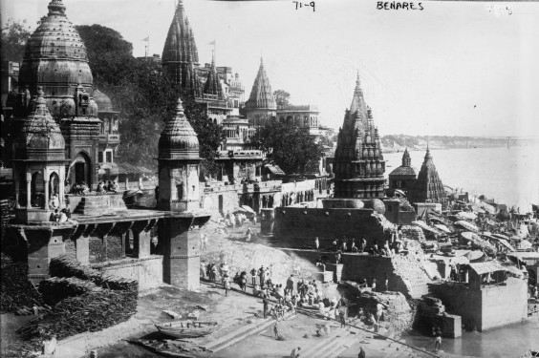
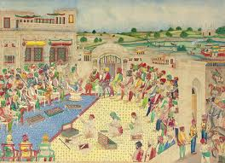
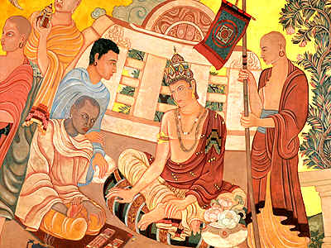
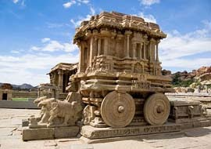
Empires of India

Slide 3
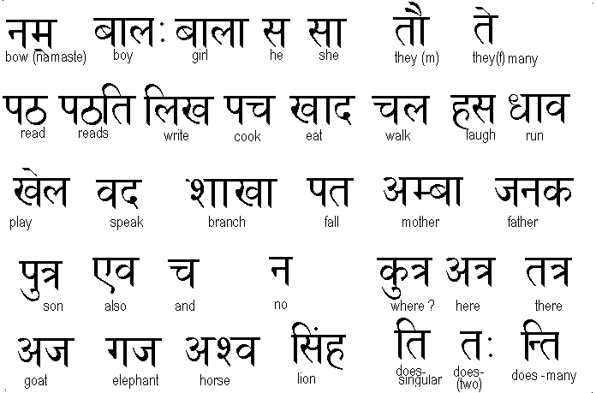
Aryan Invasion
Aryans were nomadic people from central Asia
By 900 BC they formed city-states in the major river valleys
Each city had its own ruler
Had a form of writing known as Sanskrit

Slide 4
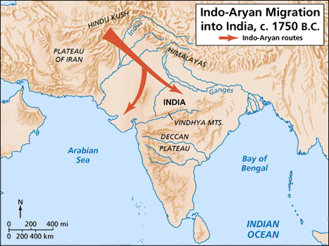

Slide 5
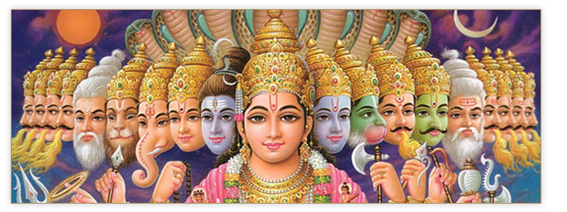
Hinduism
Brought to India by the Aryans
Major Beliefs
Many Gods
Reincarnation
Karma
Ganges River and Cows are sacred

Slide 6
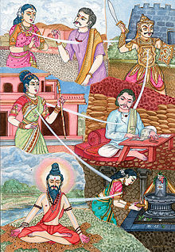
Way of life the Hindus must follow
Explained everything they should do from life to death
Two books that contain their major teachings
Upanishads and the Bhagavad-Gita

Slide 7
Caste System
Aryans put into effect new social and religious rules
Only Aryans could occupy the height social classes
Under this system, people were divided into five hereditary classes, known as castes

Slide 8
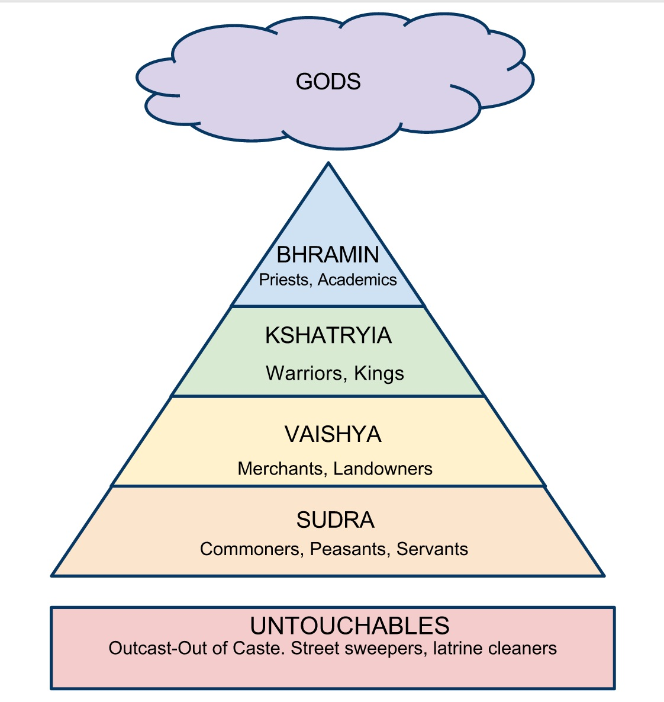

Slide 9
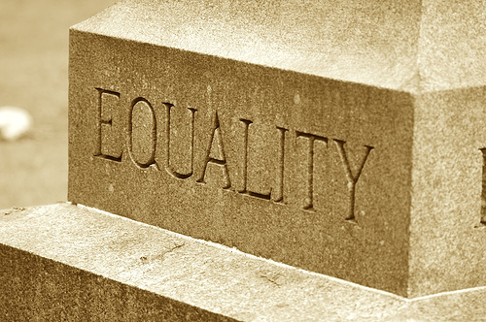
Castes were based on birth
NO social mobility
Could not marry outside their own caste
Untouchables performed the lowliest tasks like handling dead bodies or sweeping streets

Slide 10
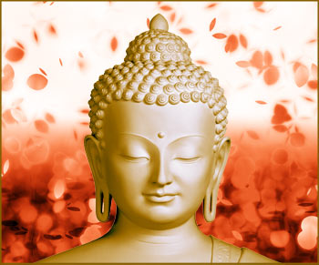
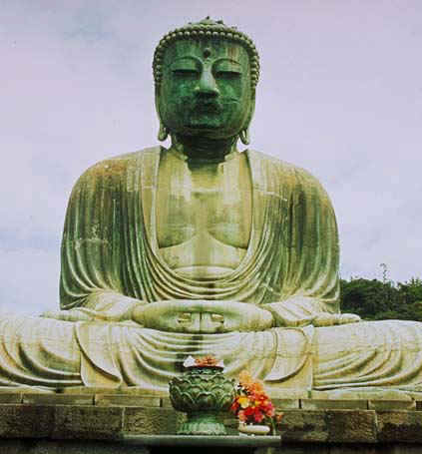
Buddhism
Began in India around 500 BC
Siddhartha Gautama (563-487 BC) lived his youth in luxury in Nepal.
Left everything behind to search for truth
Found all suffering was caused by human desires
Became known as “Buddha” or Enlightened One

Slide 11
Major Beliefs
Philosophy: Self-denial and meditation, believe in reincarnation
No one main God, beliefs are written in the Sutra
4 Noble Truths: suffering caused by human desires, must give them up to find harmony
Eightfold Path: to give up desires you must follow path: goals, perspectives, be aware, act in a worthy manner, speak truthfully, live righteously, respect all things, meditate
Nirvana: follow the Eightfold Path and can escape reincarnation and achieve nirvana (state of eternal bliss)

Slide 12
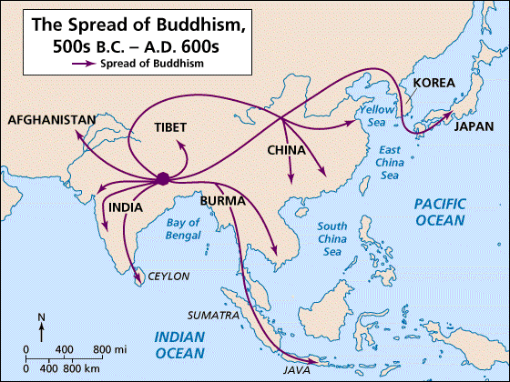
Spread of Buddhism
Quickly attracted followers
Missionaries spread it to Southeast Asia and Central Asia
It also spread it to China, Korea, and Japan
Popular because it rejected the Caste System

Slide 14
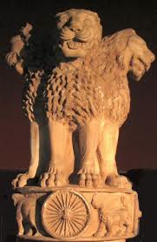
Mauryan Empire (321 BC-232 CE)
One of the greatest Hindu empires
King Chandragupta challenged the Greeks and established the Mauryan Empire in India
Stretched from Afghanistan to the Ganges
His grandson Asoka (269 BC-232 BC) was the next great ruler

Slide 15
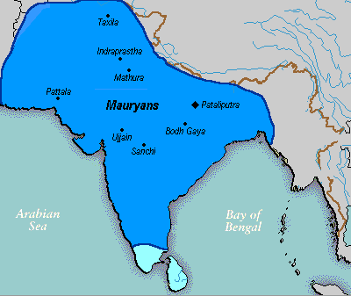

Slide 16
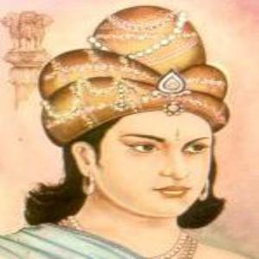
Asoka
Fought wars to enlarge his empires
Bloody fights for 8 years
Became horrified and converted to Buddhism
Began to try and win loyalty by acts of kindness

Slide 17
Freedom of religion
Improved roads
Built hospitals
Sent teachers
Built Buddhist shrines throughout India and sent missionaries
After his death the empire began to fall apart

Slide 18
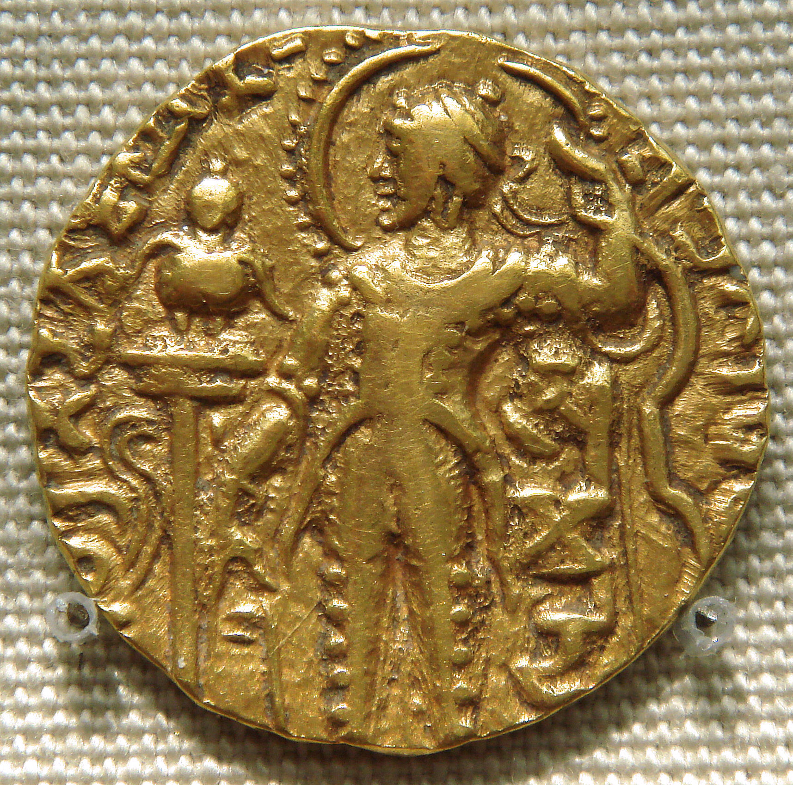
Gupta Empire (320 AD-535 AD)
United the territory around the Ganges River
Encouraged peace, prosperity, and trade with foreign lands
Referred to as the “Golden Age of Hindu Culture”
Period of peace and accomplishments in the arts and literature
Universities, colorful murals, poems, and plays

Slide 19
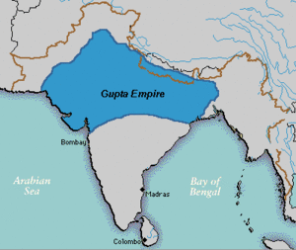

Slide 20
Excelled at science and mathematics
Come up with the concept of 0
Thought Earth was round and rotated on its axis
Calculated a year
Set bones and performed skin grafts
Grew to a close around 500 AD when the Huns invaded in the north

Slide 21
Mr ford’s site re creek central school

Slide 23
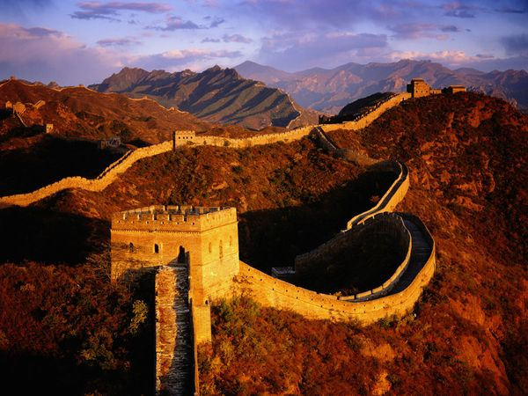
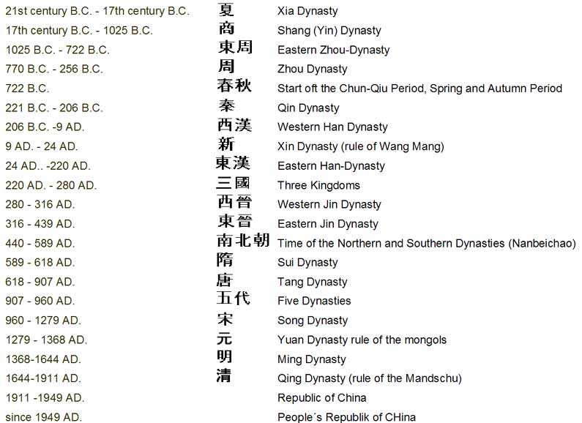
Dynasties of China
Chinese history is divided into period based upon the dynasty (ruling family) that governed China at the time
From 1027 BC-220 AD, China was ruled by three main dynasties

Slide 24
Zhou Dynasty (1027 BC-221 BC)
In 1027 BC the Shang were conquered by the Zhou
The Zhou justified their rule as the Mandate of Heaven
The belief that their ruler was chosen to rule by heaven, and that heaven would also overthrow a bad ruler
Taught that if a ruler was selfish, then heaven would bring floods and revolts to end his reign and a new dynasty would emerge

Slide 25
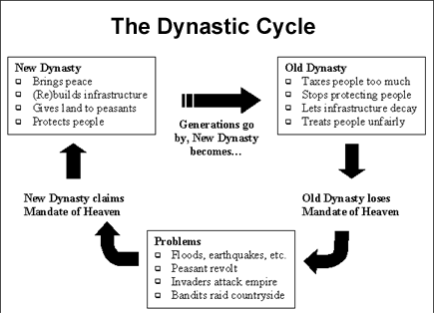

Slide 26
Established a system in which land was given to nobles in exchange for military service (Feudalism)
The greatest legacy of the Zhou was the work of two Chinese philosophers, Confucius and Lao Tzu
Both wanted to bring peace and order to China and its individuals

Slide 27
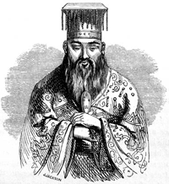
Confucianism
Named for its founder Confucius
A philosophy that said people must be ethical
Great importance on traditional values like obedience and order
Ancestor worship
Stressed importance of family
Filial piety: show devotion to your parents

Slide 28
Major Beliefs
Natural order: each person has a role in society
Role: fulfill your obligations
Relationships: superior must show love and responsibility and inferior must show loyalty and obedience
Mandate of Heaven: ruler must do what is right for his people so they will obey him

Slide 29
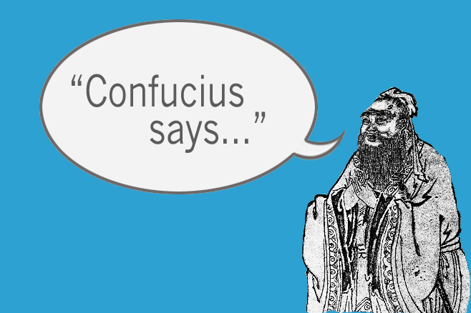
“Choose a job you love, and you will never have to work a day in your life. “
“I hear and I forget. I see and I remember. I do and I understand.”
“Before you embark on a journey of revenge, dig two graves.”
Confucius rap

Slide 30
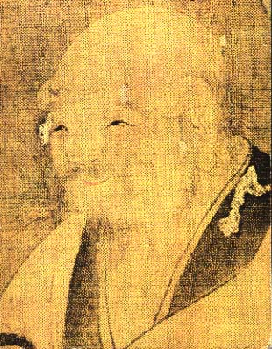
Daoism
Chinese philosophy based on the teachings of Lao Tzu
Believe that nature has a “way” (the Dao) in which it moves, and that people should accept the way of nature rather than to try to resist it
Respect for nature and harmony
Ying and Yang
Achieve enlightenment by “non-striving” and abandoning earthly concerns

Slide 32
Create a saying like Confucius and Lao Tzu that gives good advice to live by.
Write it on the back of your 10 facts from the video
It must be encouraging and original
Draw a picture that represents it
If there is enough time please color it

Slide 33
“Before you embark on a journey of revenge, dig two graves.”
Confucius

Slide 35
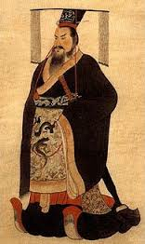
Qin Dynasty (221 BC-206 BC)
Shih Huang-ti, the lord of the Qin, unified all of China through conquest
He was the first to call himself emperor
He thought the ruler should have all the power because people were not good
He was very harsh
Rejected Confucianism and persecuted scholars

Slide 36
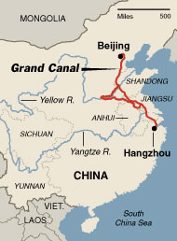
Shih’s Accomplishments
Divided China into districts with own military and civil administrator
Built roads and canals to unite China
Set system of writing and measurement

Slide 37
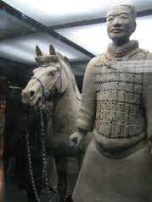
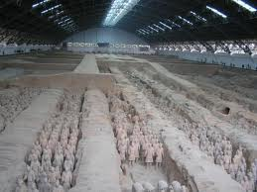
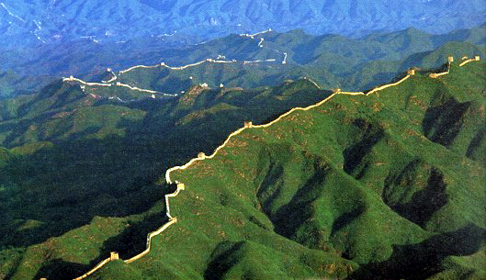
Built the Great Wall of China to protect his people from the nomads in the North
1500 miles, 22ft high, 15ft thick
Unified and centralized China
Buried with people sized clay soldiers

Slide 38
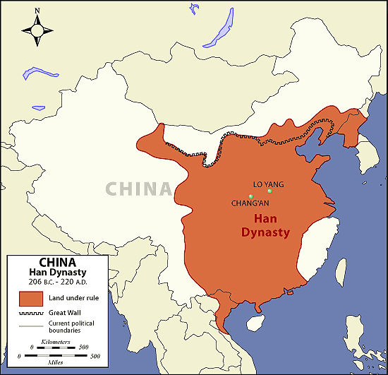
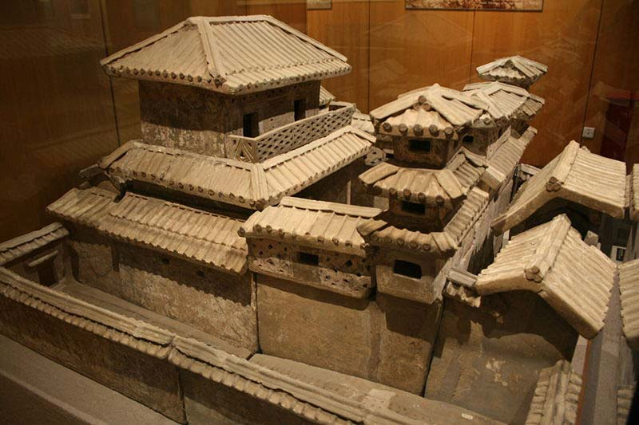
Han Dynasty (206 BC-220 CE)
People rebelled after the Qin emperor’s death
After years of civil war, the Han emerged on top
The Han emperors kept China unified for over four hundred years

Slide 39
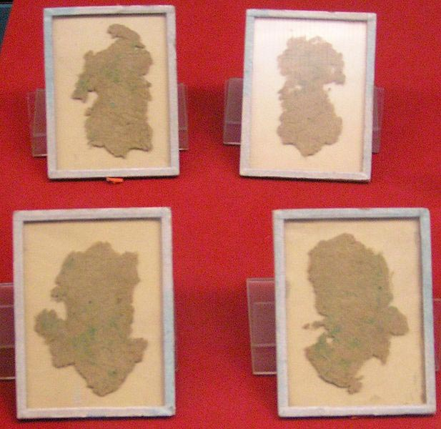
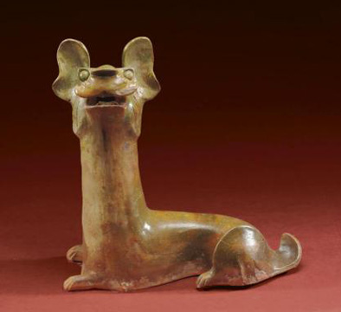
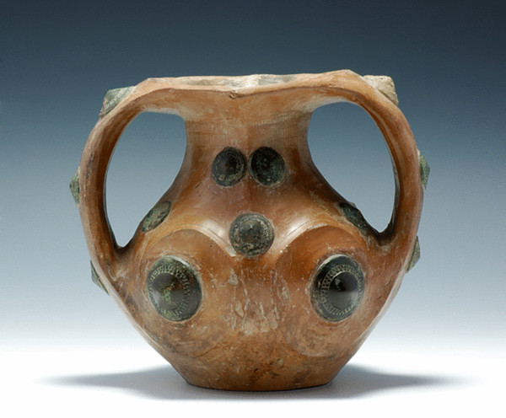
Inventions
Paper
Lead-glazed ceramics
Advance in silk weaving

Slide 40
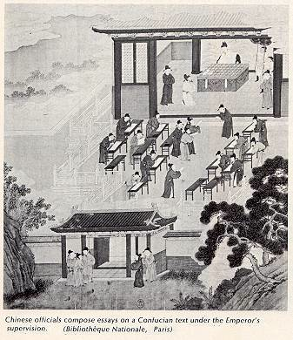
Examinations to be selected for civil service based on Confucianism
Strengthened power of emperor by taking away independence of nobles because they could no longer just inherit a job
Commoners could move up the ladder
Spread Confucian ideas

Slide 41
Established trade routes
Silk Road: connected China to the Roman Empire
Carried goods by camel caravan through mountains, steppes, and deserts
China exported silk, iron, and bronze in exchange for gold, linen, glass, ivory, hides, horses, and cattle
Also introduced to Buddhism, which spread quickly

Slide 42
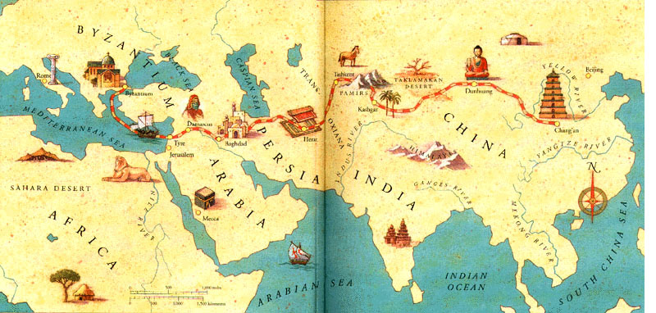
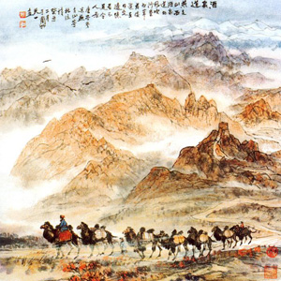

Slide 43
Children and Women
Wealthy families had many children, so the boys would work in the government and the girls would marry into other wealthy families
Arranged marriages
Under Confucian teaching women were subservient to men
Public schools for boys only
Respect for elders and parents

Slide 44
Fall of Han Dynasty
Ruled a huge territory of almost twice the size of the US
Emperors were weakened by rebellions
To crush them the emperors gave more power to the governors
Some governors used this to became warlords
Economic hardship led to banditry
In 221 AD the last emperor lost his power to a warlord
Collapsed into civil war and divided itself up

Slide 45
End of Empires
Rome and Han
Both spread over a large area making it hard to govern
Lost land to generals and warlords
Good emperors turned into weak emperors
Spread of corruption
Threat of invasion from outside tribes

Slide 46
Name-Class Period
East Quiz
The Aryans were nomadic people from central Asia
The form of writing Aryans had was cuneiform
Hinduism was created by Buddha
Buddhism rejects the Caste System
Chandragupta was the grandson of Asoka
The Gupta Empire was referred to as the “Golden Age of Hindu Culture”
The Mandate of Heaven was used to justify the rule of Kings in India
The Great Wall of China was started in the Qin Dynasty
The Silk Road connected China to Europe during the Han dynasty
Both Rome and the Han fell because they were too big

