Slide 1
Tensions Rise and the Temperature Drops
Cold War Terms

Slide 2


Capitalism
Private ownership of industry
Freedom of competition
Survival of the fittest
Laissez-faire: government keeps “hands off”
Creates different economic classes

Slide 3
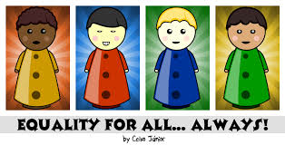
Equality
Everyone is the same
Highly valued: basic needs supplied for all people
Food
Housing
Education
employment

Slide 4
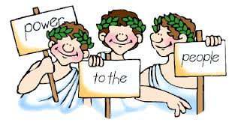
Democracy
Government by the people
2 forms
Representative
Direct

Slide 5
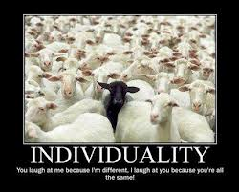
Individualism
Need for people to do their own thing
Competition: the best individual reaches higher levels of power, status, or money

Slide 6
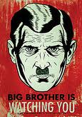
Totalitarianism
Government by one or a few
Total control over many aspects of people’s lives
No freedom of press or speech

Slide 7

Freedom
Condition of being free
Highly valued:
Freedom of the press
Freedom of speech
Freedom to do business

Slide 8
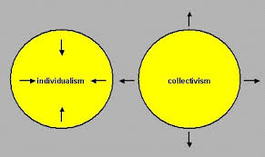
Collectivism
Work together to benefit the whole
“All for one, and one for all”
Group over the individual

Slide 9

Socialism
Government ownership of industry
Created as a reaction to capitalism
Goal is to bring economic equality to people
Classless society

