Slide 1
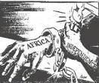
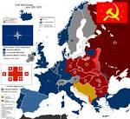
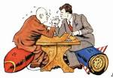
Decolonization and the Cold War

Slide 2
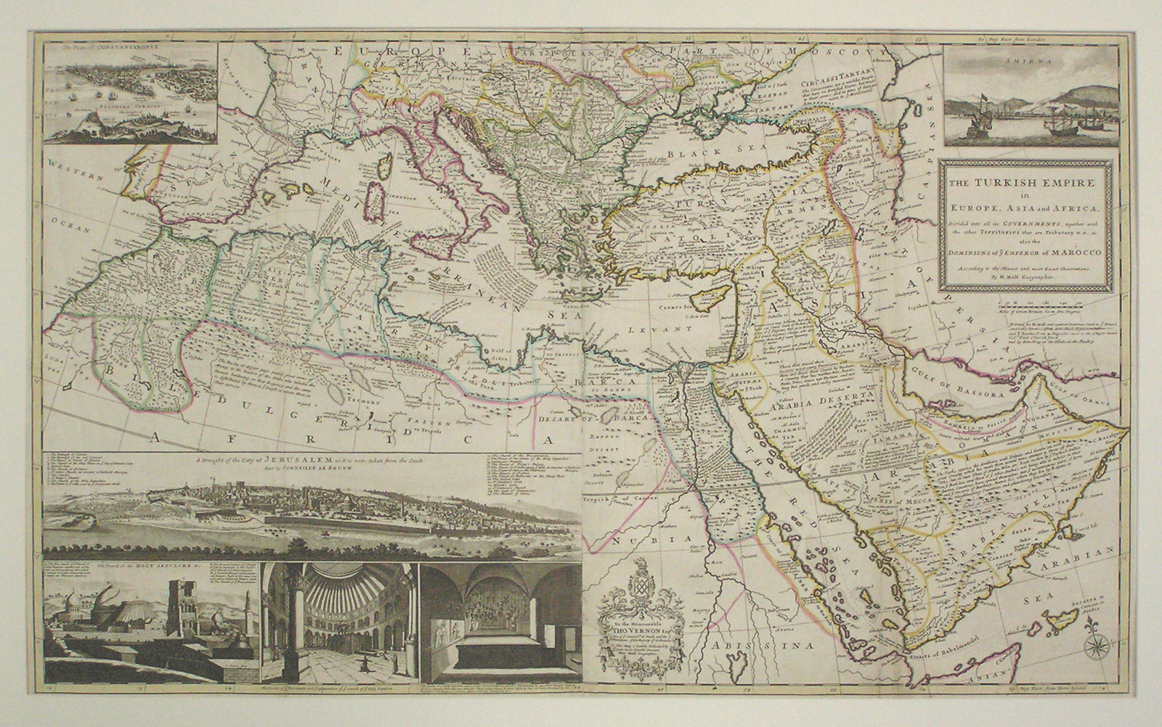
Independence of Asia and Africa
WWII ended European Imperialism in India, Indochina, Africa, and Indonesia
This is decolonization
Reasons:
Nazis and Japan discredited Imperialism
People felt guilty fighting for democracy, but not giving it to others
European powers were tired after WWII

Slide 3
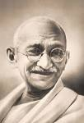
India
1st major country to reach independence
Indian Nationalist Movement:
1885: Indian National Congress was the main organization dedicated to achieving Indian Independence
Gandhi: leader, resist through non-violent approach

Slide 4
Non-violence: suffer beatings and violence and did not fight back
Civil Disobedience: disobey unjust laws, Gandhi led Salt march to protest Salt tax, fast, refuse to work
Cottage Industries: boycott British goods and buy from home industries
1947 were given their independence
http://www.youtube.com/watch?v=kxYQ4CXoIwg

Slide 5
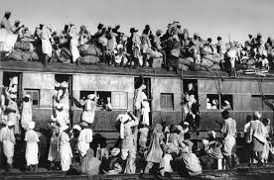
Partition of India and Pakistan (1947)
Fear of violence between Muslims and Hindus
Muslims led by Mohammed Ali Jinnah, wanted separate Muslim state
India became Hindu and Pakistan East and West became Muslim
Millions moved and thousands were killed during religious riots

Slide 6
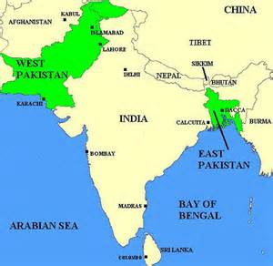

Slide 7
Southeast Asia
Road to independence
Philippines: group of Islands in the Pacific, US gave its freedom in 1946
Burma and Malaysia: Great Britain gave in 1948
Indonesia: declared in 1945, but had to fight the Dutch until they were recognized in 1949
Vietnam: Guerillas led by Ho Chi Minh fought the French and got independence in 1954, divided into a North Communist state and as South Pro-west state

Slide 8
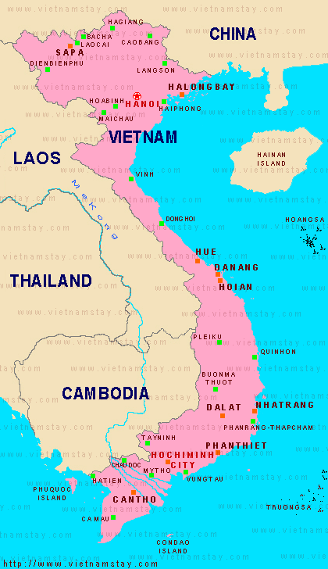
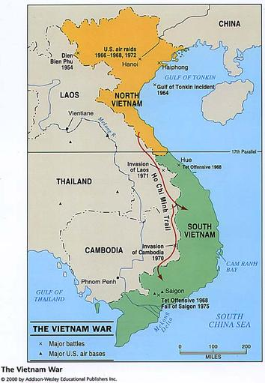

Slide 9
Is there a North and South Vietnam today?
Why not?

Slide 10
Middle East and North Africa
Gamel Nasser overthrew Egyptian King in 1952
Saudi Arabia gained its independence
France grants Morocco, Tunisia, Libya, and Lebanon their independence
Algeria fought France for 8 years to gain independence in 1962
Promise of Palestine to Jews, but was fear of Arab/Jewish Civil War
Turned issue over to the UN

Slide 11
http://www.youtube.com/watch?v=Y58njT2oXfE
Is there still fighting today?

Slide 12
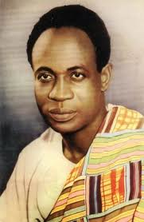
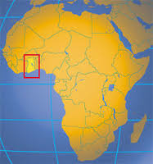
Sub-Saharan Africa
Kwame Nkrumah: in Gold Coast, followed Gandhi’s example, wanted independence from colonial rule, won independence in 1957, changed name to Ghana

Slide 13
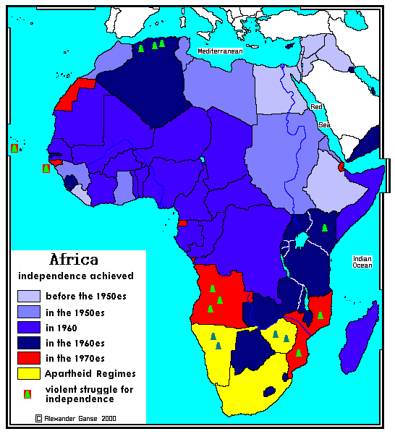
The rest of Africa followed suit quickly
There was some bloodshed, but independence mostly happened without major wars

Slide 14
Quick Quiz
1. What ended Imperialism in India, Indo China, Africa, and Indonesia?
WWII
WWI
Cold War
Atomic Bomb
The US

Slide 15
2. Who came up with resistance through non-violence?
Nelson Mandela
Gandhi
FDR
Churchill
Truman

Slide 16
3. Why did India become two states?
The British decided it was too big
The British made them
Couldn’t agree on a government
Afraid of Muslim Hindu violence
Disagreement over beef and pork

Slide 17
4. What did Kwame Nkrumah want for his State?
Independence from colonial rule
Gold
To become a dictator
To use violence against enemies
Trade gold and salt

Slide 18
5. What happened when a few African States got their independence?
Out break of war
A lot of blood shed
The rest followed quickly
Nothing
Encouraged Colonizers to tighten their hold

Slide 19
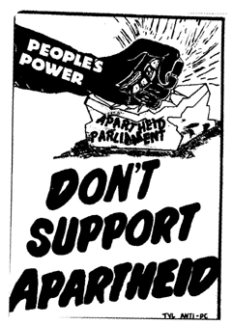
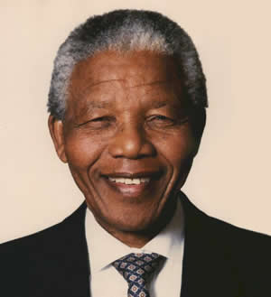
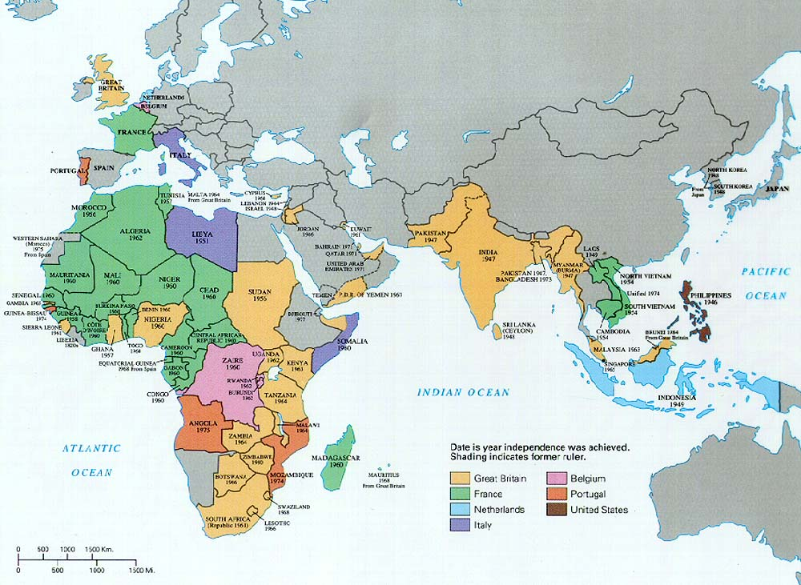
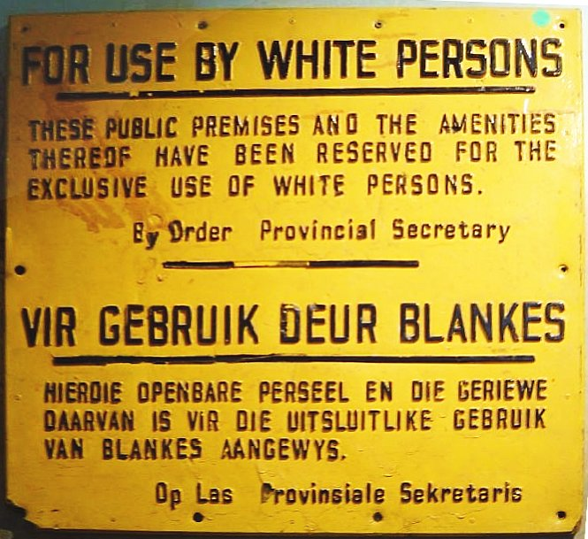
Continuing Conflicts in the Post-Colonial World

Slide 20
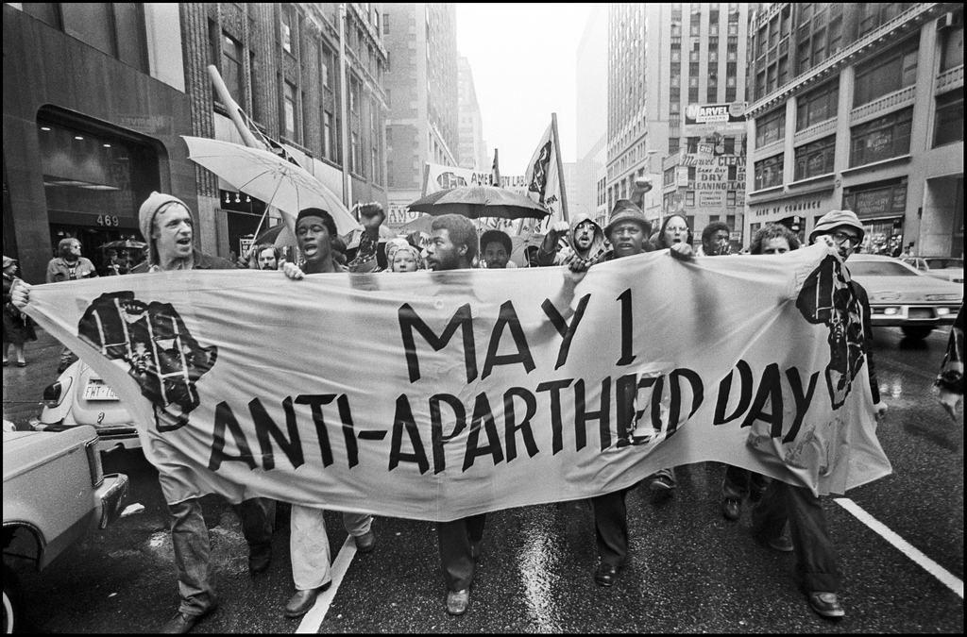
Apartheid in Africa
Tribalism: nations created not based on tribal borders
Led to civil wars or tribes trying to leave
Became One party states
A dictator took power or military took charge
When did tribalism occur?

Slide 21
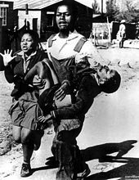
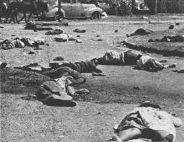
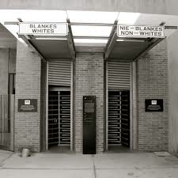
Apartheid (racial separation) began in 1948
Could not intermarry
Lived separately
1960 anti-apartheid demonstrators were killed by police in Sharpeville Massacre (69 people killed)
Soweto uprising in 1976
Led by high school students
http://www.youtube.com/watch?v=2f2k6iDFCL4

Slide 22
Nelson Mandela was the leader of anti-apartheid African National Congress
US refused to do business with South Africa until Apartheid stopped
FW de Klerk was elected in 1989
Freed Mandela, transitioned to a Multi race state
1994 Mandela became the 1st black President
http://www.youtube.com/watch?v=hmm-aazQQKA

Slide 23
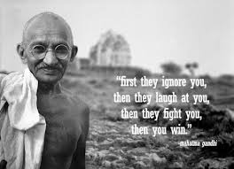
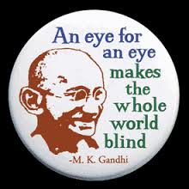
Conflicts in South Asia
Muslims and Hindus disagreed over control of Kashmir, a province north of India
Gandhi was assassinated by a Hindu extremist
1947 Jawaharla Nehru became the 1st Prime Minister

Slide 24
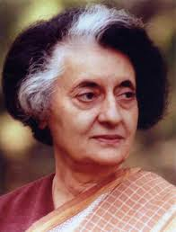
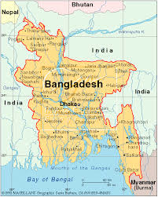
Nehru’s daughter Indira Gandhi followed him
She was assassinated
Voted greatest Prime minister ever
1971 East Pakistan declared itself Bangladesh

Slide 25
Quick Quiz
6. What is it called when nations are not based on tribal borders?
Cannibalism
Imperialism
Division
Tribalism
Decolonization

Slide 26
Quick Quiz
7. Where was Apartheid prominently found?
Ghana
South Africa
India
Egypt
Pakistan

Slide 27
Quick Quiz
8. Who became the first black president of South Africa?
Gandhi
Nehru
Mandela
Rajuv
Nosekini

Slide 28
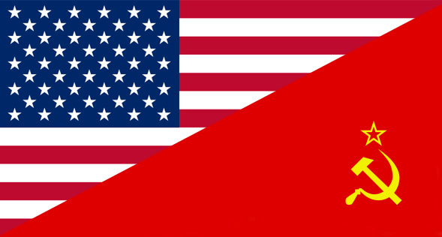
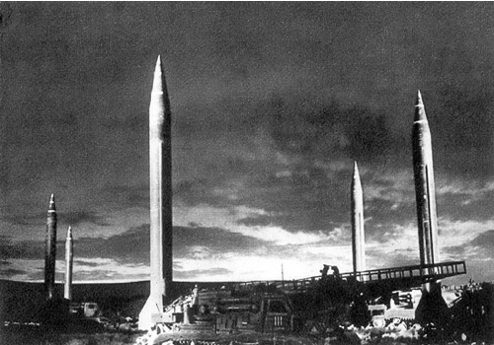
Cold War

Slide 29
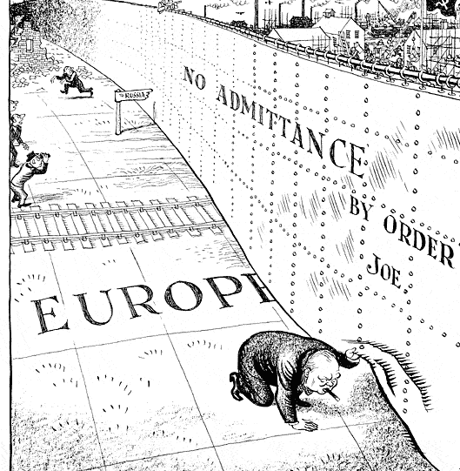
End of WWII leaves the US and USSR as Superpowers
Attempt to extend influence over others
Cold War: cold because they never confronted each other in open warfare
Led to conflict and crisis for 45 years

Slide 30
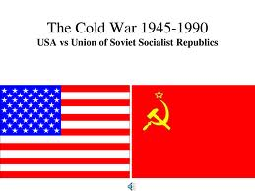
WWII helped start the Cold War
2 Superpowers: US has nuclear weapons, USSR had large army
Ideological differences: Democracy vs. Communism
Soviet Security Fears: after Germany attacked they wanted a buffer

Slide 31
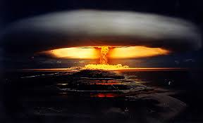
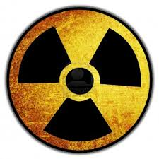
WWII helped start the Cold War
US avoids Isolation and appeasement: saw Communism as a threat to aggressively attack
New Weapons: Nukes were dangerous, so didn’t want to attack directly
Rise of Communism in Asia: Japans invasion weakened the government, so communists were able to take over

Slide 32
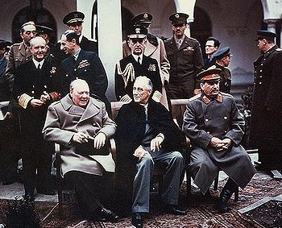
Cold War Begins in Europe
Stalin, FDR, and Churchill met at the Yalta Conference in 1945
Divided Germany into 4 parts monitored by the Allies and France
Stalin agrees to allow free election in Eastern Europe

Slide 33
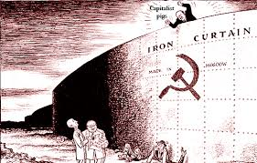
Iron Curtain Falls
Term coined by Winston Churchill
Stalin breaks his promise
Puts local communists in charge
Wants Eastern Europe as a buffer between him and the West

Slide 34
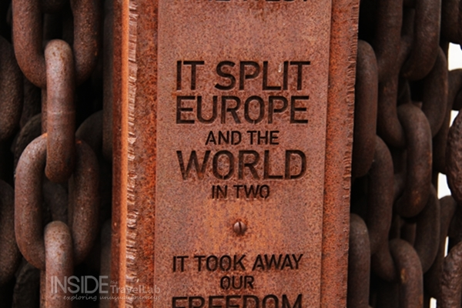
Cut off communication between Eastern and Western Europe
The East had to create a communist government and economy

Slide 35
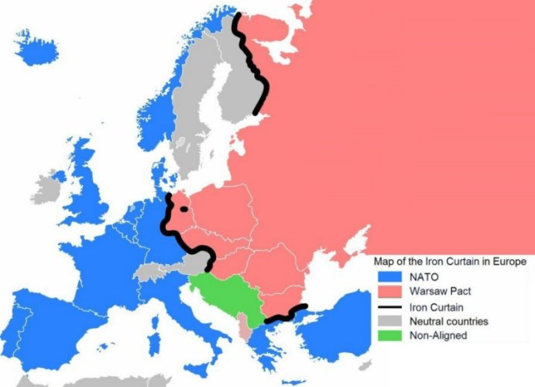

Slide 36
American Involvement
Feared Stalin was the new Hitler
Truman Doctrine: will give aid to all people resisting communism
Containment: prevent communism from spreading
Marshall Plan: give billions of dollars to Europe to rebuild itself, so we get trading partners and they can resist communism

Slide 37
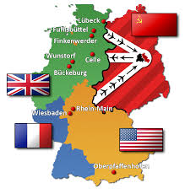
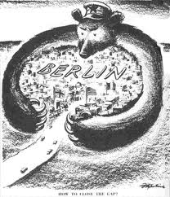
Germany
1948 the Allies take steps to merge their zones of occupation in Germany
Stalin reacts by blockading Berlin

Slide 38
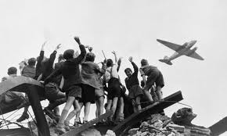
The Allies airlift in supplies to Berlin and Stalin gives up after a year
1949 officially merge into the Federal Republic of Germany (west)
Stalin makes the German Democratic Republic (east)
http://www.youtube.com/watch?v=5GoIL9gVonQ

Slide 39
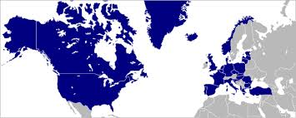
NATO and Warsaw Pact
1949 the US, Canada, and 10 Western European countries formed the North Atlantic Treaty Organization (NATO) to protect Western Europe from Communism
US pledged to defend them with nuclear weapons
1955 the Soviets force Eastern Europe to make Warsaw Pact in response

Slide 40
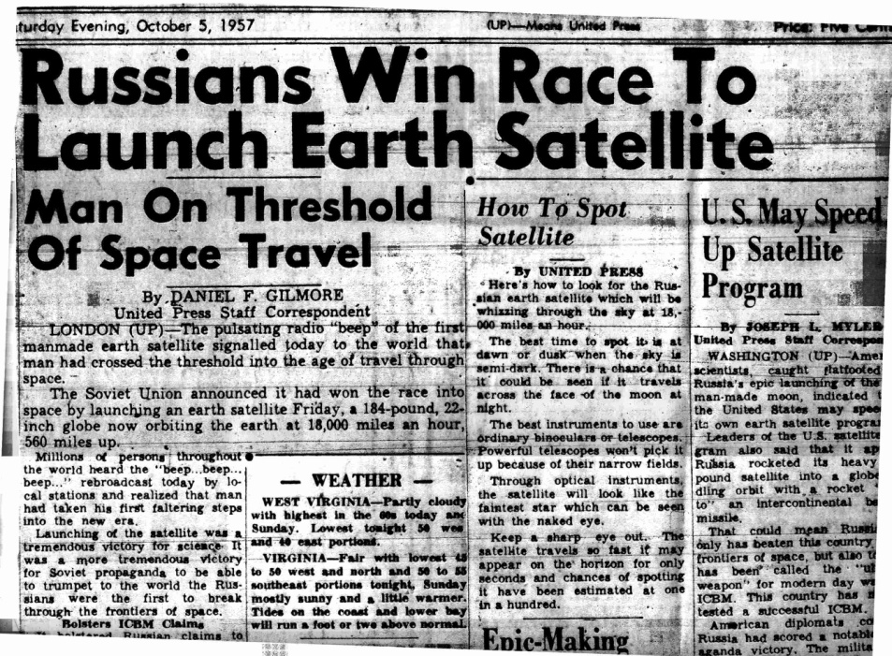
Cold War at its Height

Slide 41
Nuclear Arms Race
1949 USSR exploded its 1st atomic bomb
Launch Sputnik in 1957
Nukes served as deterrents keeping the superpowers from attacking each other
Found other avenues of competition
http://www.youtube.com/watch?v=TbAXkWPasYw

Slide 42
Khrushchev and Eastern Europe
1953 Stalin died and Khrushchev took over
He criticized Stalinism which triggered unrest in Eastern Europe that was unhappy with Communism
Problems and Protests:
Poland: can handle own affairs as long as it stays communist
Hungary: threaten to leave Warsaw Pact, USSR crushes them
East Berlin: 1961 build the Berlin Wall, symbol of Cold War
Czechoslovakia: created more liberal policies, USSR replaces them with strict Communism

Slide 43
Communism Comes to Latin America
Wide spread poverty and repression made it ripe for communist beliefs
1959 Fidel Castro takes over Cuba
Promised democracy but lied
US breaks off trade connections with Cuba
Castro turns to Soviets and Communism for help

Slide 44
1961 CIA send Cuban exiles to the Bay of Pigs to invade Cuba
Fails and is embarrassment to US
1962 US finds out that Cuba is building bases for nuclear weapons
In striking distance of US
Starts the “Cuban Missile Crisis”
JFK orders a blockade and invasion
Khrushchev withdraws missiles for promise of no invasion

Slide 45
http://www.history.com/topics/formation-of-nato-and-warsaw-pact/videos#cuban-missile-crisis

Slide 46
Quick Quiz
14. What came out of WWII that led to the Cold War?
USSR and US being Superpowers
Forming new colonies
Everyone becoming democratic
Equal rights for all

Slide 47
Quick Quiz
15. What was the purpose of NATO?
Open trade
Communicate with communists
Dismantle atomic weapons
Defend Europe from communists

Slide 48
Quick Quiz
16. What did the Truman Doctrine say?
Give aid to people resisting communism
Give money to European countries
Declare war on the USSR
Made US isolationist again

Slide 49
Quick Quiz
17. What city in Germany was blockaded by the USSR?
Munich
Hamburg
Berlin
Stalingrad

Slide 50
Quick Quiz
18. What purpose did Nukes serve?
Military deterrents
war starters
Used for offense only
All were destroyed

Slide 51
Quick Quiz
19. Who won the Cuban Missile Crisis?
Russia
Cuba
US
France

Slide 52
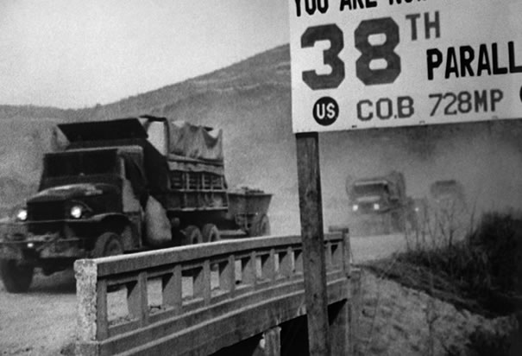
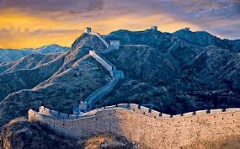
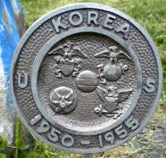
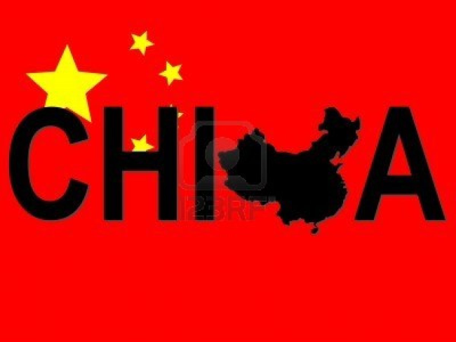
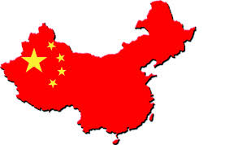
Cold War Reaches Asia

Slide 53
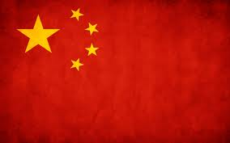
Communist Revolution in China
Weakened by struggle with Japan and Chinese communists
Mao Zedong was the leader of the communists, took Long March (1934-37) to North West China
Communists cooperated with China to fight Japanese, but called off truce when the war was over
USSR helped communist Mao to drive out the Nationalist party to Taiwan

Slide 54
All aspects of life were controlled by the Communist Party
Raised peasants to a high level of importance
Changes:
Eliminated capitalist class (those better off, land owners, leader), 1 million “capitalists” killed
Reeducation (books to promote communism, teach it in school)
Family (replaced by Communist Party, obey state, no ancestor worship)

Slide 55
“Great Leap” Forward
1956 Mao moves farmers onto cooperative farms where they divide work and crops equally
Then moves them onto larger communes
1958 introduce the 5 year plan to turn China into industrial power
Build infrastructure, but poor planning and no money led to disaster
Faced starvation and crisis (30-50 million dead)

Slide 56
Korean War (1950-1953)
Korea divided into North (Communist) and South (Pro-west)
1950 the North invaded the South
UN intervened, led by MacArthur to push the North out
1953 reached a compromise that put the border back to where it was before the fighting started

Slide 57
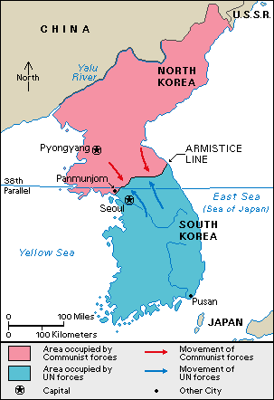
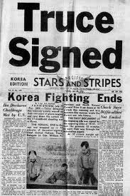
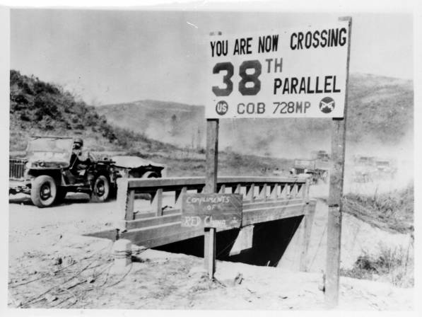
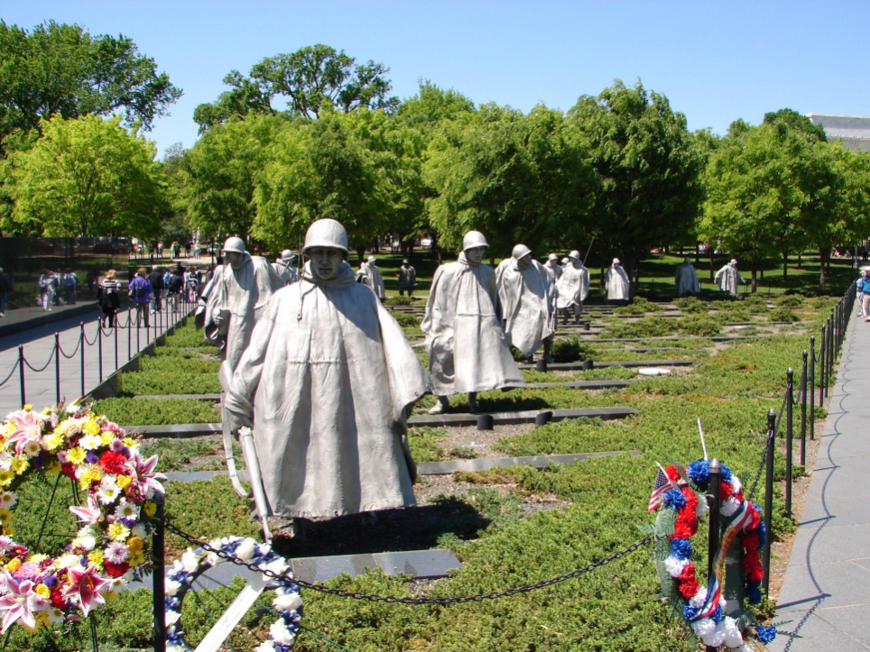
US: 54,229 KIA 103,248 Wounded 8,142 MIA 3,746 Captured 169,365 Total
NK and China: 1,500,000 KIA

Slide 58
Cultural Revolution
Cause: border disputes between China and USSR, Mao wanted to be the leader of Communism, lack of enthusiasm for Communism in China, want to cover up mistakes in “Great Leap Forward”
Attempt to push China towards ideal communist society= Cultural Revolution

Slide 59
“Little Red Book” had the instructions for everything Communist
1966 Mao closed all schools and made the students the Red Guard (I million)
Traveled attacking upper class, oppressed political opponents
Mao had to use army to control them
Food shortages because were not working
Dismissed in 1969 after having killed up to a million people

Slide 60
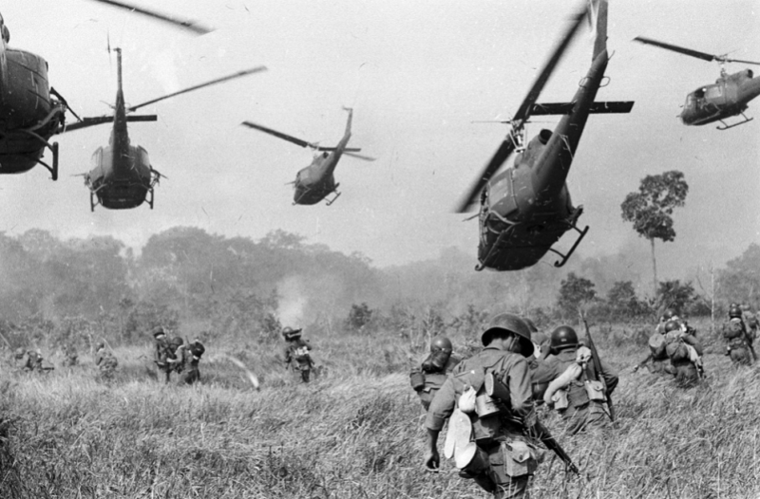
Conflict in Indo China

Slide 61
War in Vietnam
Vietnam was divided: Ho Chi Minh had the Communist North while the South had ties to the West
Vietcong launched guerilla attacks against the South
US stepped in to help the South
Thought other countries would fall to communism in a domino effect around South Vietnam

Slide 62
US sent in troops in 1964
Both sides committed horrible atrocities
US couldn’t turn the tide of the war
1968 the Tet Offensive showed the strength of the Vietcong
1973 the US withdrew
1975 South Vietnam falls to the North

Slide 63
Images from Vietnam
Mai Lai Massacre
Use of Napalm
Use of Agent Orange
Monk burning himself out of protest

Slide 64
Cambodia
With collapse of South Vietnam came the collapse of Cambodia
1975 the Cambodian communists, Khmer Rouge took control
Pol Pot was the leader, he used genocide
Killed 4 million people in 1975-78
Overthrown by Vietnamese intervention

Slide 65
Vietnam in Pictures
Read the document on your desks as a group
Recreate the significance of the document in a big picture
You will present your picture to the class and have to explain what it means
You will be graded on how well you work as a group and on group member participation

Slide 66
Quick Quiz
9. What did Mao change about China?
Raised the standard of living
Eliminated the wealthy
Got ride of communism
Made the family important

Slide 67
Quick Quiz
10. Who was oppressed during the Cultural Revolution?
Students
Army members
Political opponents
commoners

Slide 68
Quick Quiz
11. What war was fought that ended where it began?
Korea
Vietnam
WWII
Cold War

Slide 69
Quick Quiz
12. What was the outcome of the Vietnam war?
US wins
South takes over the North
US stayed in Vietnam
North takes over the South

Slide 70
Quick Quiz
13. What did Pol Pot do in Cambodia?
Free the Serfs
make a Democracy
Use genocide
All of the above

Slide 71
Cold War Ends

Slide 72
Soviet Stagnation (1964-1982)
After Khrushchev, the USSR fell into stagnation (failure to advance)
People had little incentive to work, not enough food, poor quality goods
Détente: attempt to ease Cold War tensions
Collapsed when USSR went to Czechoslovakia and Afghanistan
Increased pressure for change
Dissidents like Natan Sharansky, founder of Refusenik Movement were imprisoned

Slide 73
Gorbachev Years (1985-1991)
1985 Gorbachev became the leader of the Soviet Union
Wanted to preserve and reform Communism
Glasnost: opened society, created congress with elected officials
Perestroika: economic reform, people had some control over businesses
Foreign Policy: withdrew troops from Afghanistan in 1988/ Reagan challenged him to tear down the Berlin Wall/ allowed some democracies to form

Slide 74
Iron Curtain Falls in Eastern Europe
Polish Pope elected in 1978, Pope John Paul II
Poland was the first to elect a non-communist government
People staged demonstrations
Berlin Wall opened in 1989 and reunited officially in 1990
Non-communist governments were coming to power in Eastern Europe
http://www.youtube.com/watch?v=wnYXbJ_bcLc

Slide 75
Dissolution of the Soviet Union (1991)
Communist military coup overthrew Gorbachev but then collapsed
Discredited many communists
Parts of USSR began to declare their independence
1991 the Soviet Union dissolves
Communism collapses because central planner couldn’t predict the needs of the people

Slide 76
Changes come to China
China introduced free enterprise with out giving up political power
Deng Xiaoping became the leader of China in 1976
Made practical reforms and modernized China

Slide 77
Changes:
Land Reforms: communes disbanded, more agricultural production
Consumer goods: produced more goods like radios and TVs
New Factory Management: allowed to sell some products at profit
Limited capitalism: can own small businesses
Foreign investments: allowed, bring in new technology and capitol

Slide 78
Tiananmen Square and the Limits of Reform
Encouraged reform, but didn’t abandon Communism
1989 college students protested in Beijing’s Tiananmen Square for greater freedom and democracy
Army tanks fired killing 100’s
US reduced trade with China for a while
China has more freedom now and has the fastest growing economy

Slide 79
http://www.youtube.com/watch?v=9-nXT8lSnPQ

Slide 80
McCarthyism
http://www.youtube.com/watch?v=AWeZ5SKXvj8

Slide 81
Quick Quiz
20. What did the USSR’s movement into Afghanistan do?
Start WWIII
Make allies with the US
End the Cold War
Increase pressure for change

Slide 82
Quick Quiz
21. what was Perestroika?
With drew troops from Afghanistan
Was an economic reform
Tore down the Berlin Wall
Opened up Chinese society

Slide 83
Quick Quiz
22. What Polish Pope was elected in 1978?
John Paul II
Benedict IV
Cladius I
Peter III

Slide 84
Quick Quiz
23. What year did the Berlin Wall open?
1989
1999
1995
1987

Slide 85
Quick Quiz
24. 1991 is the date of the….
Tiananmen Square Massacre
End of WWII
Dissolution of the Soviet Union
Year Ms. Davis was born

Slide 86
Quick Quiz
25. Why did communism collapse?
No one liked it
It was outdated
It couldn’t predict the needs of the people
People liked democracy better

