Slide 1
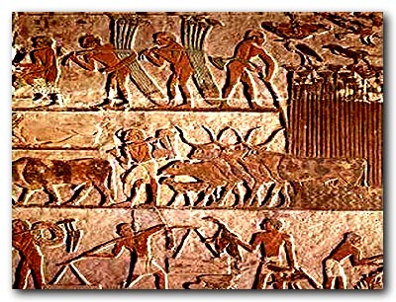
The Rise of River Valley Civilizations

Slide 2
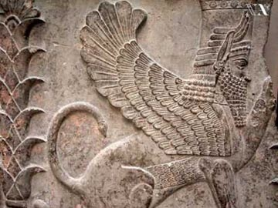
The Importance of Culture
THINK, PAIR, SHARE
What do you think culture is?
What makes up your personal culture?
Be prepared to share with the class

Slide 3
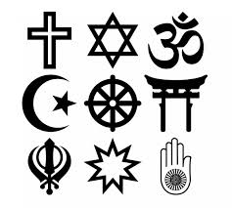
The Importance of Culture
Culture: a people’s way of life
Includes language, clothing, homes, family organization, system of government, art, music, religious beliefs
https://www.youtube.com/watch?v=o32l-_U6nGY

Slide 4
Left Side Activity
On the left page in your notebook, draw a picture that represents your personal culture.
Write a sentence that explains why this is important to you.

Slide 5
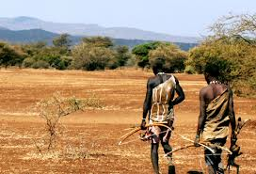
Hunter-Gatherers
In the earliest human societies people were hunter-gatherers.
They relied on hunting, fishing, and gathering wild plants for food
They made tools of stone, so historians called these societies Stone Age cultures
What cultures do you think are/were Hunter-Gatherers?

Slide 6
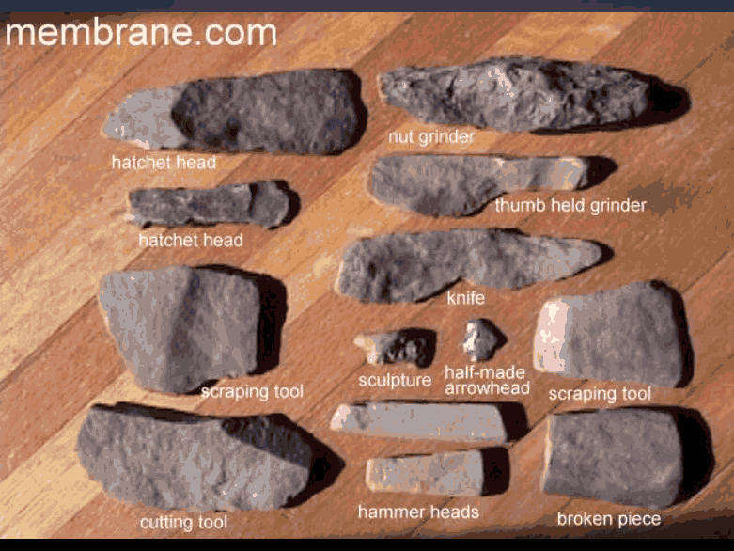

Slide 7
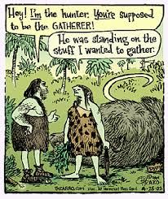
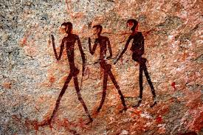
Hunter Gatherers spent most of their time hunting for food
They migrated to areas where food –nuts, berries, fruits, grains, and wild animals- could be found
During the Ice Age, people migrated out of Africa to other parts of the world
http://www.youtube.com/watch?v=hUB4-k7kVBc

Slide 8
Cave Painting Left Side Activity
If you did not have a written language, how could you communicate?
Draw a picture on the left side of your journal that communicates either
No food
Good hunting
Bad water
Danger

Slide 10
Neolithic Revolution (Agricultural Revolution)
About 10,000 years ago, one of the great turning points in history occurred
Moved from hunters and gatherers to producers of food
Why?
Learned how to grow food and domesticate animals
Why would this be a good thing?

Slide 11
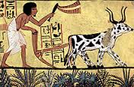
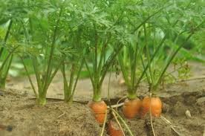
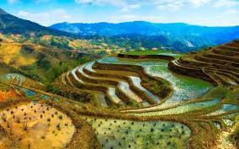
Grew Food (Agriculture)

Slide 12
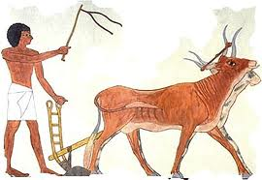
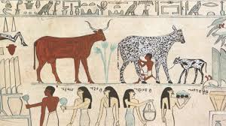
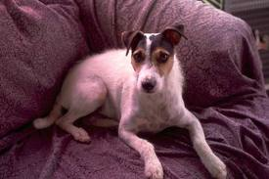
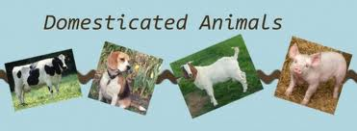
Domesticated Animals (bread for human purposes)

Slide 13
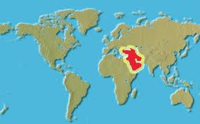
Anthropologists believe this change first occurred in the Middle East
People learned they could spread seeds of grain and herd farm animals
So what was the Neolithic Revolution?

Slide 14
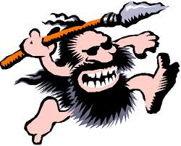
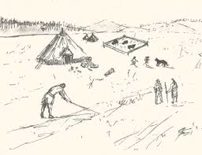
The change that occurred when people learned how to plant and grow crops and herd animals around 8000 BC
DRAW ME

Slide 15
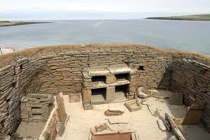
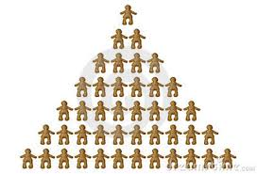
The introduction of agriculture meant people no longer had wander in search of food
They could build permanent homes and villages
Populations grew
Not everyone needed to work anymore so they could specialize

Slide 16
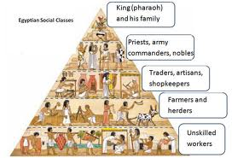
People could grow more food but they were more open to attack by other people
They needed new classes to deal with this and, because of specialization, this was possible
Warrior and priest class emerged to protect the new villages
Specialization
leads to

Slide 17
Left Side Activity
On the left side of your notebook create this chart for the Neolithic Revolution and fill in three facts for each side.
Life Before | Cause of Turning Point | Life After

Slide 18
Crash Course
http://www.youtube.com/watch?v=Yocja_N5s1I

Slide 19
Quick Quiz
Culture includes all of the following EXCEPT
Language
Clothing
Government
Art
None of the above

Slide 20
The people known for fishing and finding wild plants are known as
Cave Men
Hunter-Gatherers
Early Humans
Neolithic Warriors
None of the above

Slide 21
3. Which of the following is NOT something that occurred after the Neolithic Revolution?
A. Were more open to attack
B. New class of indentured servants arose
C. Permanent homes were built
D. Specialization occurred
E. Population grew

Slide 22
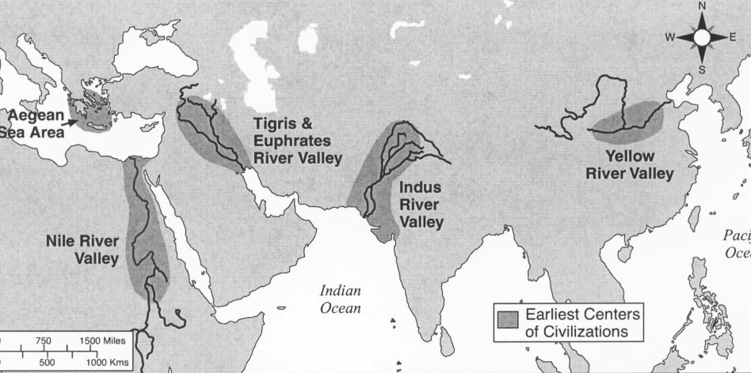
Rise of River Valley Civilizations
As agricultural societies developed and grew, their way of life further changed
Around 3500 BC, the first civilizations arose
DRAW ME

Slide 23
Traits of Civilization
Advanced cities

Slide 25
Traits of Civilization
Specialized Workers

Slide 27
Traits of Civilization
Complex Institutions

Slide 29
Traits of Civilization
Writing

Slide 31
Traits of Civilization
Improved technology

Slide 33
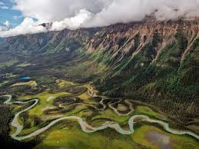
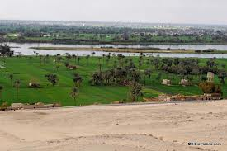
The first civilizations developed in river valleys
Nile, Tigris and Euphrates, Indus, Huang He
Each of these river valleys offered a mild climate and a water source

Slide 34
The water could be used for drinking and for cooking
Each of these valleys was also a flood plain where an overflowing river deposited fertile soil
This soil led to abundant harvests and food surpluses

Slide 35
PERSIA
Introduction

Slide 36
Quick Quiz
The first civilizations arose around
4500 BC
2500 BC
3000 BC
3500 BC
4000 BC

Slide 37
Which of the following is NOT a trait of a civilization?
Complex institutions
Code of law
Advanced cities
Specialized workers
Improved technology

Slide 38
The first civilizations arose next to rivers because
They were easier to travel
Enemies could not cross them
They provided water for irrigation
they offered a cold climate
None of the above

Slide 39
You will put dates of important events in order on a timeline
Left Side Activity
I will give you the dates and what the events are.
Some events stretch across a long period of time. When this happens your timeline should look like this
198,000 BC Stone Age 8,000 BC

Slide 40
When you have dates that overlap, you will draw them above or below each other. Do NOT overlap them in a straight line.
198,000 BC Stone Age 8,000 BC
198,000 BC Stone Age 8,000 BC

Slide 41
Put these dates in order on your timeline. You must draw the picture that goes with them
Hebrews return to Israel (1000 BC)
Mesopotamia (3500 BC-1700 BC)
Neolithic Revolution (8,000 BC)
Shang Dynasty Starts (1700 BC)
Code of Hammurabi (1772 BC)
India (3000 BC- 1500 BC)
Stone Age (198,000 BC-8000 BC)
Egypt (3200 BC-500 BC)
China (2500 BC- 1027 BC)

Slide 43
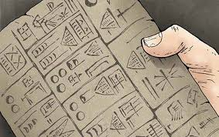
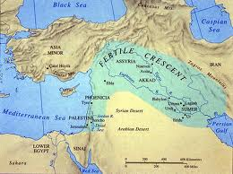
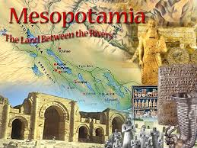
Mesopotamia (3500 BC-1700 BC)
https://www.youtube.com/watch?v=84y2q4giihY
The first river valley civilization
Located between the Tigris and Euphrates River
Means “land between two rivers”

Slide 44
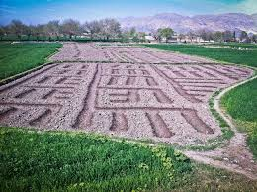
Agriculture (Fertile Crescent)
People irrigated the land by diverting water from the Tigris and Euphrates Rivers
Irrigation allowed farming settlements to flourish and food supplies to increase

Slide 45
Fewer people could produce more food, leading to a surplus
This leads to specialization

Slide 46
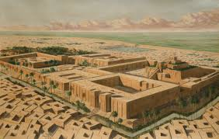
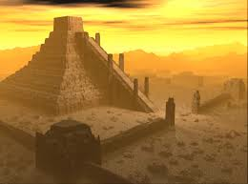
Government
They built several cities
Uruk, Ur, and Babylon
Each city had its own ruler and god
Eventually multiple cities united

Slide 47
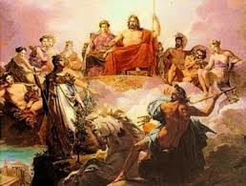
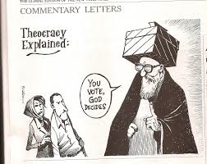
Religion
Polytheism: belief in multiple gods
Believed in over 2,000 different gods
Rulers were often priests
Theocracy: society governed by a religious leader

Slide 48
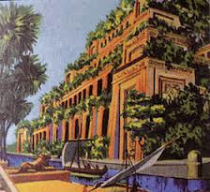
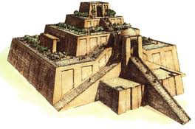
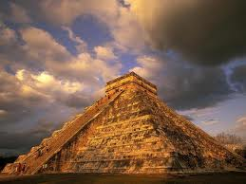
Building
World’s first city-builders
Walled cities, temples, stepped-pyramids known as ziggurats
Hanging gardens of Babylon
DRAW ME

Slide 49
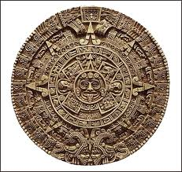
Culture and Science
Sumerians invented the wheel and the sailboat, Irrigation techniques, Tools and weapons out of copper and bronze, calendar
DRAW ME

Slide 50
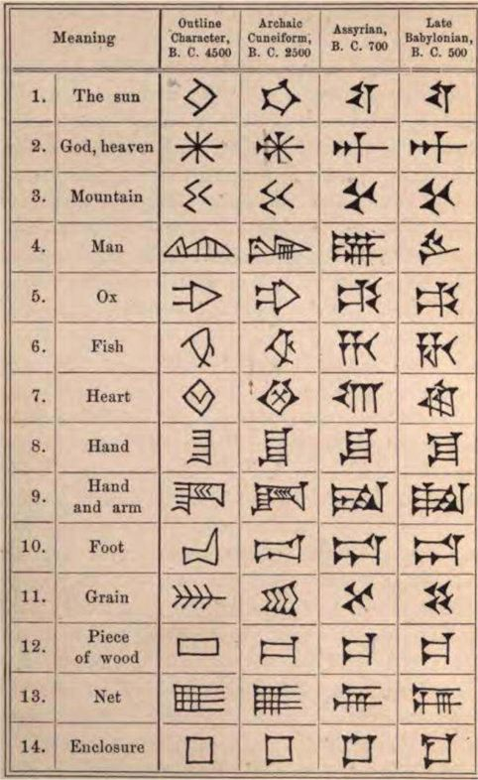
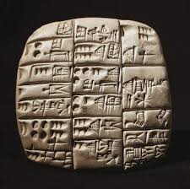
Babylonians developed a number system, earliest known writing system (CUNEIFORM)- stylus makes mark on clay
DRAW ME

Slide 51
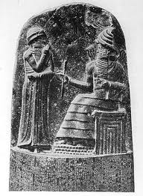
“If a son strike his father, his hands shall be cut off”
Legal System
Code of Hammurabi: earliest written law code
Ensure justice and protect the weak
Treated nobles and commoners differently
Punished criminals harshly
Known for its “eye for an eye” punishments

Slide 52
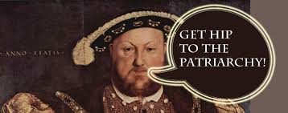
Women
Stayed at home and learned cooking and housekeeping
Poor women received very few rights
Wealthy women could do their own business and obtain divorces
Men were mainly in charge: Patriarchy

Slide 53
Excerpts from Hammurabi’s Code
If a person accused another person and brought a charge of murder against him, but has not proved it, the accuser shall be put to death.
If a person is charged with sorcery and he shall throw himself into the river. If the river has shown the person to be innocent by coming forth safe, the one who brought the charge of sorcery against him shall be put to death, while the one who threw himself into the river shall take over the estate of his accuser.

Slide 54
If a person committed robbery and has been caught, that person shall be put to death.
If a son has struck his father, they shall cut off his hand.
If a builder has built a house for a man, and has not made his work sound, and the house he built has fallen, and caused the death of its owner, that builder shall be put to death.
If it is the owner's son that is killed, the builder's son shall be put to death.

Slide 55
If a woman was not careful, but was a gadabout, thus neglecting her house and humiliating her husband, they shall throw that woman into the water.
If a man has destroyed the eye of a member of the aristocracy, they shall destroy his eye. If he has broken another man’s bone, they shall break his bone. If he has destroyed the eye of a commoner or broken the bone of a commoner, he shall pay one mina of silver. If he has destroyed the eye of another man’s slave or broken the bone of a man’s slave, he shall pay one-half of the slave’s value.

Slide 56
Think about some crimes today. What would Hammurabi’s punishment be for them and what is the actual punishment?
LEFT SIDE ACTIVITY
Discuss with a partner and write down the consequences of
Adultery
Falsely accuse someone
Theft
Faulty construction
Witch craft

Slide 57
Think about some poor behavior that could happen in the classroom. What would Hammurabi do if……?
You forgot your pen/pencil
You talked while the teacher was talking
You cheated on a test
You stole Ms. Davis’ pencil
You had your phone out
You went to the bathroom for a very long time
Write down your answers on the left side.
The best answers will be put on a sticky note and stuck on the board

Slide 58
Crash Course Mesopotamia
http://www.youtube.com/watch?v=sohXPx_XZ6Y

Slide 59
Quick Quiz
Mesopotamia lies between the
Nile and Indus river
Tigris and Nile River
Tigris and Euphrates River
Nile and Euphrates River
Euphrates and Indus River

Slide 60
Polytheism is the belief in
One god
No god
Multiple gods
Jesus
Animal gods

Slide 61
The Babylonians came up with the first writing system called
Hieroglyphics
Cursive
Arabic
Cuneiform
Demotic

Slide 62
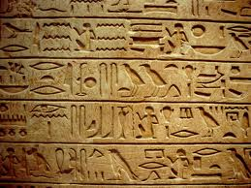
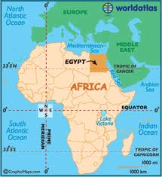
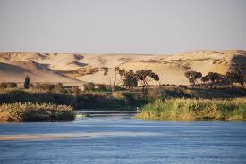
Egypt (3200 BC- 500 BC)
Located in Northeast Africa
Gift of the Nile.
Predictable flood
Deposits fertile soil
Grow large amounts of food
Use the river for transportation
https://www.youtube.com/watch?v=wgTPH5y1-ZI

Slide 63
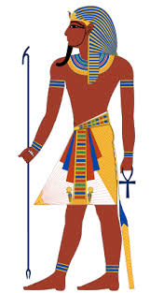
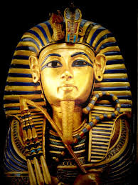
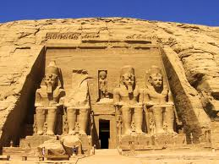
Government and Society
Most powerful person was the Pharaoh (King)
They were an absolute ruler
Owned all the land, commanded the army, made laws, controlled irrigation, and defended Egypt
DRAW ME

Slide 64
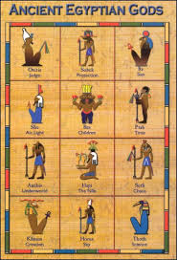
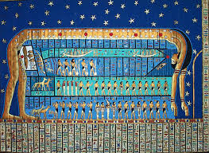
Considered to be a God (Theocracy)
Pharaoh ruled upper and lower Egypt

Slide 65
Social Order
Pharaoh
priests and nobles
Then warriors, scribes, merchants, and craftsmen
https://www.youtube.com/watch?v=_JSMkwVU_Xw

Slide 66
Peasants and slaves were at the bottom
Spent time farming, herding cattle, and working on building projects

Slide 67
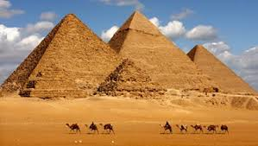
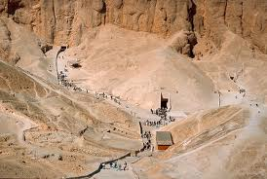
Religion
Believed the body should be preserved (mummification)
Pharaohs were buried under pyramids and in the Valley of the Kings
They were surrounded with gold, jewels, and other precious objects for use in the afterlife
Polytheistic

Slide 68
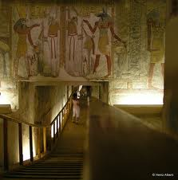

Slide 69
DRAW ME

Slide 70
Accomplishments
Medicine: Developed knowledge of the human body through embalming (preserving). Performed surgical operations
Hieroglyphics: one of the earliest forms of writing, based on picture symbols
https://www.youtube.com/watch?v=EqGLLOqOhLQ

Slide 71
Building and Art: pyramids, temples of stone, palaces
Geometry and Astronomy: used geometry to build pyramids. Developed calendar based on 365 days

Slide 72
Left Side Activity
Create a PERSIA chart on the left side of your notebook for Egypt.
You must have three facts for each category
When done, turn and share with your neighbors.

Slide 73
Which of the following are in the correct order?
Pharaoh, Priest, Warrior, Slave
Priest, Warrior, Pharaoh, Slave
Pharaoh, Warrior, Priest, Merchant
Warrior, Pharaoh, Merchant, Slave
Pharaoh, Merchant, Priest, Warrior

Slide 74
The people of Egypt were
Monotheistic
Christian
Atheist
Polytheistic
Agnostic

Slide 75
The Egyptian form of writing is known as
Cuneiform
Demotic
Latin
Hieroglyphics
Arabic

Slide 76
Egypt Crash Course
http://www.youtube.com/watch?v=Z3Wvw6BivVI

Slide 77
India (Harappan)
More than 5000 years ago, the Indus River Valley became another of the first centers of human civilization
River deposited rich soil when it flooded

Slide 78
Agriculture and Building
Farmers grew barley, wheat, dates, and melons
Food surpluses allowed people to build large cities like Harappa and Mohenjo-Daro

Slide 79
Harappa
More than 30,000 people
Technologically advanced urban culture
Dockyards, granaries, warehouses, brick platforms, and protective walls

Slide 80
Mohenjo-Daro

Slide 81
First urban planners
Houses connected to public sewers and a water supply
Made cotton cloth
DRAW ME

Slide 82
Trade
Trade was an important part of Harappan economy
Kilns for pottery and signs of metal use
Own form of writing
Can’t decipher it

Slide 83
Collapse
By 1500 most of the cities had been abandoned
Happened quickly
Not sure why it declined
Possible invasion of the Aryans
Climate change, deforestation, and loss of water

Slide 84
Left Side Activity
Create a PERSIA chart on the left side of your notebook for the Indus River Valley.
You must have three facts for each category
When done, turn and share with your neighbors.

Slide 85
The two main cities of the Indus River Valley were
Harappa and Mohenjo-Daro
Cairo and Abu Symbel
Sumer and Babylon
Mohenjo-Daro and Sumer
Babylon and Cairo

Slide 86
The Indus River Valley had the first public
Bath
Execution
Crowning ceremony
Sewer system
Transportation system

Slide 87
What is the excepted reason for why the Indus River Valley collapsed?
Climate change
Deforestation
Invasion
Loss of water
There is not one

Slide 88
Indus Crash Course
http://www.youtube.com/watch?v=n7ndRwqJYDM

Slide 90
China
500 years after India
Emerged along the Huang He River (Yellow River)

Slide 91
Agriculture
River flooded periodically and deposited rich soil
Grew Millet (a type of grain)
Eventually farmed soy bean and raised chickens, dogs, and pigs

Slide 92
Government
1700 BC the Shang Dynasty took power
Dynasty: ruling family
Built the first cities and set up the capital at Anyang

Slide 93
Shang
Ruled with the help of powerful nobles
Kings were military leaders and priests

Slide 94
http://www.youtube.com/watch?v=Jd0M_glwpwQ
Offered sacrifices to their royal ancestors
Worshipped many Gods
http://www.youtube.com/watch?v=ppobDZeSJ9Q

Slide 95
Cultural Contributions
Bronze work (weapons and vessels)
Silk
Pictograph writing system
Use a character to represent a word
First written on bones and tortoise shells to worship ancestors and tell the future
DRAW ME

Slide 96
Left Side Activity
Draw 3 people on the left side of your notebook.
Label them Mesopotamia, Egypt, and Indus.
Draw a thought bubble around their head.
In the thought bubble, write a COMPLETE SENTENCE about what people from that River Valley Civilization would think about China.

Slide 97
What river did the Chinese River Valley civilization develop next to?
Huang He
Yantze
Mekong
Jinsha
Songhua

Slide 98
What dynasty first took over China?
Han
Qin
Shang
Tang
Song

Slide 99
What type of government did the Shang dynasty have?
Monarchy
Democracy
Theocracy
Oligarchy
A and C
D and A

Slide 100
19. What was used to predict the future?
stars
ancestors
Turtle shells
shamans
Tarot cards

Slide 102
Graphic Organizers (Left side)
Today you will complete AT LEAST 3 different Venn Diagrams.
These Venn Diagrams will compare your choice of River Valley Civilizations. (Meso, Egypt, Indus, China)
Each circle MUST have 3 facts.
When done, you will chose the Venn Diagram you feel you have the most knowledge about and decide if they are more similar or different.
You will then decide what 3 PERSIA categories they are more similar/different in.

Slide 103
The Ancient Hebrews
Hebrews (Israelites) lived south of Phoenicia in the area occupied by present day Israel, Egypt, and Jordan
Influenced by Mesopotamia and Egypt

Slide 104
Prophet Abraham
Founder of the Hebrews
Lived in Ur
God commanded him to move his people to Canaan
Abraham promised to obey God, so God looked after his people
Covenant

Slide 105
Believed in one universal God, who was both just and all-powerful
It was called Judaism
God was an invisible but powerful force that created the world and demanded proper moral conduct
Monotheism: belief in one God
Judaism was the base for Christianity and Islam
DRAW ME

Slide 106
History is told in the first book of the bible (Old Testament)
The bible is a primary source
1st 5 books of Hebrew Bible called the Torah
Most holy of sacred writings in Judaism

Slide 107
Says they migrated to Egypt and remained enslaved there for 100’s of years
Moses freed them and took them out of Egypt
http://www.youtube.com/watch?v=5Kr4aCUYg8A

Slide 108
http://www.youtube.com/watch?v=3oX-Kcx2BAc
Moses’ mother hid him along Nile
Lived with Egyptian princess
Never forgot religion
Threatened with plagues
Led Hebrews out of slavery from Egypt
http://www.youtube.com/watch?v=OqCTq3EeDcY

Slide 109
Moses gave them the 10 Commandments:
http://www.youtube.com/watch?v=9K4q22kMzm4
http://www.youtube.com/watch?v=4TAtRCJIqnk
DRAW ME

Slide 110
Hebrews returned to Israel around 1000BC
It was occupied by new people
This led to a series of war
The Hebrews eventually conquered Israel
Built their capital at Jerusalem and a temple to worship God

Slide 111
Left Side Activity
Create a sensory figure of Moses
Draw him
Include 3 of the following
What he might be SEEING, FEELING, HEARING, SAYING, or DOING
I speak the UT fight song to support my team
I believe with all my heart that UT is the best team ever.
My feet walked for hours to go from tailgate to tailgate

Slide 112
20. ________ was the founder of the Hebrews
A. Moses
B. Abraham
C. Jesus
D. John
E. Jacob

Slide 113
21. Monotheism is the belief in
Many gods
A few gods
One god
Two gods
No gods

Slide 114
The 10 Commandments are…
Code of law
List of acceptable behaviors
List given to Moses
Laws of God
All of the above

Slide 116
Review (Left/Right side)
On the next completely blank page you will create a Unit Summary.
MUST HAVE
Unit Name in center (GREEN)
Name of all 9 topics covered (RED)
3 pictures from each topic covered (BLUE)
These pictures must be colored and labeled

Slide 117
Thesis
X. However, A, B, and C. Therefore, Y.
X represents the strongest point against your argument.
A, B, and C represent the three strongest points for your argument.
Y represents the position you will be taking in your essay.

Slide 118
Example
Asses the validity of the statement, “Coach Davis’ class is too time consuming and makes history incredibly boring ”
Coach Davis expects her students to do higher level work in her Pre-AP class. However, the work given often involves drawing pictures, playing games, and interacting with other students. Therefore, Coach Davis’ class does not have to be time consuming and is entertaining, not boring.
Pros | Cons
Coloring | Higher level
Games | More writing
interacting

