Slide 1
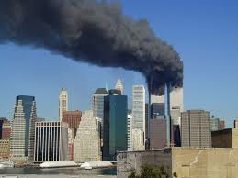
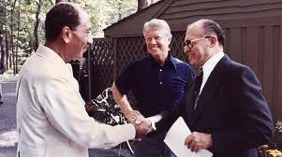
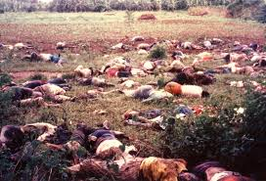
Challenges in Our World Today

Slide 2
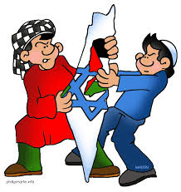
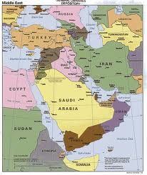
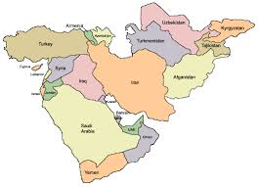
Challenges in the Middle East
Want to achieve greater stability and peace
Most ME countries share similar cultures
Once part of Ottoman Empire and then under British or French rule

Slide 3
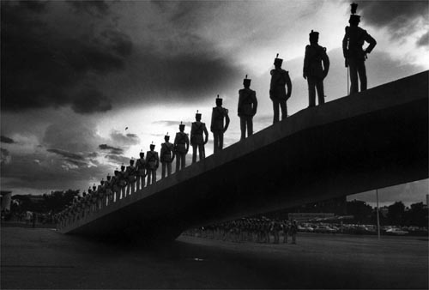
Saudi Arabia, Iraq, Syria, Jordan, and the countries of North Africa are mostly Arabs, speak Arabic, are Sunni
Iran= speak Farsi, are Shi’ite
Israel=Jewish, speak Hebrew
Some places are monarchs, others are military dictatorships, and Israel is a democracy

Slide 4
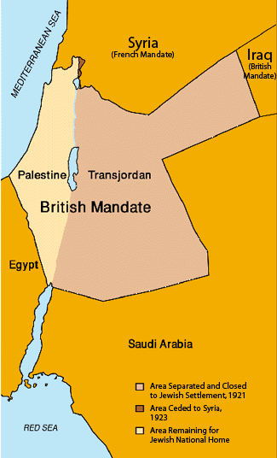
Arab-Israeli Conflict
1917 the British issued the Balfour Declaration
Announced homeland for Jews created in Palestine
Arabs saw Zionism (migration of Jews to Palestine) as Imperialism
Jews saw it as a return to their homeland

Slide 5
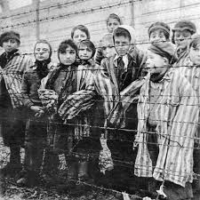
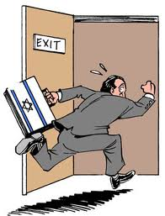
Immigration grew in 30’s and 40’s as Nazism grew
Arab Palestinians and the British limited the admission of Jews to Palestine
1948 British gave up control of Palestine and turned problem over to the UN

Slide 6
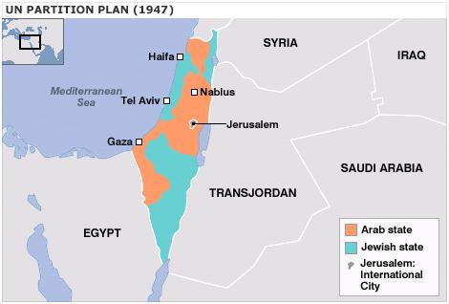
United Nations decided to split Palestine into two-states: Jews got Israel and the Palestinians got the West Bank and Gaza Strip
Still a political issue to this day

Slide 7
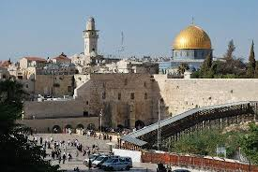
What city is in Israel that multiple religions have a claim to?
http://www.youtube.com/watch?v=AoizSL-TEJQ

Slide 8
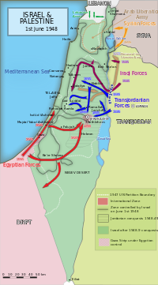
Israel Struggles to Survive
War for Independence:
1948 5 Arab countries rejected the existence of Israel
Launched an attack but were defeated
Jordan took West bank
Egypt took Gaza Strip
Israel took parts from both
Palestinians fled

Slide 9
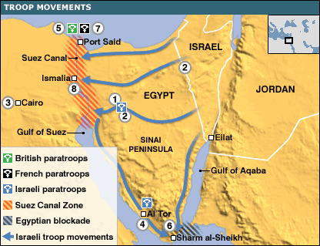
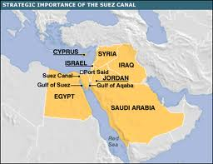
Suez Crisis of 1956:
Gamel Abdul Nasser of Egypt nationalized the Suez Canal
Closed it to Israel
Britain, France, and Israel invaded Egypt
US and USSR demanded they stop
http://www.youtube.com/watch?v=no__OfEsh4o

Slide 10
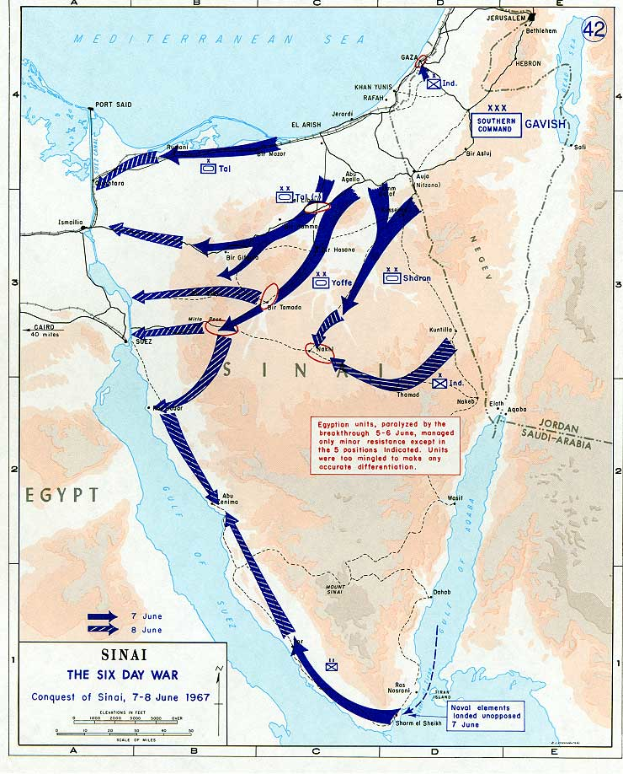
Six Day War:
1967 war erupted again
Israel was attacked by Egypt, Syria, and Jordan
Israel won in 6 days
Took Gaza Strip and Sinai Peninsula from Egypt, West Bank from Syria, and Golan Heights from Syria
US made Israel give parts of it back
http://www.youtube.com/watch?v=awnB45csHwk

Slide 11
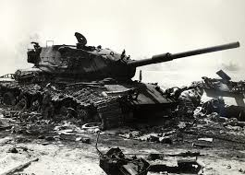
Yom Kippur War (1973):
Egypt and Syria launched a surprise attack on Israel on the Jewish holiday of Yom Kippur
Achieved early successes, but Israel pushed them back

Slide 12
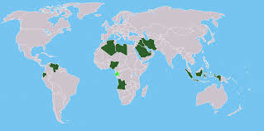
OPEC and Oil as a Political Weapon:
In 1970’s oil-producing countries formed the Organization of Petroleum Exporting Countries (OPEC)
Main members are Saudi Arabia, Iran, Iraq, Kuwait, and UAE
Used oil as weapon by refusing to sell to countries friendly to Israel
Gained wealth and influence

Slide 13
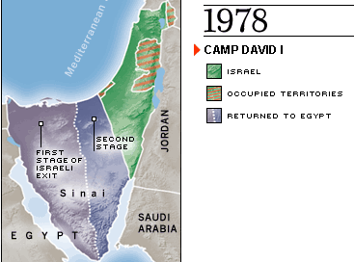
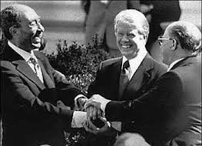
Camp David Accords (1978):
Egyptian President and Israel’s Prime Minister visited President Carter at Camp David
Agreed Israel would give back Sinai Peninsula in exchange for peace (ended 30 years of warfare)
Other Arab countries broke ties with Egypt
Sadat was assassinated by Arab extremists
first step in the direction of Peace
http://www.youtube.com/watch?v=jYASjRMEWeA

Slide 15
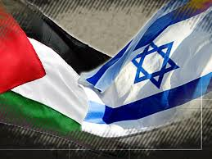
Israel and the Palestinians
Hate between Palestinians and Israelis complicate Israel’s relations with its Arab neighbors
http://www.youtube.com/watch?v=GdtGOY8T5XE

Slide 16
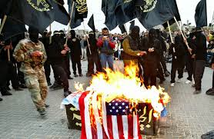
PLO: Palestinian Arabs formed the Palestinian Liberation Organization.
Refuse to recognize Israel and vow to win back their homeland
Use of Terrorism: in 60’s and 70’s the PLO used terrorism (use of acts of violence against innocent civilians in order to make demands on a hostile government)
Hijacked planes, attacked schools, 1972 Olympics in Munich

Slide 17
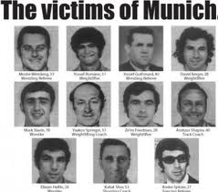
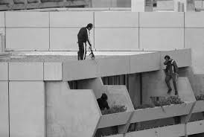
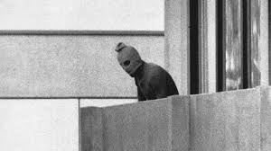
1972 Olympics
http://www.youtube.com/watch?v=BGTFn25clr4

Slide 18
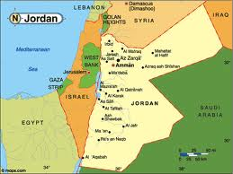
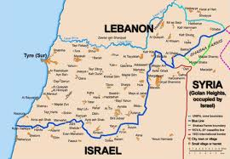
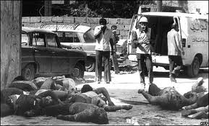
War in Lebanon: PLO’s first lived in Jordan, but then expelled to Lebanon.
1975 war erupted between Christians, Shi’ites and Sunnis.
1976, Syria invaded
in 1978 and 1982 Israel entered to destroy PLO camps

Slide 19
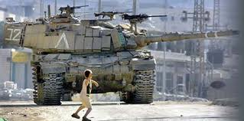
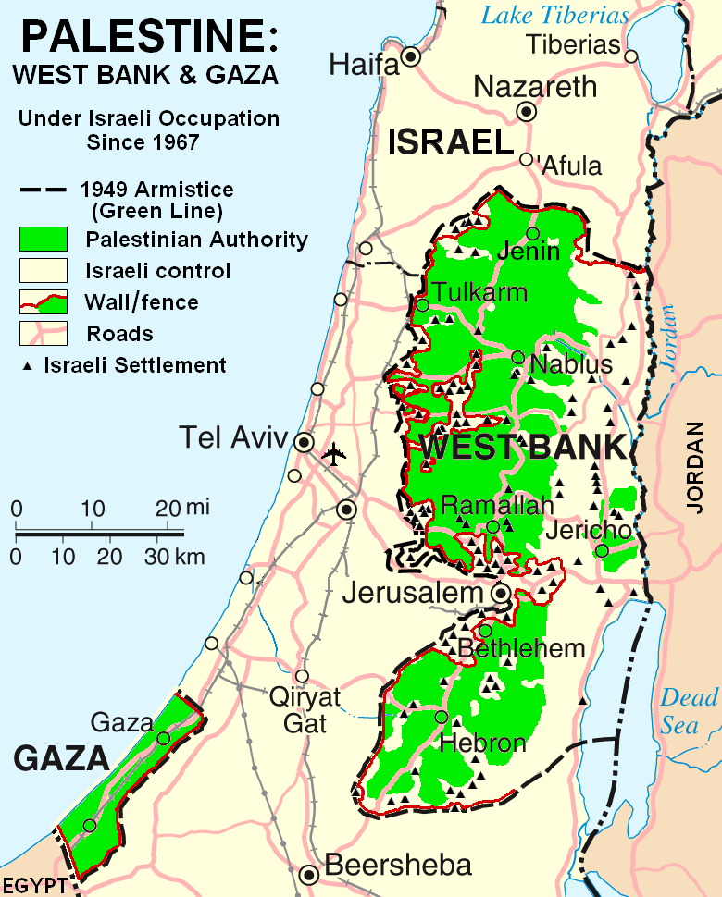
Intifada (“Uprising”):
West Bank and Gaza Strip that Israel took had Palestinian populations
In 1987 Palestinians began a series of violent demonstrations there
Israel tried to stop them
Jews began to build there own settlements in the West Bank and Gaza Strip

Slide 20
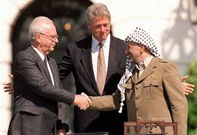
Progress in Arab-Israeli Relations
Middle East Peace Conference
In 1991, the US pressured Arab and Israeli leaders to sit down to the Middle East Peace Conference
Next year Israel’s and the PLO’s leader entered into secret negotiations
Signed the Oslo Accords in 1993
Israel give control of West Bank and Gaza Strip to Palestinians and the PLO recognized Israel’s existence

Slide 21
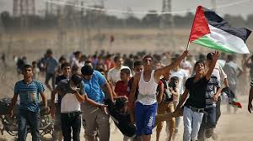
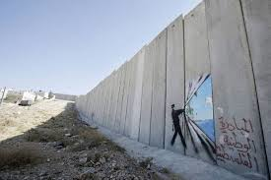
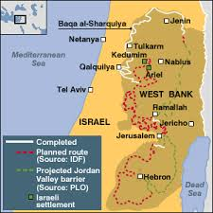
The Second Intifada:
Lack of progress led to another uprising among the Palestinians
In 2002 Israel built the West Bank Barrier
In 2003 Israel said it would dismantle all its settlements in the West Bank and Gaza Strip
In 2005 Israel left its settlements in the Gaza Strip
http://www.youtube.com/watch?v=HRWQC9UGO8A

Slide 22
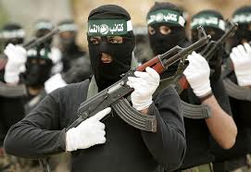
Divisions Among the Palestinians:
PLO leader Yassir Arafat died in 2004
Led to split in the PLO between Fatah and Hamas
Hamas refuses to recognize Israel, so Israel sees them as a terrorist organization
Hamas is in power in Gaza while Fatah has the West Bank
http://www.youtube.com/watch?v=F5o1XqUb_6c

Slide 23
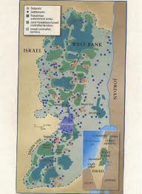
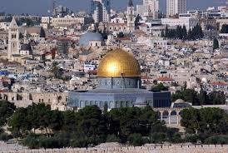
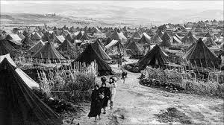
New Attempts at Negotiations:
In 2007 Israel and Palestine agreed to negotiate
Talked about future control of Jerusalem, existence of Jewish settlements in the West Bank, and rights of Palestinian refugees

Slide 24
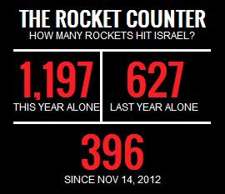
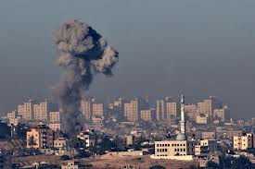
Israel Strikes Against Hezbollah and Hamas:
While negotiating, Israel faced rocket attacks by both Hezbollah in Lebanon and Hamas in the Gaza Strip
Israel responded by invading Sothern Lebanon
UN ended fighting by promising to disarm Hezbollah
Hezbollah has refused to disarm
Israel attacked by rockets, responds by invading

Slide 25
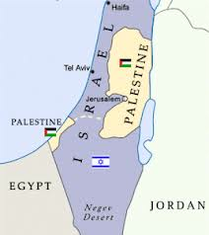
In 2008, Israel launched air strikes and sent ground troops into the Gaza Strip
Some supported this movement, others said it was too harsh
In 2010, new negotiations held between Israel and the Palestinian Authority
Leaders on both sides support “two-state” solution

Slide 26
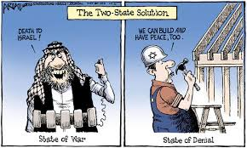
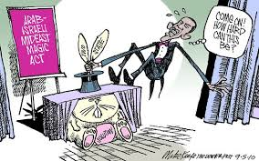
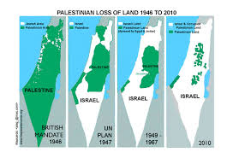
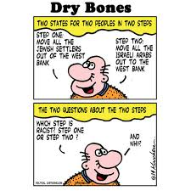
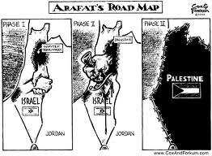
Do you think this will happen?

Slide 27
Talks stalled when Israel resumed building new settlements in the West Bank
In 2011 Palestinian Authority introduced UN resolution calling for Palestinian statehood
Many still unresolved issues:
Israeli security against terrorism
The right of Palestinians to their own state
Future of Jewish settlements in Palestinian lands
Future status of Jerusalem

Slide 29
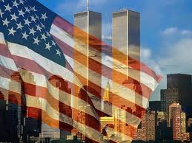
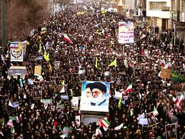
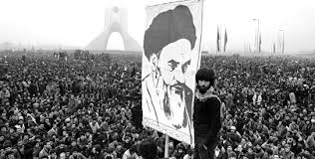
Iranian Revolution (1979)
In the 60’s and 70’s, the Shah of Iran adopted Western culture and technology
He was also guilty of corruption and brutal repression
Iran’s religious leaders led demonstrations to overthrow the Shah in 1979
http://www.youtube.com/watch?v=kY0ixG94cHE

Slide 30
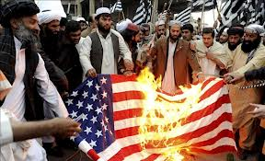
An Islamic Fundamentalist became Iran’s new ruler
Fundamentalism: movement within a religion to return to its basic values
Radical Islamic Fundamentalism: reaction against the values of the West that calls for strict enforcement of Islamic law (Sharia)

Slide 31
No separation of religion and state in Iran
Constitution based on the Quran
Gave support to terrorism in Lebanon
Allowed hostages to be taken from the US Embassy in Tehran
Held for 1 year and then released
http://www.youtube.com/watch?v=w918Eh3fij0

Slide 32
First Gulf War
1979 Saddam Hussein seized power in Iraq
1980 Hussein attacked Iran, led to 8 year war
In 1990, Iraq occupied oil-rich Kuwait

Slide 33
US feared Iraq would invade Saudi Arabia
US feared would disrupt the flow of oil
US and allies expelled the Iraqis from Kuwait
Allowed Hussein to stay in power

Slide 34
Al-Qaeda and 9/11/2001
Al-Qaeda: terrorist organization formed by Osama bin Laden
Mad at US troops in Saudi Arabia
Consider themselves radical Islamic Fundamentalists fighting a holy war (jihad) against the West

Slide 35
Majority of Muslims reject their views
Al-Qaeda set up camps in Afghanistan to train
On September 11, 2001, Al-Qaeda member living in the US hijacked several planes

Slide 36
Two into the World Trade Centers in New York, one into the Pentagon, one headed for DC but ended up in a field in PA
President Bush and other leaders declared a “War on Terror”
http://www.youtube.com/watch?v=kU738srDJRY
http://www.youtube.com/watch?v=kHdqw6scuIc
http://www.youtube.com/watch?v=nh28XcnpzX4

Slide 37
http://www.youtube.com/watch?v=RXkfs8KjRSc
You must write down 4 Emotions the people of New York and the World felt during this tragedy.
Second Day: Write down three responses of the people of New York and three responses of the American government to the tragedy.

Slide 39
In 3 sentences describe what you think this cartoon is saying

Slide 40
War on Terror in US
Issued the Patriot Act Oct. 2001
To protect the US from something like 9/11 ever happening again
authorization of indefinite detentions of immigrants
permission given law enforcement officers to search a home or business without the owner’s or the occupant’s consent or knowledge
FBI to search telephone, e-mail, and financial records without a court order (wire tapping)
http://www.youtube.com/watch?v=0wL9Li0f1Po
http://www.youtube.com/watch?v=UN2PG1EJZ0Y
http://www.youtube.com/watch?v=gFVQ0HZz2mc

Slide 41
Nov. 2002 issued the Homeland Security Act
Established the Department of Homeland Security in the US.
Goals: prevent terrorist attacks within the United States
reduce the vulnerability of the United States to terrorism; and minimize the damage, and assist in the recovery, from terrorist attacks that do occur within the United States.”
Complaints: Reduced Privacy, Increased Government Secrecy, Strengthened government protection of special interests
http://www.youtube.com/watch?v=xguj8KY8RqM

Slide 42
Revised Patriot Act Will Make It Illegal To Read Patriot Act
NEWS IN BRIEF • Politics • Issue 43•27 Issue 39•36 • Sep 17, 2003
WASHINGTON, DC—President Bush spoke out Monday in support of a revised version of the 2001 USA Patriot Act that would make it illegal to read the USA Patriot Act. "Under current federal law, there are unreasonable obstacles to investigating and prosecuting acts of terrorism, including the public's access to information about how the federal police will investigate and prosecute acts of terrorism," Bush said at a press conference Monday. "For the sake of the American people, I call on Congress to pass this important law prohibiting access to itself." Bush also proposed extending the rights of states to impose the death penalty "in the wake of Sept. 11 and stuff."

Slide 43
Patriot Act Activity

Slide 45
War in Afghanistan
Taliban (group of radical Islamic Fundamentalists) control Afghanistan
Imposed strict religious beliefs
Women must cover faces and bodies
Women are denied opportunities for education and employment
Men cannot trim beards
Religious police roam the streets

Slide 46
Taliban allow terrorist groups like al-Qaeda to operate training camps there
They refused to give up Osama bin Laden after 9/11
US invaded Afghanistan and over threw the Taliban
US established democratic government but violence continues

Slide 47
Second Gulf War
In Iraq, Saddam Hussein failed to allow UN inspectors in to check for weapons
World Leaders insisted Iraq prove they were not hiding WMDs
US, Britain, and allies invaded Iraq in 2003 on suspicion of possessing WMDs
Hussein’s government collapsed

Slide 48
Saddam fled but was caught and then executed
Iraqis voted on a new constitution and elected a democratic government in 2005
Ironically, it appears there were no WMDs

Slide 49
US experienced early success
But suffered casualties due to insurgents
Also tensions there between Sunnis, Shi’ites, and Kurds that cause violence
Allied troops finally began to withdraw in 2011

Slide 50
The Arab Spring, 2011
Democratic practices never spread to the Middle East
ME were often monarchies or military dictatorships because…
Traditional practices
Concentration of wealth in ruling elites
Government corruption
Human rights abuses
Cold War rivalries
Fear of rising Islamic Fundamentalism
http://www.youtube.com/watch?v=tqOdG9RygNw

Slide 51
Protests against this start around the world
In 2010 a street merchant in Tunisia set himself on fire in protests
Soon more protests erupted against Tunisia’s dictator
Forced the President to resign after 24 years in power

Slide 52
Spread to Egypt against President Hosni Mubarak- resigned
Then Libya, Bahrain, Yemen, Syria, and the Sudan – try to use force to keep power but are overthrown as well

Slide 53
Known as Arab Spring: global march for Democracy
West fears it may lead to the spread of radical Islamic Fundamentalism

Slide 54
Did catch and kill Osama bin Laden on May 2, 2011 where he was hiding in Pakistan
http://www.youtube.com/watch?v=M6vtiaNqtv4

Slide 55
Finish video on 9/11

Slide 57
Challenges to Human Rights
Promoting human rights and democracy has been an important US foreign policy goal
Human rights: rights that all people possess (meet basic needs without persecution)
Many places ethnic minorities and political opponents are deprived of their rights

Slide 58
Genocide in the Balkans
Yugoslavia was created in 1918 by joining Serbia to parts of Austria-Hungary
Yugoslavia fell apart in 1991 when Communism collapsed
Began to fight between Christian Serbs, Catholic Croats, and Bosnian Muslims

Slide 60
Croatia and Slovenia declared their independence
Yugoslavia responded by attacking
Fighting then erupted in Bosnia between Muslims and Orthodox Christian Serbs
Yugoslavia helped the Serbs

Slide 61
Some Bosnian Serbs began murdering the Muslim civilians in what they called “ethnic cleansing” (attempt to exterminate a people)
US and other NATO countries sent in military to stop it
Divided Bosnia up into two republics- one Muslim and one Serb
http://www.youtube.com/watch?v=VQxXekP_bSs

Slide 62
Genocide in Rwanda and Burundi
Both small countries in Central Africa
Populated by Hutu majority and Tutsi minority
1994 Rwanda’s President, a Hutu, was killed by explosion in plane

Slide 63
Hutu began exterminating the Tutsi minority who were blamed
Estimated 850,000 Tutsi were killed
http://www.youtube.com/watch?v=qZzfxL90100

Slide 64
Genocide in Darfur
Since 1990s conflict has grown over territory in western Sudan
Janjaweed (government-backed militia group made up of Arab tribesman) has committed atrocities against the black population

Slide 65
200,000 killed and 2 million displaced
Massacres, rape, forced from homes
UN has called for the Janjaweed to be disarmed
US declared it a genocide in 2007
http://www.youtube.com/watch?v=hXdWDM4fmRY

Slide 66
Human Rights Violations
In addition to genocide, governments have also committed politically motivated crimes
Violated human rights by
Imprisoning
Torturing
executing

Slide 67
Examples
Cuba: Castro imprisoned and killed many opponents
Chile: military gov’t tortured and killed
El Salvador: “death squads” gunned down advocates of reform

Slide 68
Argentina: 20,000 people disappeared during the military rule there
Desaparacidos: people who were kidnapped and then never heard of again
Las Madres de la Plaza de Mayo: mothers who demanded info about the whereabouts of their children
Also are demanding social reforms

Slide 70
Women’s Rights
Human rights also includes the rights of women
Most societies were patriarchal: men had the authority, while women were inferior
During 19th and 20th c. this began to change
After WWI most women received the right to vote
http://www.youtube.com/watch?v=pFOieRHRzh8
http://www.youtube.com/watch?v=IYQhRCs9IHM

Slide 71
Some women still experience inferior status in parts of the world
In Africa and Asia they suffer from forced mutilation of their bodies when they reach adolescence
In some Islamic countries, women must wear veils, cannot be seen in public, and can’t drive cars

Slide 72
Even in West women are under represented in politics, top corporate jobs, and on average earn less then men
International organizations are trying to end all of this
Many individual women are also inspiring others to end this

Slide 73
Mother Teresa (1910-1997)
Catholic nun
Devoted her life to helping the impoverished and homeless people living on the streets of India
Awarded the Nobel Peace Prize in 1979 for work with poor

Slide 74
Golda Meir (1898-1978)
Born in Russia but grew up in Wisconsin
1921 migrated to Israel
Became first women Prime Minister of Israel

Slide 75
Margaret Thatcher (born 1925-2013)
First women Prime Minister of Britain
Served from 1979-1990
“Iron Lady”
Promoted free enterprise
Opposed Soviet Communism
http://www.youtube.com/watch?v=hZrAKdlX0SA

Slide 77
Challenge of Globalization
http://www.youtube.com/watch?v=As3pWXoq_as
Globalization: the greater contact that now exists between different parts of the world
We can communicate and travel around the world much faster now
People are influenced by the same technologies and ideas
Phones
Internet
Music
Fast food

Slide 78
http://www.youtube.com/watch?v=NfXb7cDGEVo
Emerging global economy
Outsourcing
Companies move their products all over the world to where cost of labor and resources are the least
hire other companies to produce parts or provide service

Slide 79
New technology like the Internet have greatly contributed to globalization
What did you do before the internet to find the answer to a question?
People can obtain information easier
Shipping is also much easier

Slide 80
Global network of communication, low tariffs/free trade, and low shipping costs = resources and manufactured goods flow across national borders much easier
Goods and services are exchanged internationally through trade

Slide 81
Globalization = people enjoy a great variety of goods and services from around the world
Benefit of connectivity – ease of communication
Advances spread quickly

Slide 82
Globalization also speeds up economic development
Avg. standards of living are higher
Local traditions are often lost to globalization
Walmart, McDonalds

Slide 83
http://www.youtube.com/watch?v=5SnR-e0S6Ic
Write 10 Facts

