Slide 1
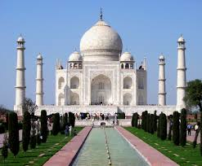
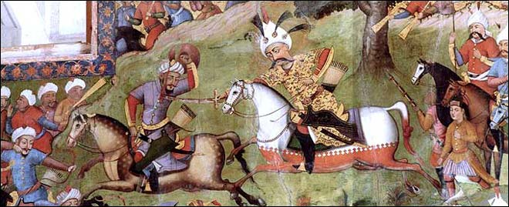
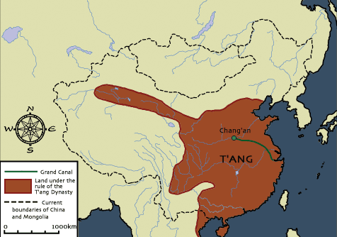
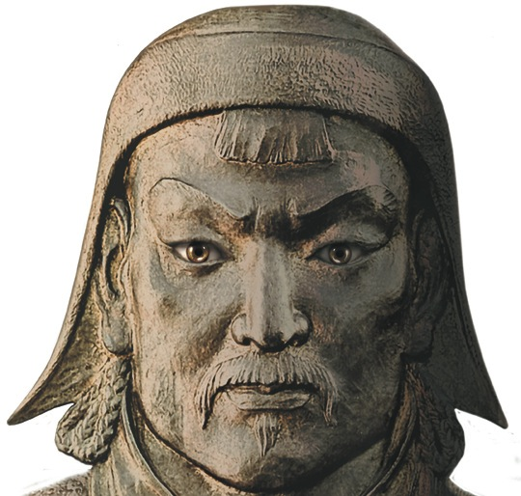
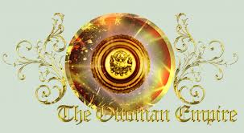
Post-Classical Asia and Beyond

Slide 2
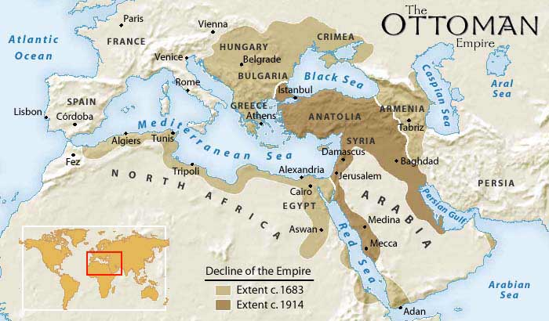
Rise of the Ottoman Empire
The Ottomans, a nomadic group of Turkish people originally from Central Asia
Emerged as rulers of the Islamic World in the 13th c.
Captured Constantinople in 1453
Located between Europe and Asia and interacted with the East and the West

Slide 3
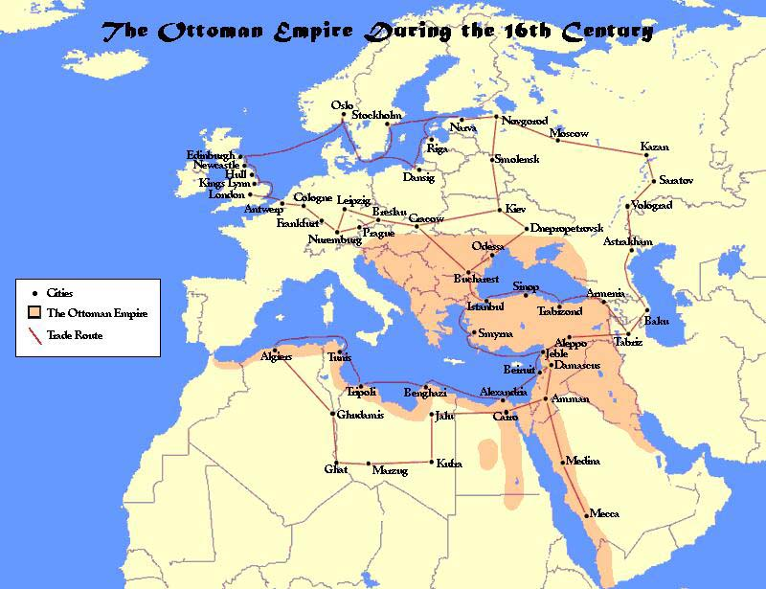
The Ottoman Empire During the 16^{c}

Slide 4
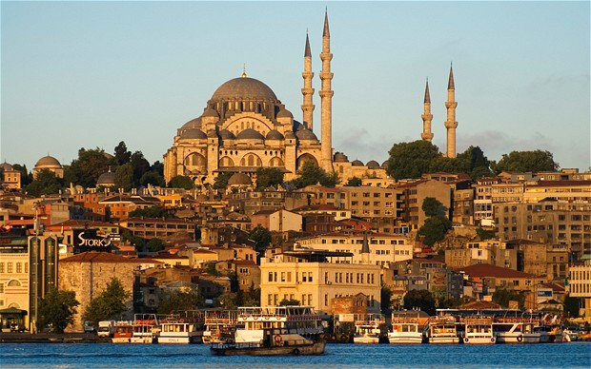
Moved their capitol from Constantinople to Istanbul
Conquered Egypt and North Africa
Reunited Muslim world except for Persia and Afghanistan
Took parts of Eastern Europe

Slide 5
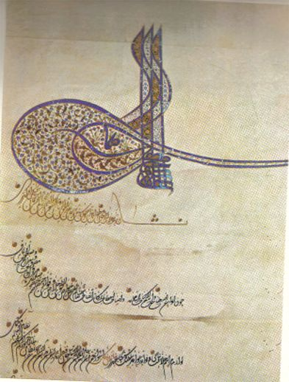
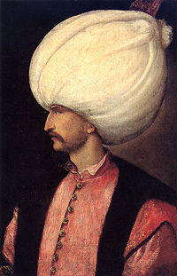
Suleiman the Magnificent
Notes:
Suleiman’s state occupied the crucial link between three continents and controlled western Asia, eastern Europe, and northern Africa, while dominating the surrounding seas. Istanbul, the capital, became one of the largest and wealthiest cities in the world, attracting flocks of diplomats, merchants, and artists, who came to reap its riches. “Suleyman the Magnificent” was a title bestowed on him by the Europeans.
Sultan Suleiman was appraised by Lord Eversley, author of “The Turkish Empire: Its Growth And Decay” published in 1918, as – quote: “the greatest of the Ottoman race who created the Empire, and in that generation of famous rulers of Europe, including Charles V, Francis I, Leo X, Henry VIII, Sigismund of Poland and others, he excelled them all in the deeds and qualities which constitute the greatness and fame of a ruler."
European travelers to his Empire returned with similar stories of Suleiman the Magnificent. In 1553 a report by the Venetian Ambassador, Bernardo Navagero, reads: "The Turkish Court is a superb sight, and most superb is the Sultan himself. One's eyes are dazzled by the gleam of gold and jewelry. Silk and brocade shimmer in flashing rays. What strikes one about Suleiman the Magnificent is not his flowing robes or his high turban. He is unique among the throng because his demeanor is that of a truly great emperor."

Slide 6
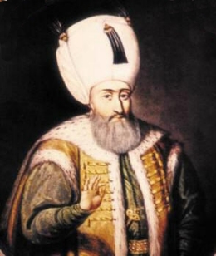
Under Suleiman the Magnificent, the Ottoman Empire reached its height
Introduced new laws and built schools and Mosques
Rebuilt Constantinople and fixed many existing structures.
The Ottoman fleet controlled much of the trade in the Mediterranean Sea until their defeat in 1571 by Spaniards and Venetians

Slide 7
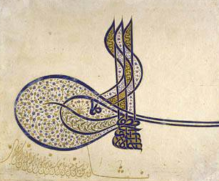
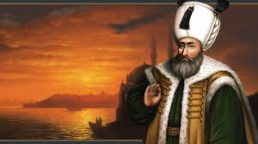
Suleiman was the first major ruler of the Ottoman empire (1520-1566)
He served as both a political and religious ruler
Sultan – political ruler
Caliph – religious leader
Suleiman used a well-trained army and bureaucracy to carry out his rule

Slide 8
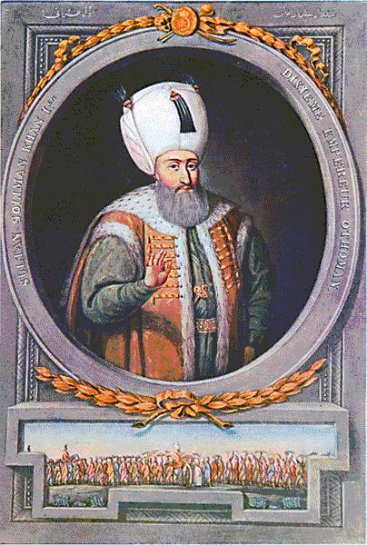
Suleiman had to create laws to govern many different types of people – Christians, Muslims, and Jews
Non-Muslims would be allowed to worship as they pleased, as long as they were loyal to him
He reformed the administration of the country as well, and created laws to make it run better

Slide 9
The heart of the Ottoman system was the Sultan and his court
Sultan governed from Istanbul
Under the Sultan, the Empire was well organized
Assisted by the Janissaries (soldiers recruited from childhood)

Slide 10
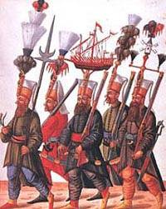
Janissaries

Slide 11
Culturally diverse
GUN POWDER
Very prosperous because it had control of the crossroad of trade.
Jewish and Christian communities had their own leaders
Governed by their own laws and collected their own taxes

Slide 12
Calligraphy

Slide 13
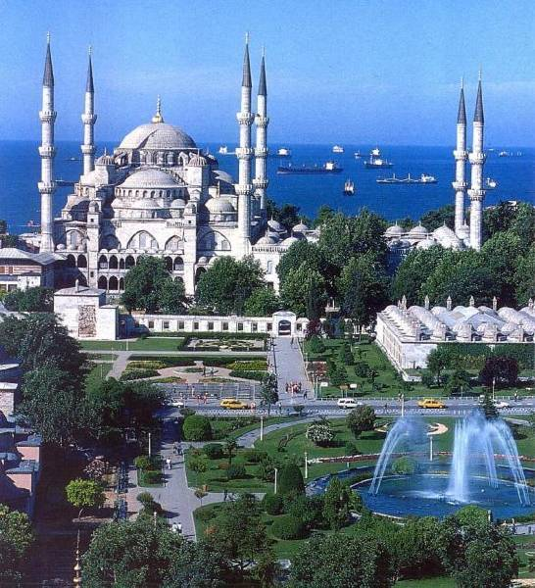
Blue Mosque

Slide 14
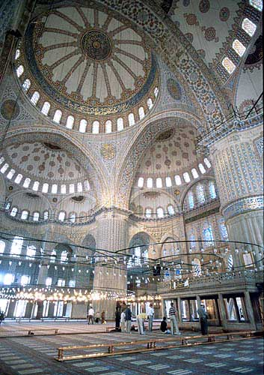
Blue Mosque - interior

Slide 15
Prayer Rug, 16c Ottoman Empire

Slide 16
Qur’an Page: The Angel Gabriel Visits Muhammad

Slide 17
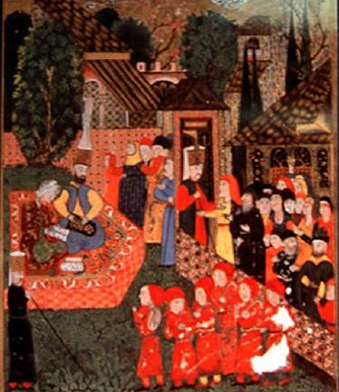
Collection of Taxes in Suleiman’s Court

Slide 18
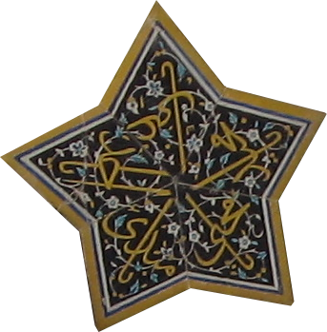
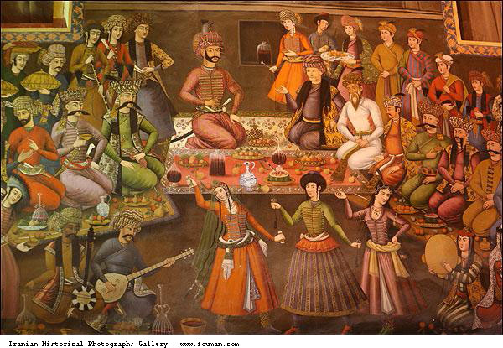
Safavid Empire in Persia
Islam also spread to Persia
The Safavids created an Islamic empire in Persia in the 1500s
Were Shi’ite Muslims
Opposed the Ottomans who were Sunni Muslims

Slide 19
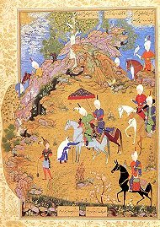
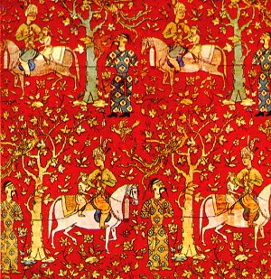
Had a different identity than their neighbors because of their religion- still affecting Iran today
Safavid rule extended as far south as the Persian Gulf and east to the Indus River
Rulers were known as Shahs
Shahs used large standing armies to maintain control
The court became famous for its beautiful palace carpets and paintings

Slide 20
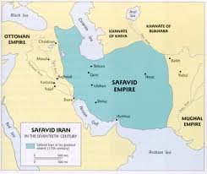

Slide 21
Ogier Ghiselin de Busbecq, Hapsburg Ambassador to Suleiman the Magnificent, Constantinople, from letters sent to the Austrian Emperor, 1554 to 1562
“The sultan’s hall was crowded with people, . . . but there was not in all that great assembly a single man who owed his position to anything save valor and merit. No distinction is attached to birth among the Turks. . . . In making his appointments, the Sultan pays no regard to any pretensions on the score of wealth or rank, nor does he take into consideration recommendations or popularity. He considers each case on its own merits, and examines carefully into the character, ability, and disposition of the man whose promotion is in question. . . . Those who receive the highest offices from the Sultan . . . do not believe that high qualities are either natural or hereditary, nor do they think that they can be handed down from father to son, but that they are partly the gift of God, and partly the result of good training [in state schools], great industry, and unwearied zeal. . . Among the Turks, therefore, honors, high posts, and judgeships are the rewards of great ability and good service. If a man be dishonest, or lazy, or careless, he remains at the bottom of the ladder. This is the reason that they are successful in their undertakings . . . and are daily extending the bounds of their empire.”

Slide 22
William Eton, British consul and merchant who lived many years in the Ottoman Empire, from his book about his life and travels, late 18th century C.E.
“General knowledge is little if at all cultivated; every man is supposed to know his own business or profession, with which it is esteemed foolish and improper for any other person to interfere. The man of general science, a character so frequent and so useful in Christian Europe, is unknown; and any one, but a mere artificer, who should concern himself with the founding of cannon, the building of ships, or the like, would be esteemed little better than a madman.
. . . With regard to the general ideas entertained by all ranks in Turkey, relative to commerce, they are no less narrow and absurd . . . ‘We should not trade,’ say they, ‘with those beggarly nations, who come to buy of us rich articles of merchandise, and rare commodities, which we ought not to sell them, but we should trade with those who bring to use useful and valuable articles, without the labor of manufacturing, or the trouble of importing them on our part.’ . . . It is therefore no wonder that the foreign commerce of the Turks is comparatively trifling. . . . They have few bills of exchange, or any of the modes of transacting business. The effects which the insecurity of property, and the watchful avarice of the government produce upon commerce, are striking.”

Slide 23
Quick Quiz
7. What year did the Ottomans conquer Constantinople?
1463
1453
1483
1443

Slide 24
8. What did the Ottomans change the name of Constantinople to?
Antalya
Moscow
Istanbul
Hagia Sophia

Slide 25
9. What did Suleiman do for the Ottoman Empire?
New laws
Built schools
Built Mosques
All of the Above

Slide 26
What area of land were the Safavids in charge of?
A. Eastern Europe
B. Persia
C. India
D. China

Slide 27
11. What type of Muslims lived in the Safavid Empire?
Sunni
Shi’ite
Sufi

Slide 28
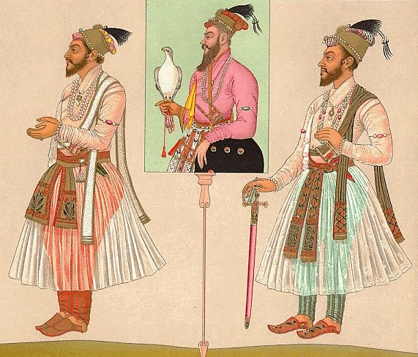
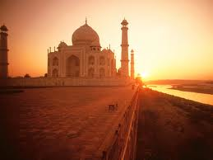
The Muslim Invasions
In the 11th and 12th centuries, Turkish Muslims invaded India’s northern plains, destroying Hindu temples and cities
Large number were killed
Muslims established independent kingdoms in Northern India, known as Sultanates

Slide 29
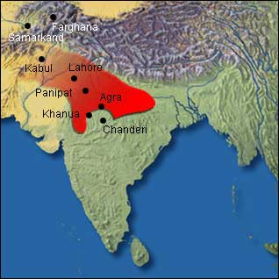
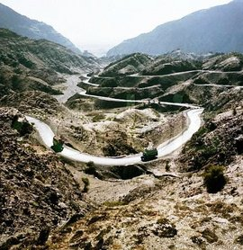

Slide 30
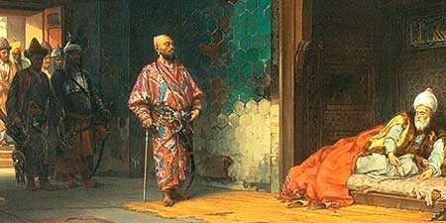
The most important Sultanate was in Delhi around 1200
The Sultans ruled in India for the next 320 years
Never adapted Indian ways
At the end of the 14th c. the Mongol ruler Tamerlane destroyed the city of Delhi and slaughtered its inhabitants

Slide 31
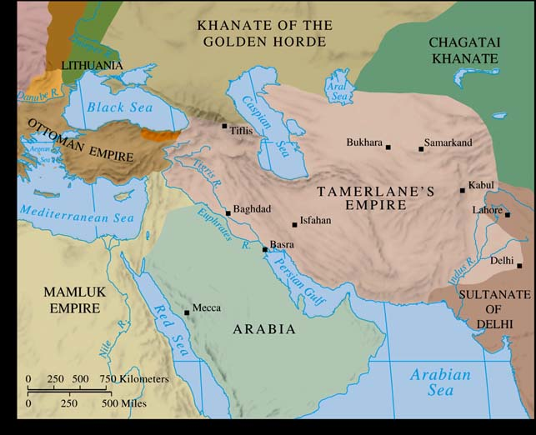

Slide 32
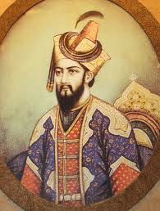
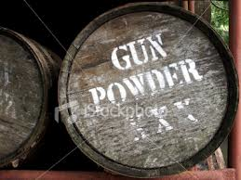
The Mughal Empire (1526-1837)
In 1526, Babur, a descendant of both Tamerlane and Chinggis Kan, defeated the Sultan of Delhi and founded the Mughal Empire
Muslims with close ties to the Safavids
Gunpowder Empire

Slide 33
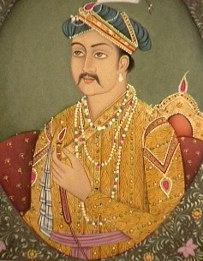
Akbar the Great (1542-1605)
Most famous ruler, Babur’s grandson
He conquered neighboring Muslims and Hindu states, uniting Northern India under his rule
Promoted religious tolerance
Ended taxes Hindus had to pay
Divided empire into 12 provinces

Slide 34
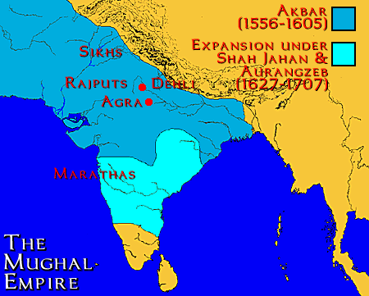
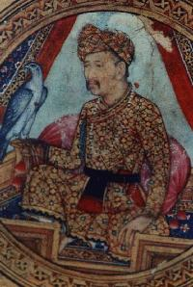

Slide 35
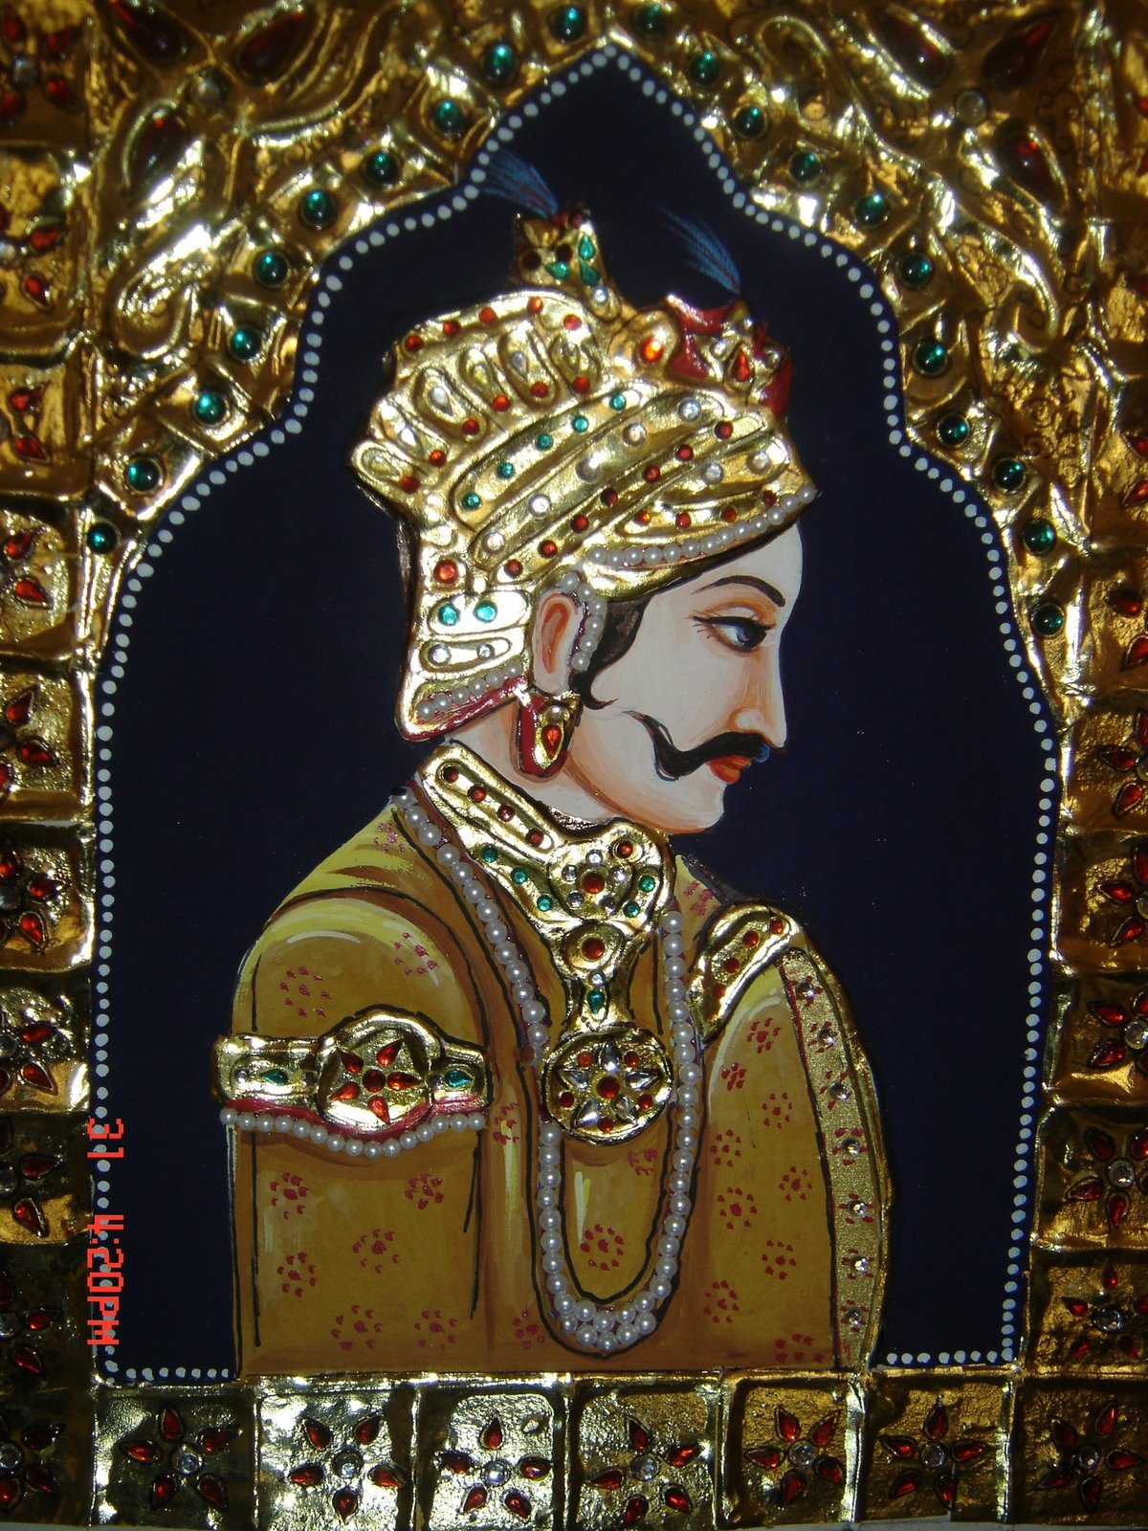
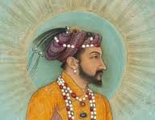
Well trained officials to enforce laws and collect taxes
Encouraged learning, painting, music, and literature
His grandson, Shah Jahan (1628-1658), was less nice to the Hindus
Reinstated taxes, destroyed temples
Many people converted to Islam to escape the taxes and move up the caste system

Slide 36
The Mughal Dynasty
As the famine increased, men abandoned towns and villages and wandered helplessly. It was easy to recognize their condition: eyes sunk deep in head, lips pale and covered with slime, the skin hard, with the bones showing through, the belly nothing but a pouch hanging down empty, knuckles and knee-caps showing prominently. One would cry and howl for hunger, while another lay stretched on the ground dying in misery; wherever you went, you saw nothing but corpses.

Slide 37
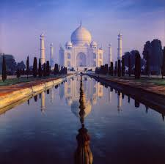
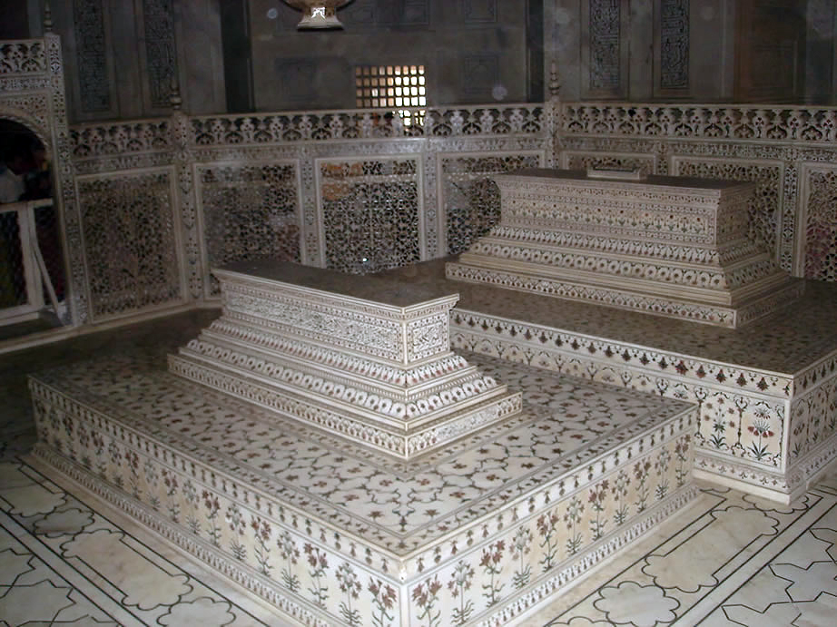
Under Jahan, art and architecture flourished
Built the Taj Mahal, as a tomb for his wife
Continued to rule until 1857 as a series of small independent kingdoms
Eventually fell apart
http://www.youtube.com/watch?v=5SjTwS7Xv-s

Slide 38
The Decline of the Mughals
By the 1600s, Hindu rebellions and a new emerging religion, Sikhism, led to the decline of the Mughals
Most Indians had held on to Hindu customs and had not converted to Islam
Later Mughal rulers abandoned religious tolerance, so this made many Hindus angry

Slide 39
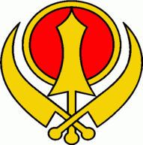
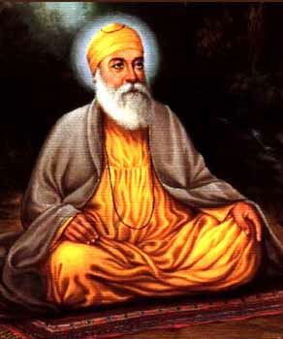
Sikhism
Founded in Northern India in 1469 by Guru Nanak
Guru: spiritual guide or teacher
Believe in one God and that everyone is equal in his eyes

Slide 40
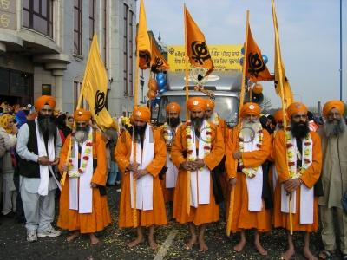
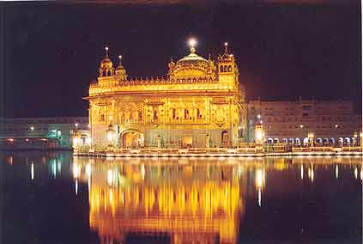
Reject the Caste system
Can reach salvation by practicing devotion to God, truthful living, service to humanity, and standing up for justice for all people
Men cover their hair with a turban and women leave it uncut
Bit of Hinduism and Islam
http://www.youtube.com/watch?v=hGqYF9eSIyc

Slide 41
Decline of Muslim Empires
These three Muslim empires declined as Europe and its countries expanded
Rulers declined, and brought their countries with them
Lack of innovation and change – not “dynamic”, like Europe
Were all land empires – didn’t focus on sea power or trade, like Europe
Superiority complex – considered themselves superior to Europe, didn’t pay much attention to European growth

Slide 42
Analyze the Documents
Title (circle)
Date (circle)
Position (positive or negative)
Why was it written? (who will read it?)
A. What is it about? (what do you learn?)
B. How do you know this? (evidence)
C. 3 Important facts (underline)

Slide 43
Quick Quiz
12. The Mughal Empire was what type of Empire?
Hindu
Tolerant
Gunpowder
Advanced

Slide 44
Shah Jahan changed Akbar’s ruling that____
People could be whatever religion they wanted
That non-muslims no longer had to pay a tax
People spent time devoted to art and learning
A and B

Slide 45
Which of the below led to the decline of the Mughal Empire?
Hindu rebellions
The forced conversion of Hindu people to Islam
The rise of Sikhism
All of the above

Slide 46
15. Sikhism is a combination of what two religions?
Christianity and Islam
Islam and Buddhism
Hinduism and Buddhism
Hinduism and Islam

Slide 47
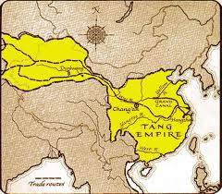
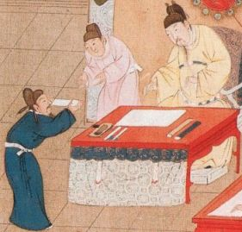
Tang Dynasty (618-907)
Golden Age in China
Tang rulers suppressed peasant uprisings, reunited China, revived feudalism, and brought peace
More than 50 million people
Expansionists
Civil service exams

Slide 48
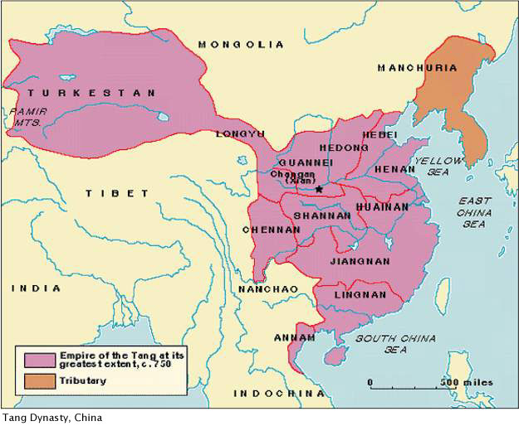
Notes:
http://www.wwnorton.com/nrl/english/nawol/maps/MAP11CHI.JPG

Slide 49
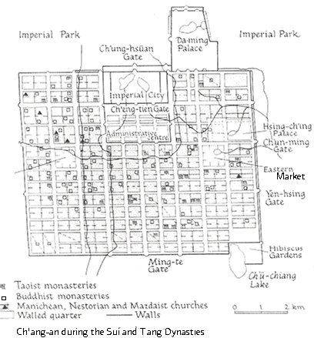
Capital at Chang’an
Merchants from Persia, India, Arabia, and Syria could be found there
Advances in architecture, sculpture, painting, and porcelain
Accomplished in literature
Glazed pottery

Slide 50
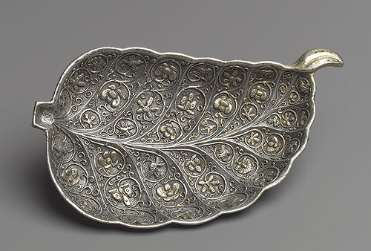
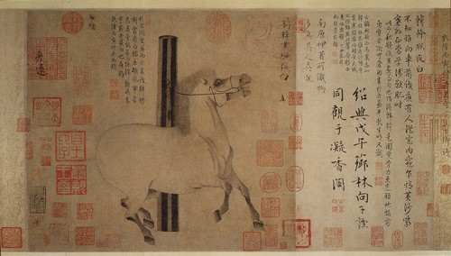
Dish in the Shape of a Leaf
Night Shinning White
Notes:
Dish in the Shape of a Leaf, Tang dynasty (618–906), late 7th–early 8th century China Silver with parcel gilding
Night-Shining White, Tang dynasty (618–906), 8th century Attributed to Han Gan (Chinese, active 742–56) China Handscroll; ink on paper

Slide 51
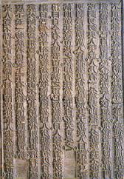
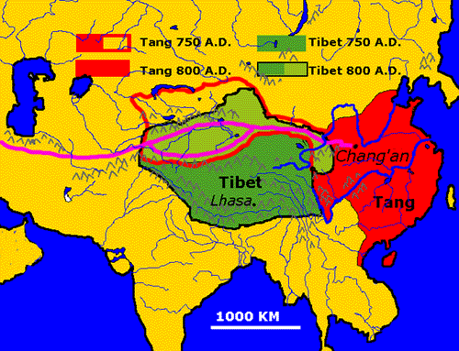
Metalwork and jade
Paintings depicted nature with brushwork on scrolls
Poetry celebrating court life
Developed block printing
Grew the Silk Road

Slide 52
Standing Court Lady
Seated Buddha
Notes:
Seated Buddha, Tang dynasty (618–906), ca. 650 China Dry lacquer with traces of gilt and polychrome pigments
Standing court lady, Tang dynasty (618–906), mid-7th century China Earthenware with pigment

Slide 53
Revenue base began to erode
Population grew more quickly than land and money could provide
Began outlawing contact with other ethnicities
Rebellions
Ended in chaos and civil war
Notes:
http://www.albertomanuelcheung.com/Tang%20Horses2.jpg

Slide 54
http://www.youtube.com/watch?v=NIC4zom3w0g

Slide 55
Song Dynasty (960-1279)
After the Tang fell, China shrunk in size
Song emerges in South China
Time of great social and economic progress
Introduced paper currency
Pay taxes using money rather than grain
Standardized coins

Slide 57
Eliminated forced labor
Increased crop production (irrigation)
Used the Grand Canal (connected Beijing, Hwang Ho, and the Yangtze River)
Used to ship grain
Caravans carried silk along the Silk Road
Introduced gunpowder, compass, moveable type printing

Slide 59
Had footbinding (feet bound in tight bandages)
Small feet were considered attractive, limited mobility for women
Faced the treat of tribes to the North
Song allied themselves with the Mongols
Mongols overran the empire and set up a new dynasty called Yuan

Slide 60
Influence on Japan
Brought aspects of Chinese culture there
Confucianism instilled loyalty to the family and ruler
Buddhism taught to renounce selfish desires
Daoism encouraged a love of nature
Ruler of Japan set up a court like the Chinese
However it was not an exact copy

Slide 61
Imperial government grew weak
Strong noble appointed himself as Shogun
Shoguns were the real rulers while the emperor was a figurehead
Shogun was at the top of Feudalism
Samurai=Knights
Daimyo=Noble
Strict code of honor (bushido)=Chivalry

Slide 62
Quick Quiz
16. How were people given jobs in the Tang Dynasty?
Based on rank
Based on their parents
Based on civil service exam
Based on wealth

Slide 63
17. What type of printing did the Tang Dynasty develop?
Moveable type
Block printing
Printing press
Square printing

Slide 64
18. Which of the following did the Song not introduce?
Paper currency
Standardized coins
Grand Canal
Block printing

Slide 65
19. What other place also practiced feudalism?
Byzantine Empire
Western Europe
Persia
Ottoman Empire

Slide 66
20. What rank in Japanese feudalism actually held all the power?
Emperor
Shogun
Samurai
Daimyo

Slide 67
Crash Course
Intro to the Mongols
http://www.youtube.com/watch?v=szxPar0BcMo

Slide 68
Mongol Empire
Located in the steppes (Europe to Asia)
Consists of treeless grassland and is between forests in the north and deserts and mountains in the south
Nomadic people lived there
Used grassland as pastures

Slide 69
Environment where the nomadic people developed horsemanship and fighting skills
People would leave this region and push into others
The Huns tried to invade China and then went to Europe where they helped Rome collapse
http://www.youtube.com/watch?v=ZSS5dEeMX64
Turks and Mongols also came out of this area

Slide 70
Mongols lived in the steppes of the eastern part of Central Asia
Slept in domed tents of felt
Were nomadic, excellent horsemen and archers
During the 1200’s the Mongols established the greatest empire the world had ever seen

Slide 72
Chinggis Khan unites the Mongols
Divided into several loosely organized tribes
Chinggis Khan unites them in 1206
Master of Mongolia
Set his eyes on the people outside
People did not stand a chance
200,000 skilled horsemen, used stirrups, had bow, catapults
Known for their brutality

Slide 73
He attacked northern China and took Beijing
In 1219 he went west and captured the Muslim states of Central Asia
He was feared, but also very tolerant of other religions
Let the locals keep their jobs
Promoted trade

Slide 74
Turn and Talk
Discuss with your neighbor why the Mongols might completely destroy a city, but then leave others alone when they surrendered?

Slide 75
His successors extended their rule into Persia, Russia, Iraq, and the rest of China
The Mongols had one of the largest empires ever seen
“Pax Mongolica”
Was divided into four kingdoms, each ruled by a different descendent of his

Slide 77
The Yuan Dynasty
Kublai Khan, Chinggis’ grandson, was fascinated with Chinese culture
Became emperor of Northern China I 1260
1279 he united north and south China
Held Mongols above the Chinese, but used their way of government
Claimed the mandate of Heaven

Slide 78
Marco Polo
Merchant from Venice
Journeyed along the Silk Road
Visited China in 1270s
Impressed by Kublai Khans court and the technology of the Chinese
Use of gunpowder and coal

Slide 79
Mongol Influence on Russia
13th c. they conquered much of Russia and controlled it for 200 years
Words, customs, and clothing made it into Russian culture
Moscow and its surrounding area, known as Muscovy, became the strongest Russian state

Slide 80
Muscovites eventually rebelled
In 1480, Ivan the Great declared independence
He proclaimed himself Tsar (emperor)

Slide 81
Tamerlane
In the 14th c. the Mongols held power in Central Asia
Tamerlane, a Turkish-Mongol ruler, expanded his kingdom from Smarkand into Persia, Afghanistan, Russia, Syria, Turkey, and Northern India
Known for his brutality and massacres
Empire fell soon after his death

Slide 82
What city did Tamerlane attack in India that would eventually become part of the Mughal Empire?

Slide 83
Mongol Legacy
While the Mongols did control almost all of Europe and Asia, they never developed a cultural identity all their own
They were most known for their ability to fight using horses and their ruthlessness in battle
The most notable thing they did was establish new trade routes

Slide 84
Source: Ata-Malik Juvaini, Genghis Khan: The History of the World Conqueror, edited by UNESCO and Manchester University Press,
In the Spring of1221, the people of Nishapur (a city in Persia) saw that the matter was serious…and although they had three thousand crossbows in action on the wall and had set up three hundred mangonels and ballistas and laid in a correspondent quantity of missiles and naphtha, their feet were loosened and they lost hear…
By the Saturday night all the walls were covered with Mongols;…The Mongols now descended from the walls and began to slay and plunder…They then drove all the survivors, men and women, out onto the plain; and…it was commanded that the town should be laid waste in such a manner that the site could be ploughed upon; and that…not even cats and dogs should be left alive…
They severed the heads of the slain from their bodies and heaped them up in piles, keeping those of the men separate from those of the women and children.

Slide 85
Quick Quiz
Which of the following is not a characteristic of the Mongols?
Nomadic
Excellent fighters
Diplomats
Skilled horsemen

Slide 86
Which Mongol leader united them?
Tamerlane
Chingghis Khan
Kublai Khan
Ivan the Great

Slide 87
What was the whole Mongol empire called?
Mongolia
Pax Mongolia
Pax Mongolica
Khanate

Slide 88
What did Kublai Khan claim that asserted his right to rule in the Yuan Dynasty?
Power
Dominancy
Who he descended from
Mandate of Heaven

Slide 89
Which of the following is the most important thing that came from the Mongols being in control of Russia?
Russia eventually declared its independence under a Tsar
Russia picked up some of the Mongols clothing
Russia used some of the Mongols words

