Slide 1
Propaganda

Slide 2
Definition
“Propaganda is neutrally defined as a systematic form of purposeful persuasion that attempts to influence the emotions, attitudes, opinions, and actions of specified target audiences for ideological, political or commercial purposes through the controlled transmission of one-sided messages (which may or may not be factual) via mass and direct media channels.”

Slide 14
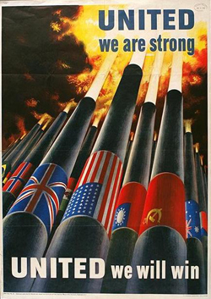

Slide 21
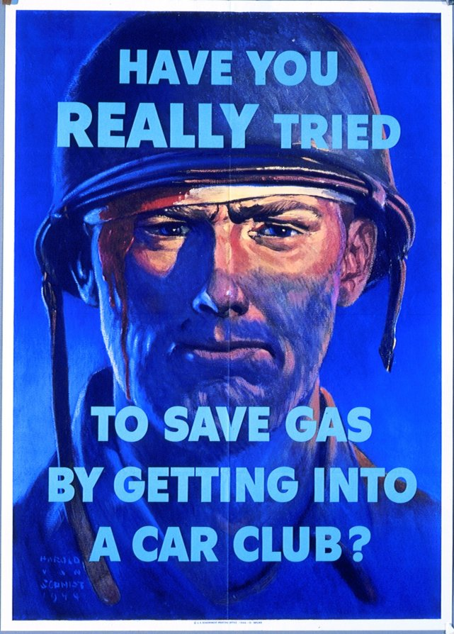

Slide 25
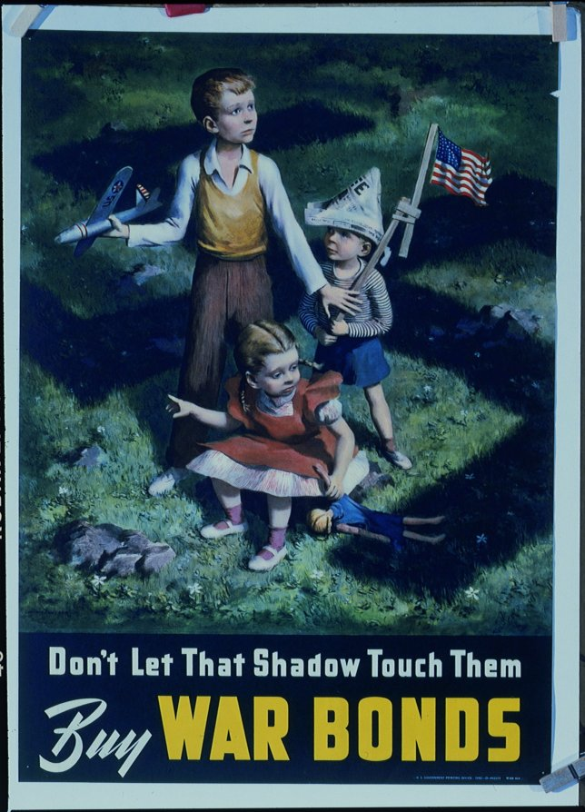

Slide 30
Propaganda, of course, is not always successful. Its effectiveness depends upon a variety of factors, including the receptivity of an audience to the message and a favorable social context. Propaganda alone, regardless of the skills of its users, cannot win wars or transform thinking human beings into mindless automatons. Regardless of the power of their messages, for instance, the Nazis could not turn back the tide of Allied victory after the middle of 1943. Nazi propaganda delayed defeat but it could not bring Germany victory.

Slide 31
http://www.youtube.com/watch?v=tk0tw0P3894 http://www.youtube.com/watch?v=tk0tw0P3894
AND propaganda wasn’t limited only to posters, it also came in the form of music, leaflets dropped from planes, books, radios shows, and many other forms of media…

Slide 32
Today’s Assignment
You may work in partners but only 2!
Each person will be responsible for designing a poster to illustrate their support of America, Great Britain, Germany, Russia, or Italy. It can make fun of another country, as long as it makes your country look good.
Each poster will be done on a big white piece of paper and colored neatly.
Along with each poster you need to design a message that goes along with your picture.

Slide 33
Grading RUBRIC
Here is how you will be scored on this activity:
50 Points- Neatness and Creativity of the Poster
30 Points- Relationship of Slogan to the Poster
20 Points- Turned in on Time

