Slide 1
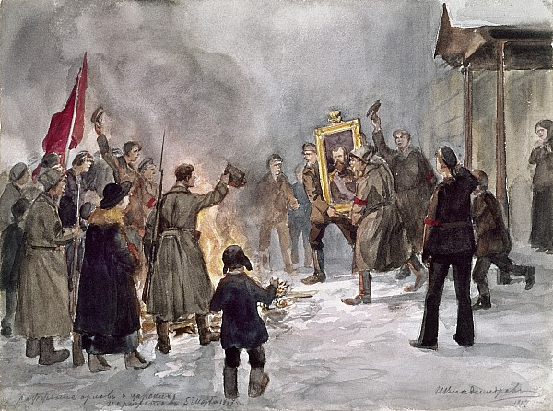
The Russian Revolution

Slide 2
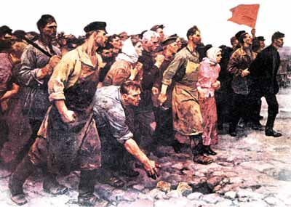
When is it ok for citizens
to rebel against their
country/government?

Slide 3
Declaration of Independence
When in the Course of human events, it becomes necessary for one people to dissolve the political bands which have connected them with another…
But when a long train of abuses and usurpations, pursuing invariably the same Object evinces a design to reduce them under absolute Despotism, it is their right, it is their duty, to throw off such Government, and to provide new Guards for their future security.--
What do these quotes
say about revolution?

Slide 4
Final Activity
Write a paragraph answering the following question:
Describe the causes and impact of the Russian Revolution.

