Slide 1
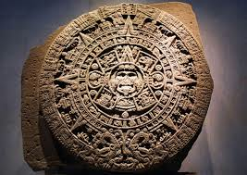
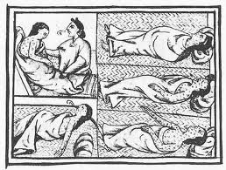
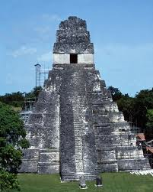
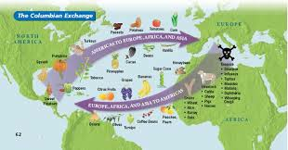
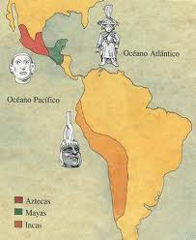
The Americas: Pre-Columbian Empires to Colonies

Slide 2
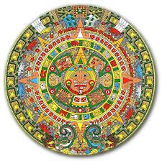
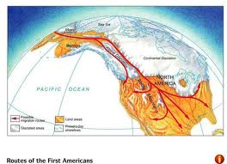
The First Americans
Scientists believe that during the last Ice Age, Asia and Alaska were attached by a land bridge where the Bering Straits are found today
Crossed the bridge in search of food and following animal migration
Spread south from Alaska

Slide 3
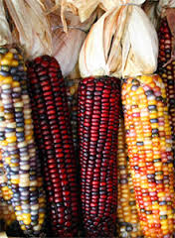
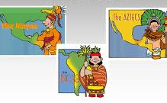
Multiplied and made it into North America, Central America, and South America
Separated by mountains and jungles, so they develop their own separate languages and cultures
“Native Americans” experienced their own Neolithic Revolution: learned to grow corn (maize)
Civilizations emerged in Mesoamerica

Slide 4
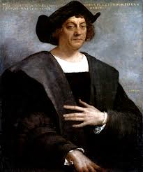
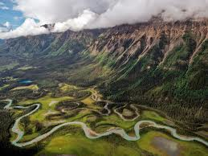
These civilizations are known as pre-Columbian because they existed before Columbus came in 1492
Did not emerge in river valleys
Learned to plant corn
Became the basic food crop in the Americas, led to the development of permanent settlements and large cities

Slide 6
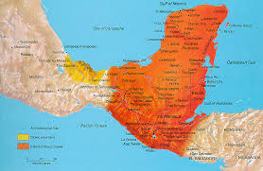
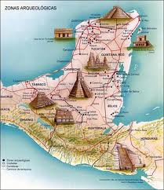
The Maya (1500 BC-1546 AD)
Earliest civilizations were the Olmecs and Toltecs
Then the Mayans developed in present day Guatemala
Each city had its own chief ruler, who was considered half man half god
Most Mayans were peasant farmers

Slide 7
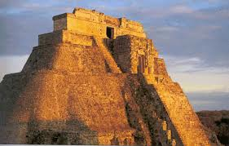
Small class of craftsmen
Nobility were a small hereditary class, who performed sacred ceremonies and assisted rulers
Engaged in frequent wars and practiced human sacrifice
Ball game

Slide 8
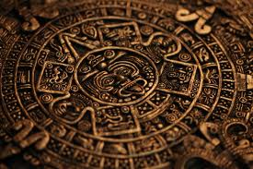
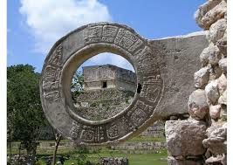
Achievements:
Builders: built huge cities in the jungle with large palaces, temples, and pyramids
Writing System: own hieroglyphics
Math and Science: calendar of 365 days
Artistry: colorful murals, ball game

Slide 10
Eldorado Ball Game
http://www.youtube.com/watch?v=yDSyhqMEzek

Slide 11
Around the 9th c. the Mayans experienced a crisis
Not sure if it was a food shortage, epidemic, or great war that ended the Maya civilization
Migrated north and built new cities
Constant warfare from the 13th-16th c. led to the final decline

Slide 12
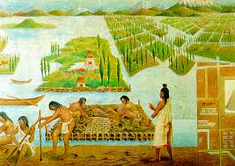
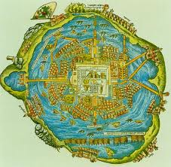
Aztecs (1200-1521)
Alliance of several local people
Learned to grow corn from their neighbors
Floating gardens
Capital at Tenochtitlan, on island in middle of Lake Texcoco
Aligned temples based on the movements of the sun and moon

Slide 13
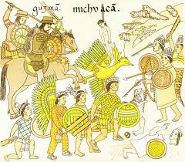
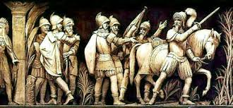
Engaged in frequent wars
End because of Europeans
Complex social organization
all-powerful emperor
Nobles: government, army, or priesthood
Commoners: farmers, fishermen, craftsmen, warriors
slaves

Slide 14
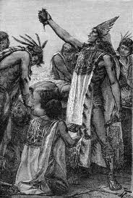
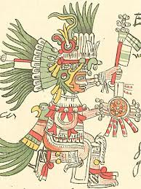
Worshipped many gods
Sun God was most important (Huitzilopochtli)
Though Sun God needed human blood, so they practiced a lot of human sacrifice
Believed in struggle between forces of good and evil

Slide 15
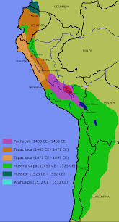
Inca Empire (1200-1535)
Along Pacific coast and in the Andes Mountains of South America
Terraced mountains and grew potatoes
Kept llamas and alpacas
Built upon the achievements of earlier people
Eventually ruled much of Peru, Ecuador, Bolivia, and Chile

Slide 16
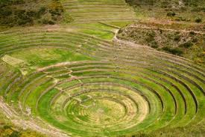
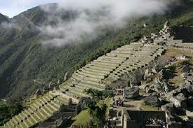
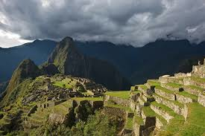

Slide 17
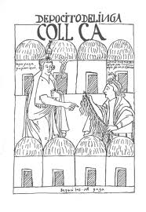
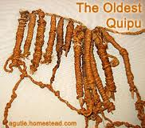
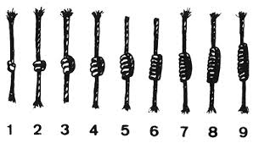
Built stone roads
Preserved food
Never developed carts with wheels
No form of writing
Used quipu-bundles of knotted and colored ropes to count, keep records, and send messages

Slide 18
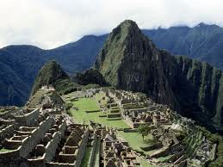
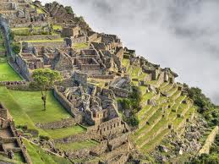
Constructed vast stone buildings high in the Andes
No cement
Machu Picchu was a famous fortress in the Andes Mountains
Blocks weigh 50 tons, but fit so close together you cannot put a knife though the joints

Slide 19
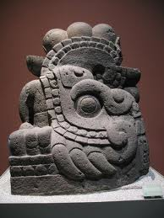
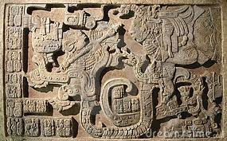
Art
Made stone sculptures to decorate the sides of temples and palaces
Ceramic bowls with human and animal forms for religious ceremonies
Used to ward off demonic spirits

Slide 20
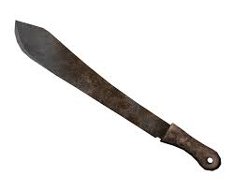
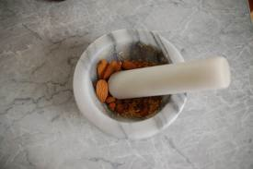
Gender Roles
Established at birth
Boys were given a machete and girls were given a stone grinder
Boys taught crafts and girls taught to cook
Women made maize into flour
Women could also hold jobs outside the home

Slide 21
Quick Quiz
What civilization created a calendar with 365 days?
Aztec
Maya
Inca
Olmecs
Toltecs

Slide 22
What civilization had its capitol in the center of a lake?
Mayas
Aztec
Incas
Olmecs
Toltecs

Slide 23
What civilization used terraced farming?
Olmecs
Toltecs
Aztec
Maya
Inca

Slide 24
4. What made the Inca different from the Aztec and Maya?
A. Monotheistic
B. democratic government
C. located in Mexico
D. used knots instead of actual writing
E. more human sacrifice

Slide 25
In what way did the Maya and Aztec differ?
A. Religion
B. Social Structure
C. Use of Sacrifice
D. Reason why they ended
E. One was located in South America

Slide 26
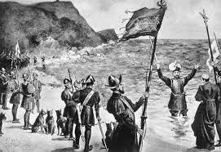
Columbian Exchange: Beginning
The writings of Marco Polo increased interest in trade with Asia
Goods were carried to Constantinople and then shipped to the Italian city-states
When the Ottoman Turks conquered the Byzantine, trade declined and a water route was needed
The Renaissance encouraged people to explore the oceans
New innovations like the compass and the triangular lateen allowed people to explore

Slide 27
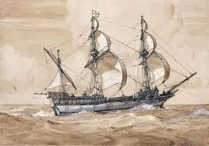
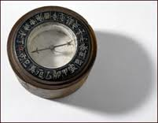

Slide 28
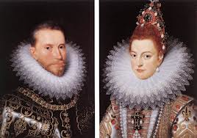
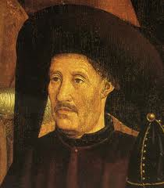
Age of Discovery
Spain and Portugal lead the way
Prince Henry of Portugal developed a lighter sailing ship and sponsored expeditions to Africa
Ferdinand and Isabella had just took over the Muslim areas of Spain and kicked out the Jews
They hoped to further the spread of the Christian faith

Slide 29
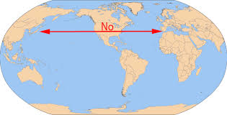
Christopher Columbus
From Genoa in Italy
Thought he could reach Asia by sailing west
Rulers of Spain gave him 3 ships to try
Accidentally landed in the Americas
“discover” provided new sources of wealth and raw materials that would alter the economy of Europe

Slide 30
Columbian Exchange
Exchange of products and ideas between the Americas and Europe
European diet was improved with corn, potatoes, chocolate, turkeys, tobacco
Americas received wheat, sugar, cattle, horses, sheep, disease

Slide 32
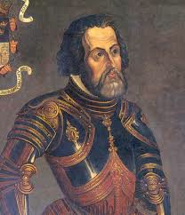
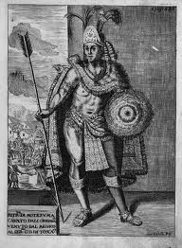
Conquest of Mexico
Conquistadors arrived in the Americas
Small numbers with horses and firearms were able to overcome large numbers of native Americans
Hernan Cortes conquered the Aztecs in search of gold and silver
The Aztecs fought back, but the introduction of smallpox knocked them out

Slide 33
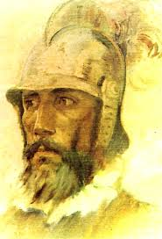
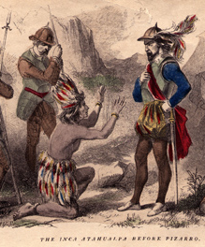
Conquest of Peru
Francisco Pizarro conquered the Inca
Fought a much larger Indian force, but he had better technology
He pretended friendship and then ambushed the Inca and murdered the emperor
Treated the Indians harshly and forced them to accept Christianity

Slide 34
Colonial Latin America
Spanish asserted their dominance, religion, and culture on native tribes
Region was transformed into Latin America
Spain set up viceroys to rule the colonies
Had to be born in Spain to have high position
Shipped Gold and Silver to Spain
Native Americans used to work the land

Slide 35
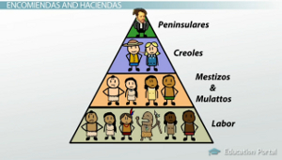
Encomienda system: system of forced labor
Jesuits built schools, hospitals, and taught
Eventually expelled

Slide 36
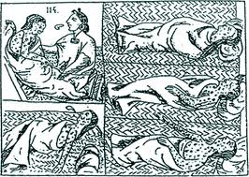
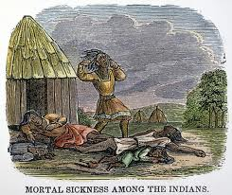
Native American population declined because had no immunity to diseases
Got smallpox, typhus, and measles
Could not survive harsh working conditions
Spanish needed stronger labor force, so began to import African slaves

Slide 38
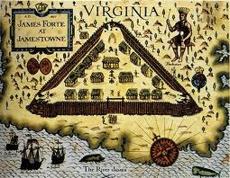
English Colonies
First permanent colony was at Jamestown, Virginia in 1607
First came for gold, but then discovered tobacco
Second was found by the Pilgrims and Plymouth Rock
Then the Puritans landed in Massachusetts bay in 1630
Came to escape religious persecution
Eventually became 13 colonies

Slide 39
Virginia Company & Gold
http://www.youtube.com/watch?v=Ne2tzfxQ6T4
http://www.youtube.com/watch?v=gFHym_W6vkE

Slide 40
Atlantic Slave Trade
Finding workers to survive harsh conditions in the colonies became a problem
Solution was the rise of the slave trade
Slavery had existed long before European intervention
However, the new Atlantic slave trade expanded slavery on an unparalleled scale

Slide 41
Enslaved people were captured by powerful African tribes
They were brought to the West Coast of Africa where they were traded to European and American slave traders in exchange for guns and other goods
Estimated the the Atlantic slave trade took away as many as 15 million African men and women

Slide 42
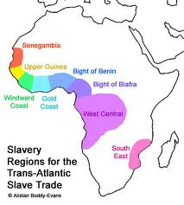

Slide 44
It decimated the population and took away all the people of child bearing age
Many died during the “Middle Passage”
Horrible conditions on voyage across the Atlantic
Most Africans worked long hours in the sugar fields of the Caribbean and Brazil
Others raised tobacco and cotton in NA

Slide 46
Effect of Slavery on Africa
Encouraged African Warfare: went to war to obtain slaves to trade for guns, rum, and other goods
Disrupted African Culture: destroyed rich heritage, created legacy of violence and upheaval
Increased Cultural Diffusion: exchange of goods and ideas increased, slavers brought new weapons to Africa and slaves brought their customs to the Americas

Slide 47
Crash Course on Slavery
http://www.youtube.com/watch?v=dnV_MTFEGIY

Slide 48
Quick Quiz
What did the writings of Marco Polo encourage?
Warfare between Europe and Asia
Increased hatred between Muslims and Christians
Increased trade with Asia
People to go out and become tourists
The expansion of the European Empire

Slide 49
The Columbian Exchange, was an exchange of what 2 things?
Guns and rum
Salt and gold
Food and disease
Products and Gold
Ideas and Products

Slide 50
Why were African slaves introduced into the Americas?
Were better farmers
Cost less
More compliant
Were less susceptible to disease
Better educated

Slide 51
What did the Africans receive for selling slaves?
Salt
Gold
Guns and rum
Bibles
Camels

Slide 52
What was a social outcome of the Slave trade?
The population of Africa grew
Africa lost many people of child bearing age
Communities established treaties with each other
Culture continued to flourish
Experienced a shortage of goods

