Slide 1
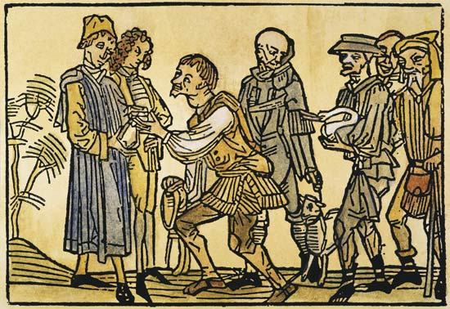
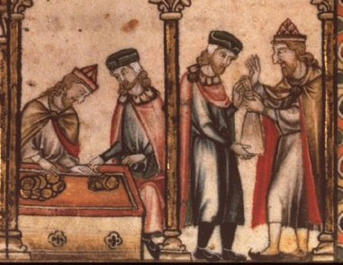
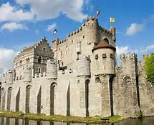
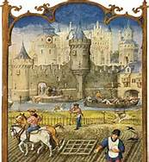
The Middle Ages in Europe

Slide 2
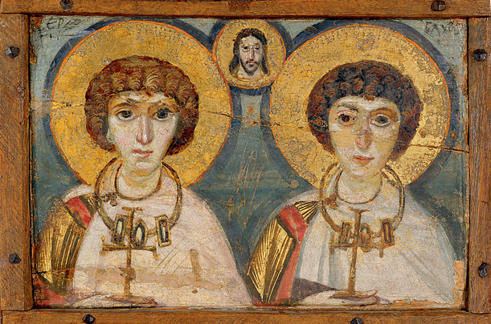
The Byzantine Empire (330-1453)
In 330 AD, Emperor Constantine moved the capital of the Roman Empire from Rome to Constantinople
It was located along trade routes by land and water
It was surrounded on three sides by water, and had thick walls, making it hard to attack

Slide 3
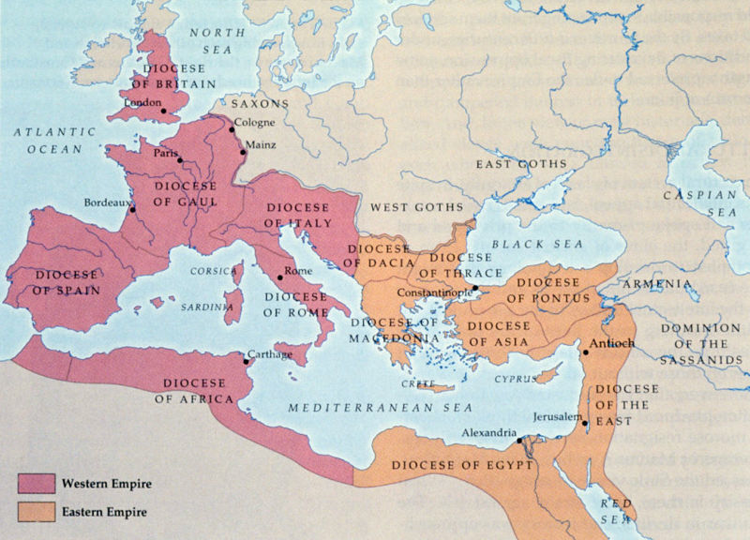

Slide 4
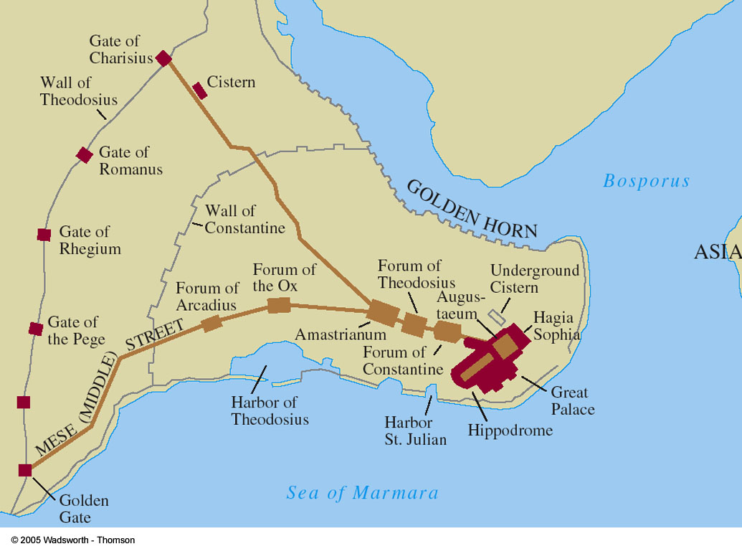
Why did it survive?
Classical Cultures: infusion of Greek, Roman, Christian, and Middle Eastern cultures
Strong Central Government: powerful emperors
Location: major center for trade
Large Army

Slide 5
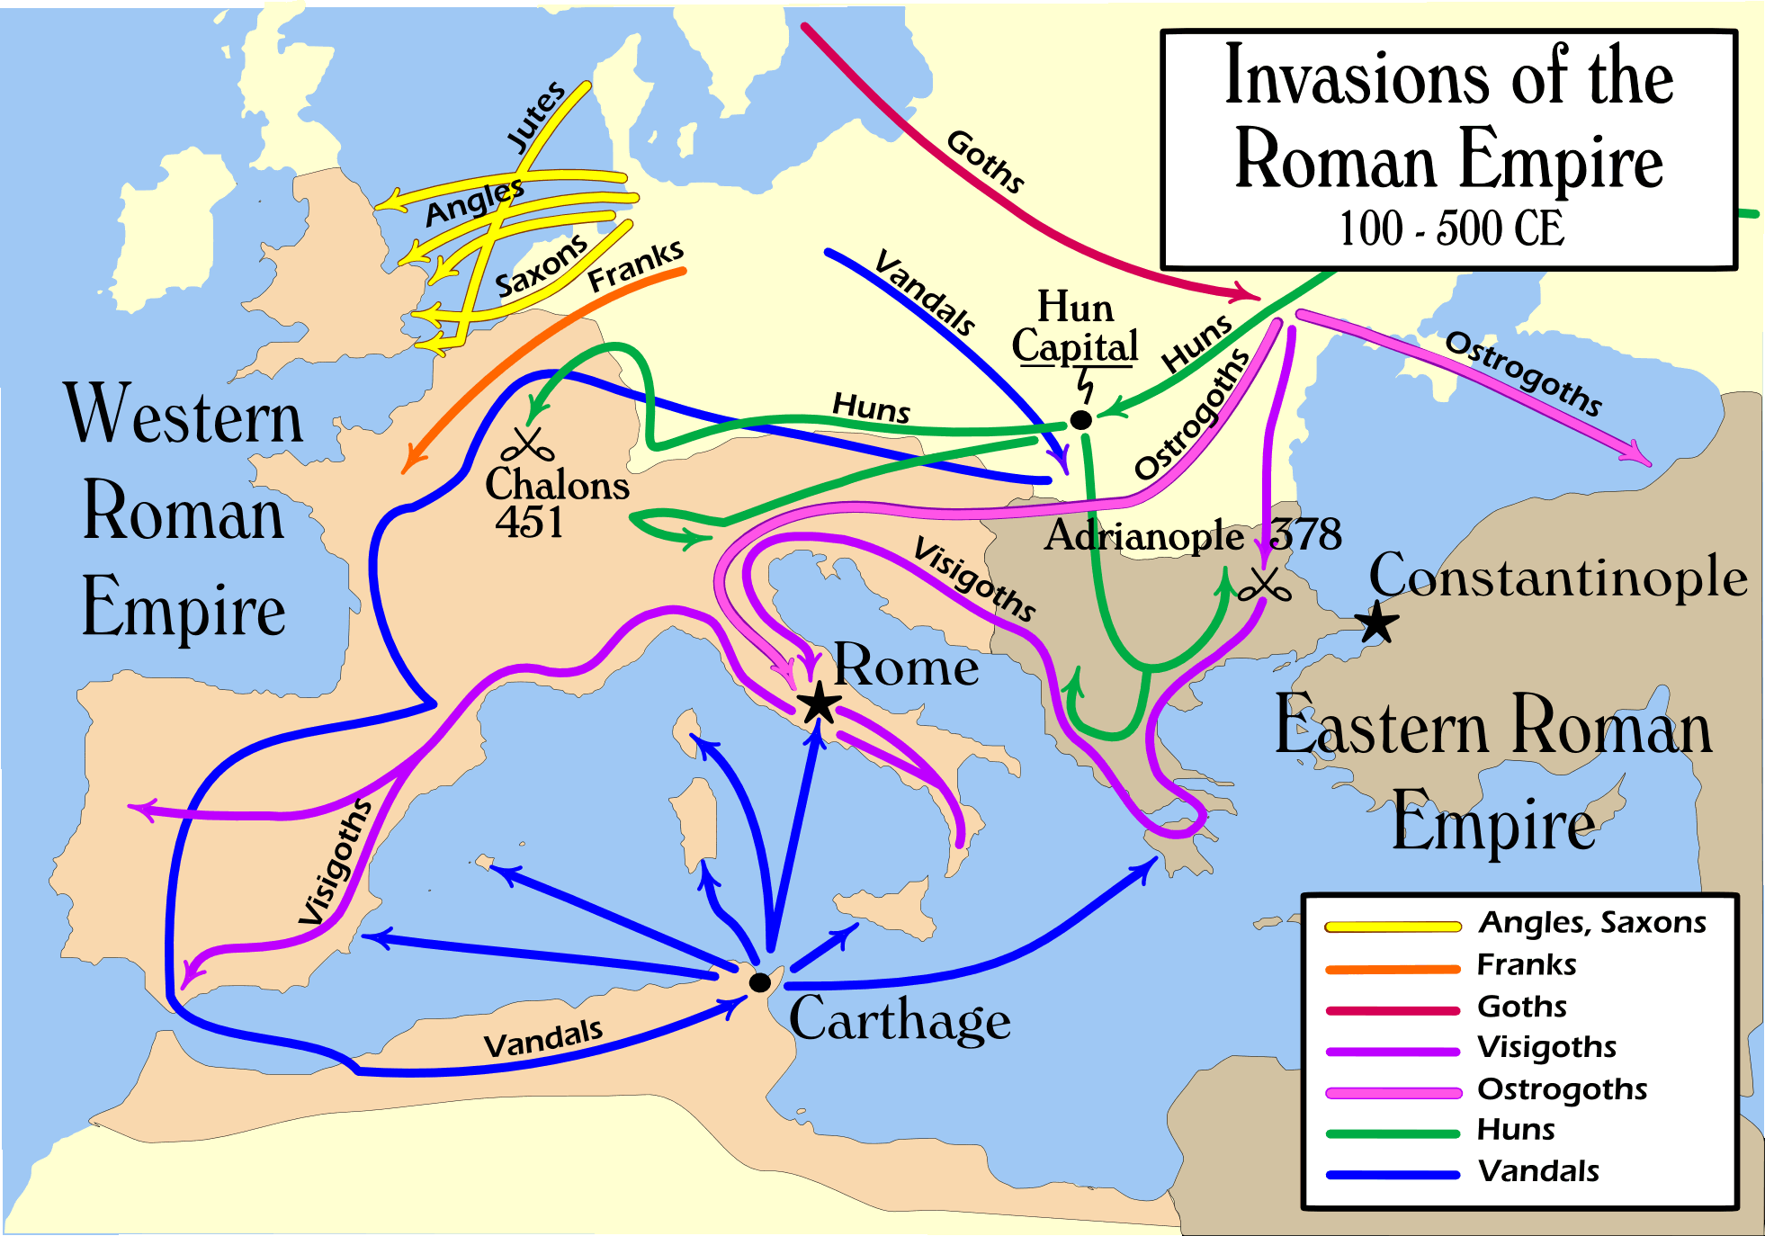
Culture
The Byzantium Empire survived while the western part of Rome collapsed
They saw themselves as continuing the Roman Empire
Continued to have an all-powerful emperor and speak Latin, but they eventually changed to Greek

Slide 6
Had their own form of Christianity
Eastern Orthodoxy: Patriarch instead of Pope, used icons, priests can marry, emperor has ultimate power

Slide 7
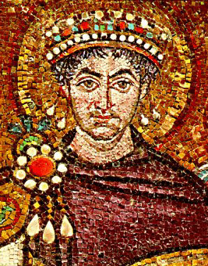
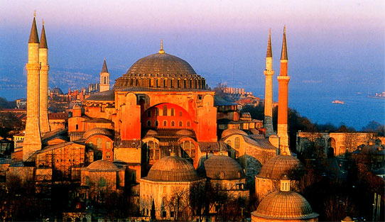
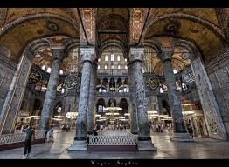
Built the Church of Hagia Sophia
Schools taught ancient Greek texts
Colorful icons and mosaics
Under Justinian (527-565) it reconquered much of the old Roman Empire

Slide 8
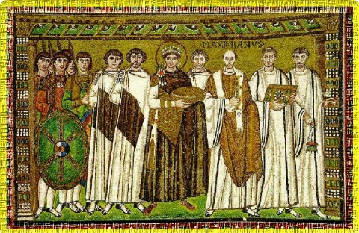
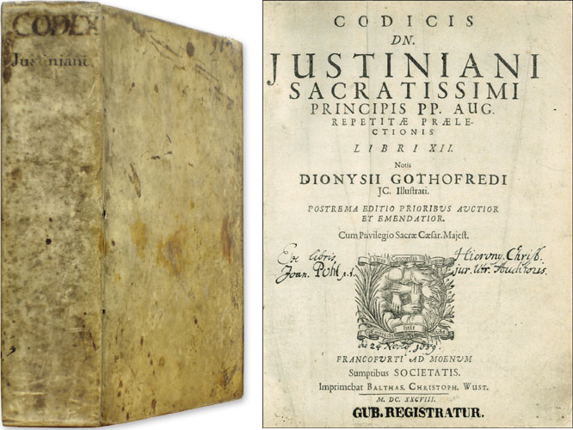
Code of Justinian
Emperor Justinian collected all of the Roman laws and organized them into a single code
Special laws regarding religion
Everyone must be part of the Eastern Orthodox faith

Slide 9
The Decline of the Byzantine Empire
Continuously fought people to the North and the Persian Empire to the east and the spread of Islam in the south
In the 600’s the Muslims took most of the empire’s territory in the Middle East
The Seljuk Turks defeated the Byzantine army in 1071 and took Asia Minor
Crusaders attacked in 1204

Slide 10
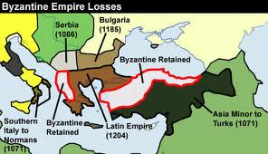
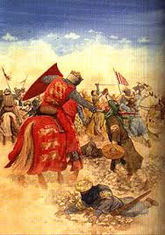

Slide 11
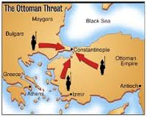
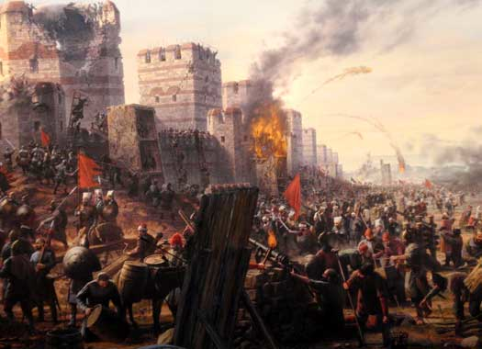
Began to unravel from attacks on all sides
By 1440, the Byzantine Empire was just the area around Constantinople
In 1453, Constantinople was finally conquered by the Ottoman Turks

Slide 12
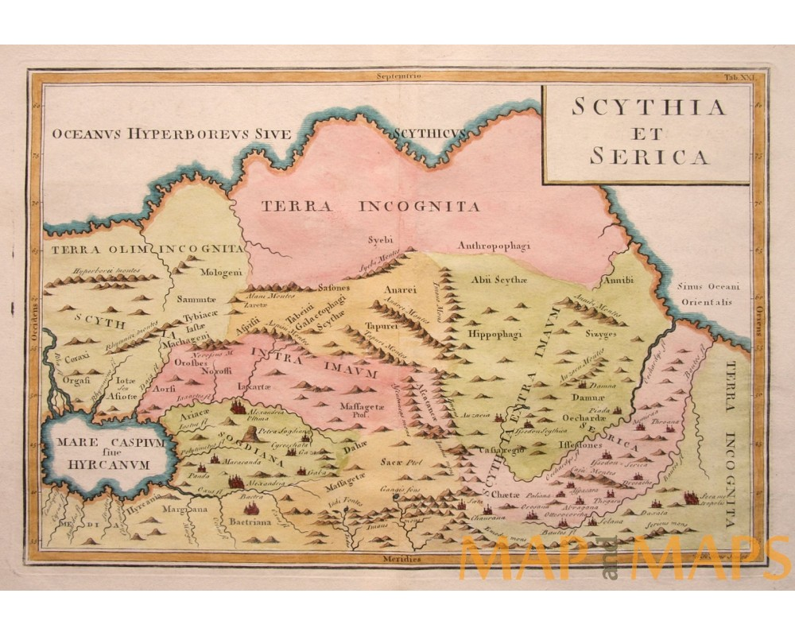
Influence on Russia
Russia emerged as a state in the 9th c.
Vikings organized Slavs into a kingdom centered in Kiev and Moscow
Traded with the Byzantine
Received Orthodox Christianity, the Cyrillic alphabet, and Byzantine crafts and products
Converted to Christianity

Slide 13
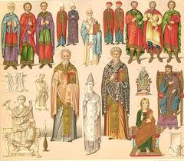
Byzantine Legacy
Preserved Ancient Cultures: Greek Philosophy, Roman engineering, copies of ancient texts
New form of Christianity: led by Patriarch and the emperor
Code of Justinian: put all Roman laws into one code
The Arts: mosaics, painted icons, gold, and silks, Hagia Sophia

Slide 14
Quick Quiz
1. What emperor moved the Capital of Rome to Constantinople?
A. Justinian
B. Constantine
C. Caesar
D Brutus

Slide 15
2. Which of the below is NOT a reason why the Byzantine Empire survived?
A. Strong Central Government
B. Location
C. Large Army
D. Use of the Latin Language

Slide 16
3. Which of the following is a characteristic of Catholicism and not Eastern Orthodox?
A. Priests can marry
B. The use of Icons
C. The Emperor does not have all the power
D. Patriarch

Slide 17
4. What was the most important lasting effect the Byzantine Empire?
A. Eastern Orthodox Religion
B. Trade
C. Arts
D. Code of Justinian

Slide 18
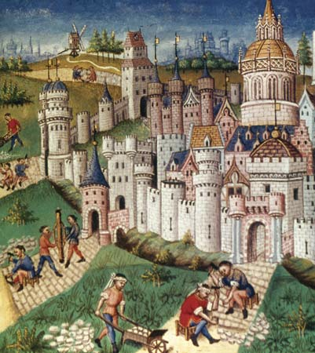
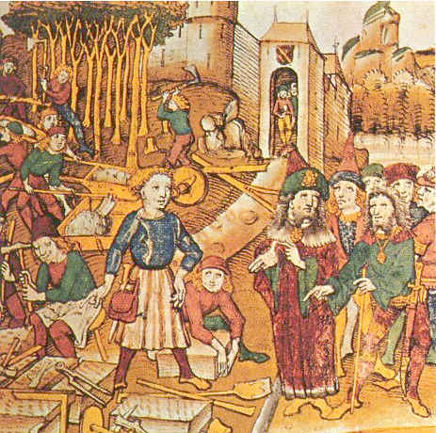
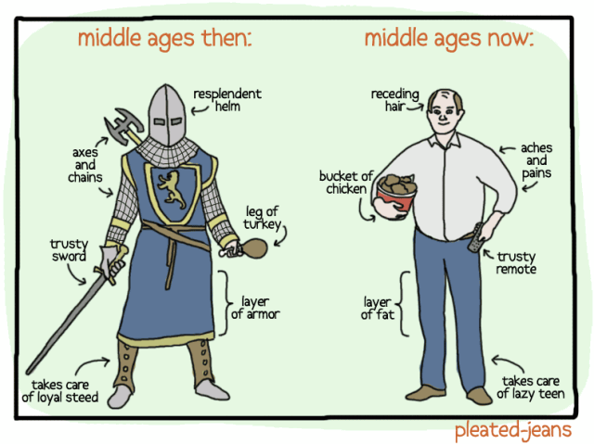
Western Europe in Turmoil
Fall of Rome in 476 AD to the 1400’s is call the “Middle Ages”

Slide 19
The Barbarian Invasions
Beyond Rome’s borders lived many Germanic tribes
The Romans considered them to be barbarians (non-Roman Culture)
In the 4th c. the Huns moved from Central Asia to Europe and forced the Germanic tribes into the Roman Empire
The Visigoths were allowed into Rome to escape the Huns
They turned on the Romans and sacked the city in 410 AD

Slide 20
The constant warfare disrupted trade
Travel became unsafe and bridges and roads fell apart
Cities were abandoned
Bandits roamed freely
Life became rural and unsafe
Wealthy families moved out of towns to the safety of fortified homes in the country
People became uninterested in learning
Churches and monasteries became the only place to learn to read and write

Slide 21
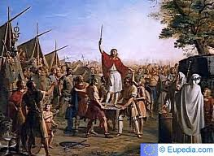
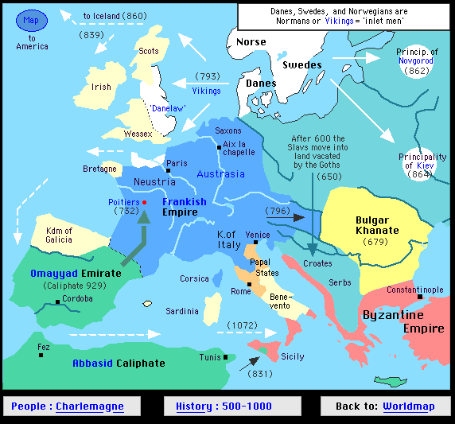
The Rise of the Franks
Franks established kingdom in what is now France
Charles Martel helped unite the Franks
In 732, at the Battle of Tours, Martel stopped the advance of Islam from Spain into France
His son Pepin became King and took control of Northern Italy
Created army by granting land in exchange for service in the army

Slide 22
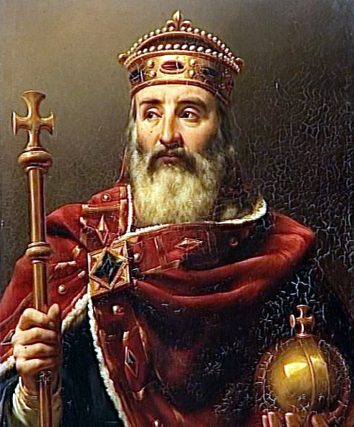
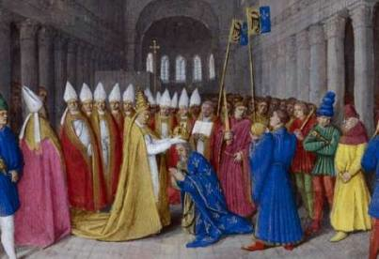
Charlemagne
Pepin’s son, became King in 768
Continued to give land in exchange for service
Peasants gave up their rights to lords in exchange for protection
Took over France, Germany, Holland, Belgium, and Northern Italy
Capital at Aachen
Was crowned “Emperor of the Holy Roman Empire” in 800
Unified Western Europe under Christendom

Slide 23
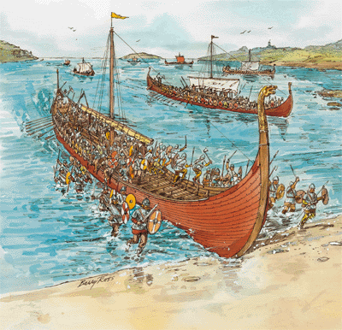
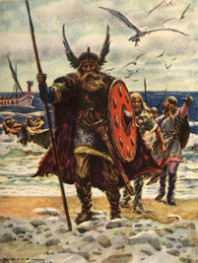
New Threats
East: Slavs and Magyars invaded the lands of Germany, France, and Italy
South: Muslims attack Italy
North: Vikings (warriors from Scandinavia)
Vikings attacked the coasts of Western Europe
Spread fear and destruction, new trade routes and settlements

Slide 24
Quick Quiz
5. The period known as the Middle Ages refers to the time frame of
A. 476 AD to the 1400’s
B. 300 AD to the 1400’s
C. 376 AD to the 1400’s
D. 576 AD to the 1400’s

Slide 25
6. Romans considered all non-Roman cultures to be
A. Outsiders
B. Barbarians
C. Outcasts
D. Germans

Slide 26
7. Which of the following did not happen when Rome fell apart?
A. The Church became the only place you could learn
B. Trade was stopped
C. Life became rural
D. Life became more safe

Slide 27
8. Who was the first person in Europe to come up with the idea of giving land in exchange for a service?
A. Charlemagne
B. Pepin
C. Charles Martel
D. King George

Slide 28
9. This group of warriors was from Scandinavia
A. Slavs
B. Germans
C. Vikings
D. Goths

Slide 29
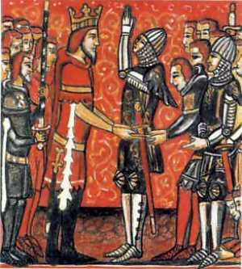
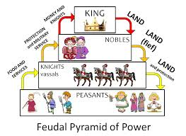
Feudal Society (800-1400)
Feudalism: Kings offered nobles a grant of land, known as a fief, in exchange for loyalty and service. The noble gave allegiance to the Kings
Done to protect themselves from violence and to provide for basic economic needs
Helped to survive the breakdown of central government and order
Characterized by key relationships…..

Slide 30
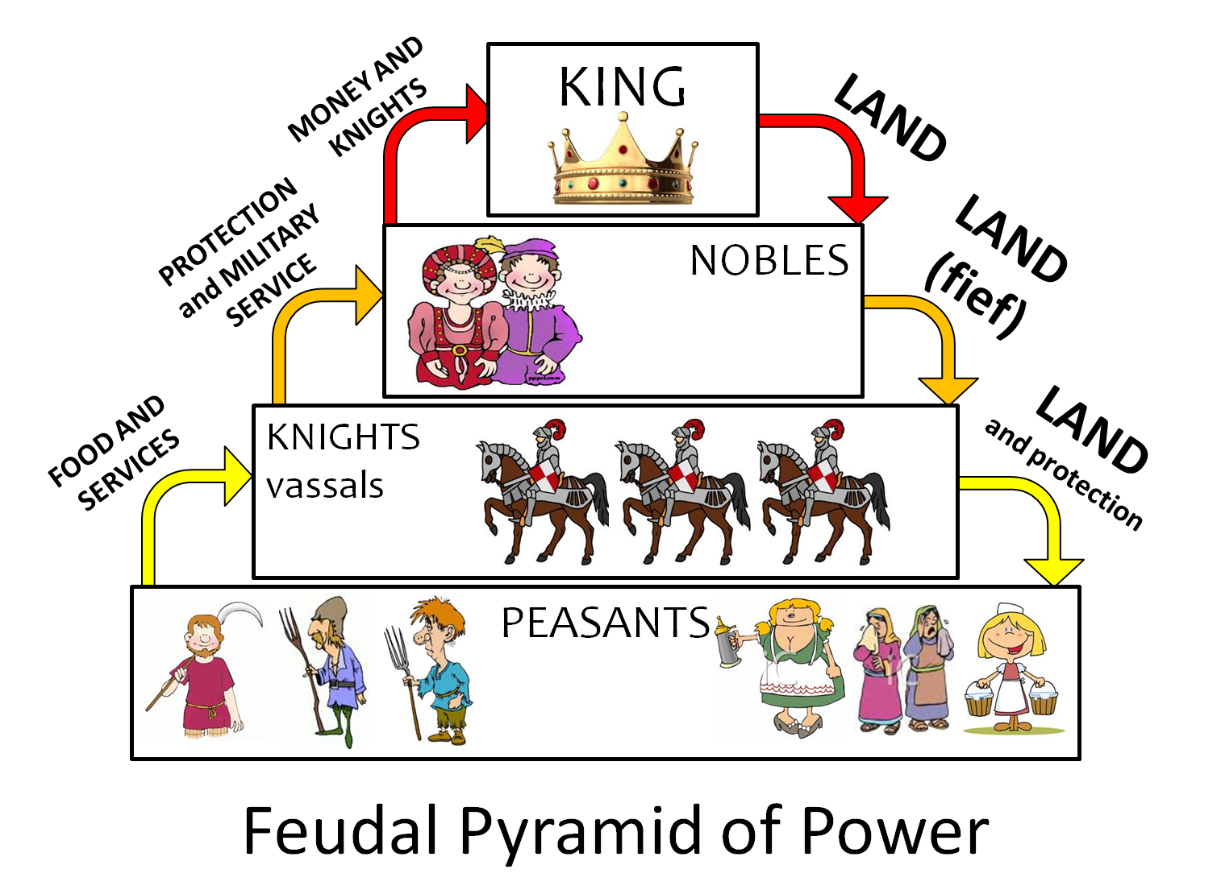
Social
Class structure based on the control of land and military power
Lords: land in exchange for service
Knights: armed warriors on horseback (Chivalry)

Slide 31
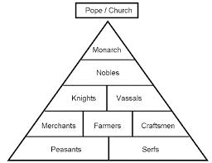

Slide 32
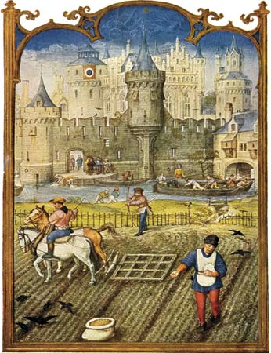
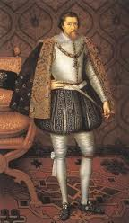
Political
Nobles in control
Had large castles
Surrounded themselves with knights
King relied on nobles for his army
Nobles often fought and challenged the King
Frequent civil wars

Slide 33
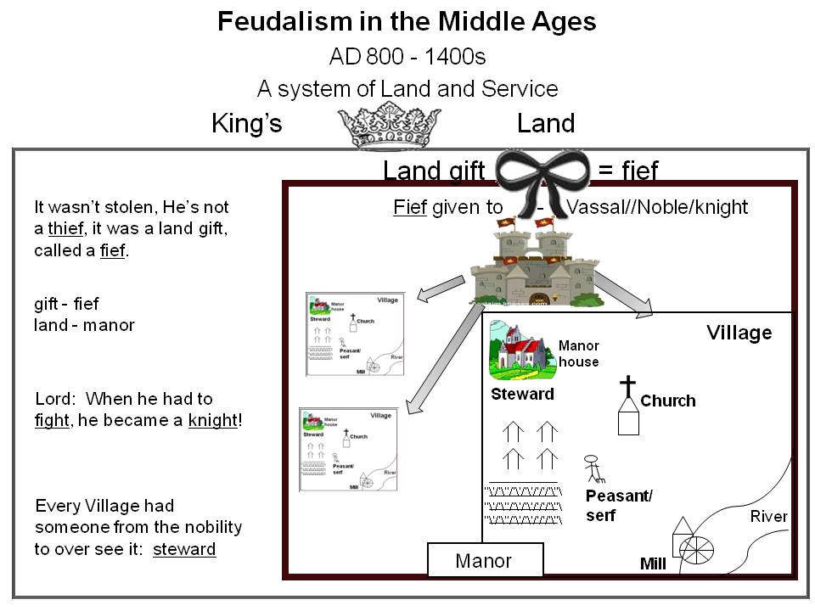
Economic
During feudalism, most people lived on manors
Manor: consists of lord’s house and the peasants living in the area
Known as manorialism
Made own food, clothing
Varied in size
Every noble had at least one manor

Slide 34
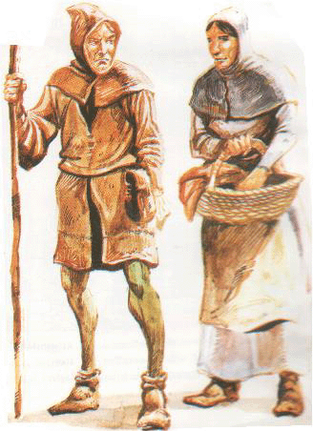
Serfs:
peasant farmers
Gave lord part of their harvest in return for the use of land and protection
Serfs were bound to the land and had no say

Slide 35
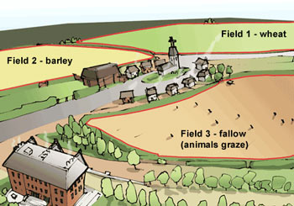
Farming
Three field system: only 2/3 of land was used while the other remained fallow (uncultivated)
Very affected by bad weather
Great Famine of 1315-1322, led to millions of deaths

Slide 36
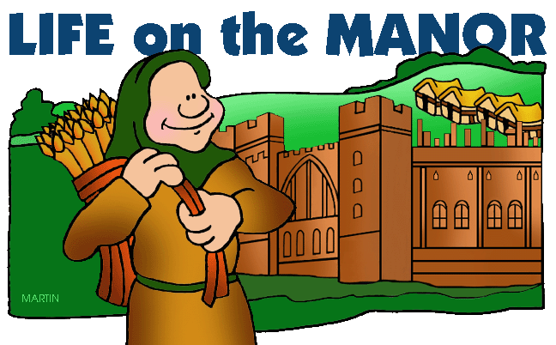
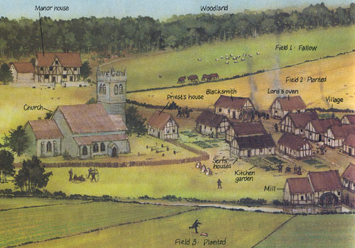
Peasant Life
Produced the food
Some were millers, blacksmiths, and tavern owners
Spent most of time working the land
Lived in small towns or nearby farms on the manor
2 room cottage with walls of dried mud, plastered branches, and straw, thatch roof, earth floors, straw for bed, pigs and other animals lived in the house

Slide 37
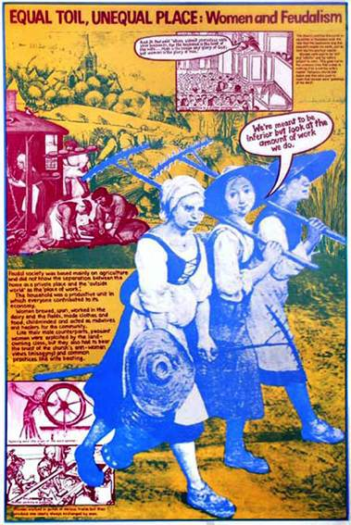
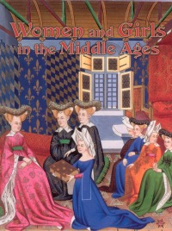
Families
Role was determined by the Church and the nobility
Obedient to men
Inferior status blamed on Eve in the bible
Extended families: all the family lived together
Had large number of children, but most died
Noble women: prayed and sewed, most not given education
Poor women: very close to husband, worked side by side, ran home

Slide 38
Quick Quiz
10. The exchange of land in return for services is known as
A. Manorialism
B. Feudalism
C. Patriarchy
D. A Favor

Slide 39
11. A grant of land is also known as a
A. Feud
B. Home
C. Castle
D. Fief

Slide 40
12. All of the following groups are located in between the Vassals and Serfs except for…
A. Merchants
B. Farmers
C. Craftsmen
D. Blacksmith

Slide 41
The king had to rely on his nobles for support because he
A. did not have his own army
B. was in constant danger of assassination
C. Was at war with the Persians
D. all of the above

Slide 42
This economic system revolves around the manor.
A. Feudalism
B. 3 Field System
C. Manorialism
D. Socialism

Slide 43
Families during the Middle Ages
A. Lived together
B. Lived far apart from each other
C. Never visited each other
D. Were not allowed to be on the same Manor

Slide 44
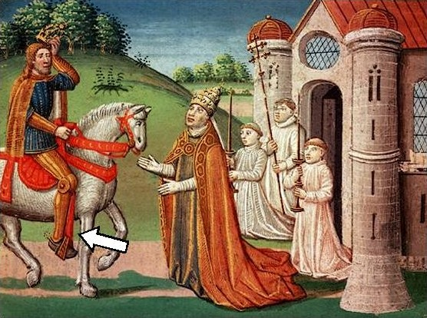
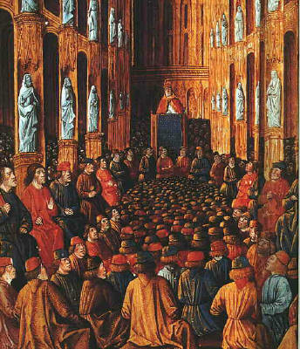
Age of Faith
Roman Catholic Church was the most powerful organization in Western Europe
Reasons:
Role of Faith: people were very religious
Power and Wealth: nobles left land to the church to get into Heaven, church was the largest landowner, tithes (church taxes)
Center of learning: main center of learning, church officials were usually the only one who could read and write

Slide 45
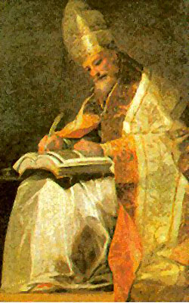
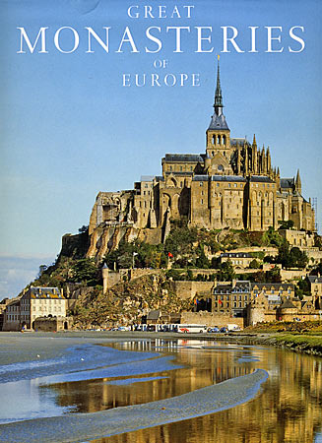
Head of the Catholic Church was the Pope in Rome
Pope governed the Church with the help of cardinals and bishops
Church controlled the most land in Europe
Had monasteries, abbeys, and convents where monks and nuns pent their lives devoted to prayer
Gave people a sense of order and unity

Slide 46
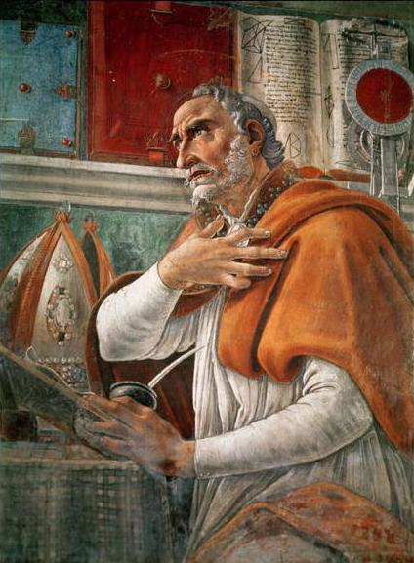
Christian Thinkers
Saint Augustine
Asked why God let the barbarians destroy Rome
Said on the “City of God” can last forever
Because our understanding is limited, we must put our faith in God

Slide 47
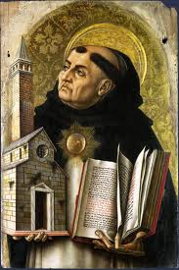
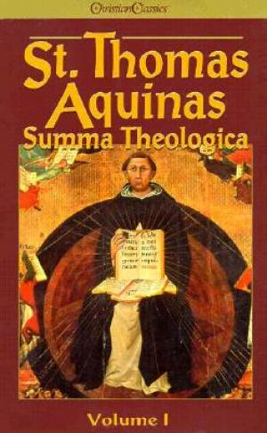
Saint Thomas Aquinas
Wrote “Summa Theologica”
God gave us reason, so we should trust in reason
Existence of “natural law” based on reason
If human law conflicts with natural law, we do not have to obey it
Ruler’s power came from God through the people

Slide 48
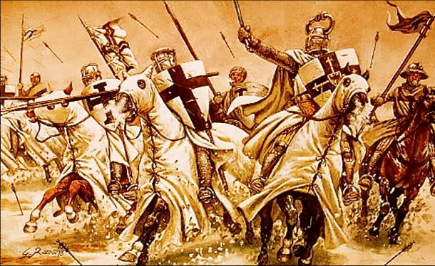
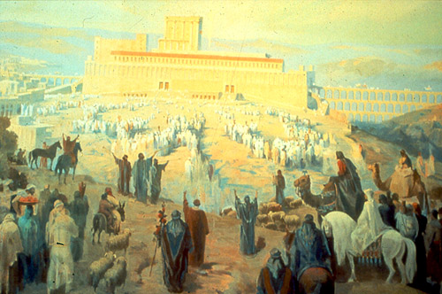
The Crusades
Holy war against the Muslims
Christian pilgrims had visited Jerusalem to see where the events of the Bible took place
In the 11th c. Seljuk Turks took control of the Holy Land and drove the pilgrims out

Slide 49
Call to free the Holy Land
In 1095, Pope Urban II received a plea from the Byzantine Emperor for help against the Muslims
Urban II called on all Christians in Europe to fight a holy Crusade
Crusade means war of the cross
fought under the banner of a red cross against a white background
Brought people from different parts of Europe together in a common cause

Slide 51
Many people died of disease and hunger along the way
Several Crusades were fought over the next two centuries
Never had more than a temporary control over Jerusalem
Effects
New ideas and products: zero I math, silk, rice, spices, coffee, cotton
Increased trade: European demanded these new products, so they established trade with the Middle East and farther
Growth of Intolerance: Christians persecuted the Jew and Muslims

Slide 53
The Later Middle Ages
During the later Middle Ages, Europe underwent gradual changes.
Trade slowly revived and cities grew along trade routes
Crusades increased interest in luxury goods from the East
New merchant class arose
Merchants and craftsmen joined guilds

Slide 54
Introduction of a new art style
Gothic style of art
Pointed arches, high spires, and beautiful stained glass windows

Slide 55
English Political Traditions
Developed traditions of liberty and limited self-government that were unique in Europe
Magna Carta: in 1215, the English nobles rebelled against the taxes and forced loans being collected King John
Forced John to sign and agreement promising not to take away any free man’s property or to imprison any free man without following procedures established by the law of the land
Magna Carta guaranteed all free men the right to a trial by jury, and further forced the king to obtain the consent of a council of nobles for most new taxes
Limited the power of the king

Slide 56
Parliament: later English kings summoned nobles and representatives of the town to grant them new taxes
This led to the origins of Parliament

Slide 57
Analyzing Documents
1. Title of Document
2. Date
3. Position
4. For what audience?
5. Information
A. Why was it written?
B. What evidence makes you think that?
C. List three things that you think are important?
D. List two other things that were also going on at this time

Slide 58
Arab Historian Ibn Al-Athir recounts the Siege of Jerusalem by the Crusaders during the First Crusade in 1099.
“The population was put to the sword by the Franks, who pillaged (raided) the area for a week... In Masjid al- Aqsa [mosque next to the Dome of the Rock on the Temple Mount] the Franks slaughtered more than 70,000 people, among them a large number of Imams and Muslim scholars... The Franks stripped the Dome of the Rock of more than forty silver candelabra... and a great silver lamp weighing forty-four Syrian pounds, as well as a hundred and fifty smaller silver candelabra and more than twenty gold ones, and a great deal more booty.”

Slide 59
"I, or rather the Lord, beseech (beg) you as Christ's heralds (followers) to publish this everywhere and to persuade (convince) all people of whatever rank, foot-soldiers and knights, poor and rich, to carry aid promptly (quickly) to those Christians and to destroy that vile (disgusting) race from the lands of our friends.”
-Pope Urban II.

Slide 60
What was the goal of the Crusades?
Get the Christians out of the Holy land
Spread Christianity to China
Recover the Holy land from Muslims
Spread Christianity to the Byzantine Empire

Slide 61
Who was the head of the Roman Catholic Church?
Emperor
Pope
Patriarch
Thomas Aquinas

Slide 62
18. What did the Church do for people after Rome fell apart?
Gave people a sense of order and unity
Replaced the King as the leader of Western Europe
Encouraged them to question authority
Limited the spiritual activities they could do

Slide 63
What of the following was a impact of the Crusades?
They strengthened the power of the serfs
They increased trade between Europe and Asia
They brought European influence to Africa
The promoted religious freedom

Slide 64
What did the Magna Carta do?
Take away some of the King’s power
Encourage the country to keep the King in charge
Took away the right to a trial by jury

Slide 65
Review
Most powerful institution in the Middle Ages?
What happened when Rome fell apart?
Where was the only place you could learn in the Middle Ages
What religion did the Byzantine Empire have?
What made Constantinople a good place to have a city?
What are two outcomes of the Crusades?
What did the caste system and the feudal system in Europe have in common?
What did the Church do for people after Rome fell apart?
What institution unified Western Europe?
What is feudalism?
Who established Constantinople as a city?
What was the goal of the Crusades?
Why did Rome fall apart?
Vocab
Constantinople
Eastern Orthodoxy
Middle Ages
Pope
Byzantine Empire
Roman Catholicism
Manor
Serfs
Crusades
Magna Carta

